Slide 1
What Are the Clinical Features of HER2 Amplified Colorectal Cancers?
Andrea Cercek, MD
Section Head, Colorectal Cancer
Co-Director, Center for Young Onset Colorectal and Gastrointestinal Cancers
Memorial Sloan Kettering Cancer Center
New York, NY

Slide 2
Disclaimer
The views and opinions expressed in this educational activity are those of the faculty and do not necessarily represent the views of TotalCME, Inc., the CME providers, or the companies providing educational grants. This presentation is not intended to define an exclusive course of patient management; the participant should use their clinical judgment, knowledge, experience, and diagnostic skills in applying or adopting for professional use any of the information provided herein. Any procedures, medications, or other courses of diagnosis or treatment discussed or suggested in this activity should not be used by clinicians without evaluation of their patient's conditions and possible contraindications or dangers in use, review of any applicable manufacturer’s product information, and comparison with recommendations of other authorities. Links to other sites may be provided as additional sources of information.

Slide 3
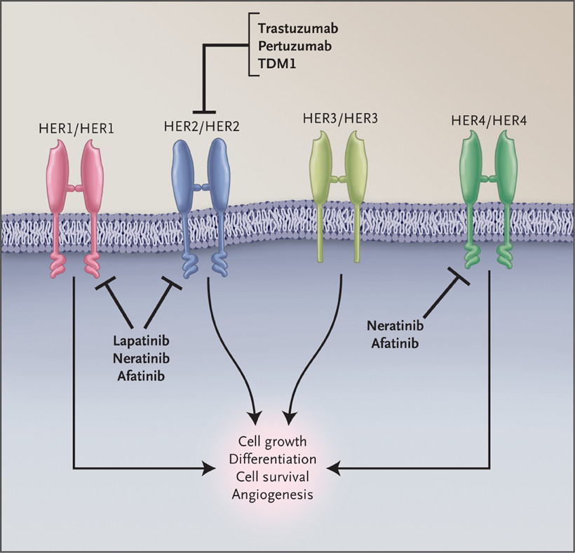
HER2 as a Target
HER2 is a RTK encoded by ERBB2
HER2 has no soluble ligand
HER2 heterodimerizes with other ligand-bound HER family members
HER2-HER3 heterodimer is a potent driver of PI3K signaling
Multiple therapies target HER2 and/or HER2 heterodimers

Slide 4
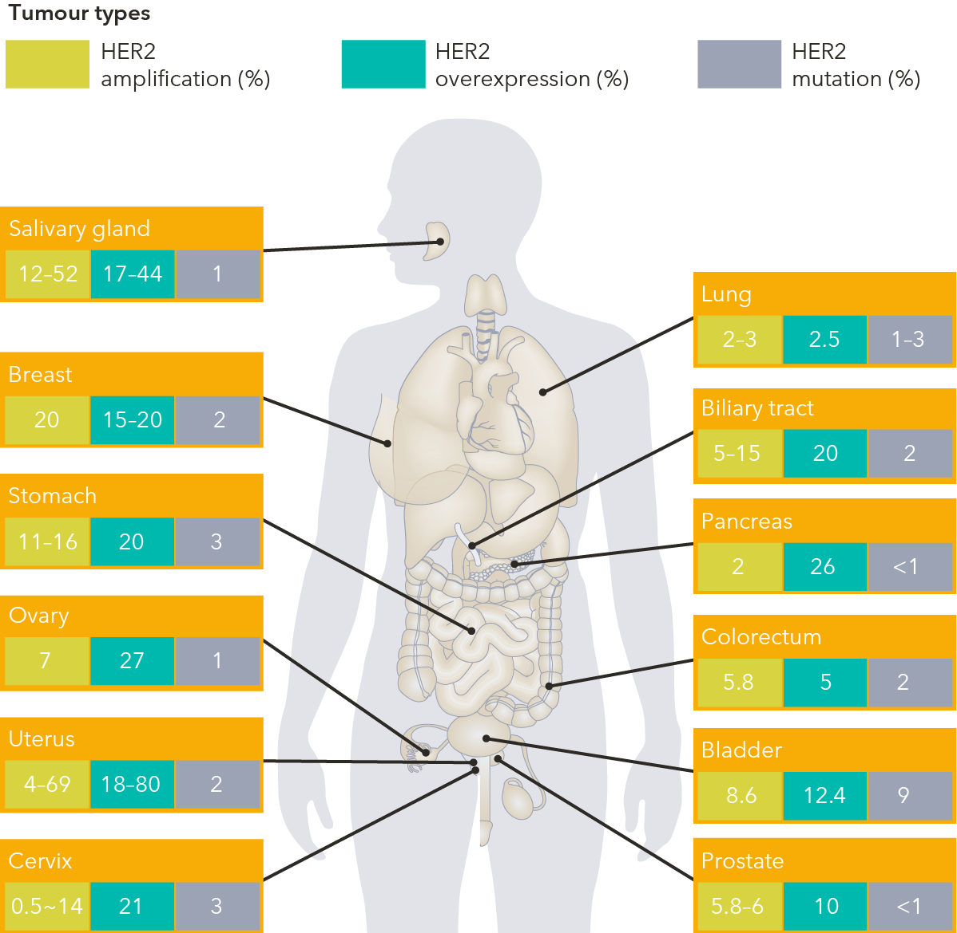
HER2 Alterations in Solid Tumors
HER2 alterations are found in a large variety of solid tumors, including
Breast cancer
Gastric cancer
Gynecologic cancer
Colorectal cancer
Tumor types
Salivary gland
12-52 | 17-44 | 1
Salivary gland
Lung
2-3 | 2.5 | 1-3
Lung
Breast
20 | 15-20 | 2
Breast
Biliary tract
5-15 | 20 | 2
Biliary tract
Stomach
11-16 | 20 | 3
Gastric
Stomach
Pancreas
2 | 26 | <1
Pancreas
Ovary
7 | 27 | 1
HER2-driven tumorigenesis can be a result of
HER2 gene amplification
Overexpression
Activating HER2 mutations
Ovary
Colorectum
5.8 | 5 | 2
Colorectum
Uterus
4-69 | 18-80 | 2
Uterus
Bladder
8.6 | 12.4 | 9
Bladder
Cervix
0.5-14 | 21 | 3
Prostate
5.8-6 | 10 | <1
Cervix
Prostate
Frequency of HER2 alterations across tumour types

Slide 5
HER2 Amplification in Colorectal Cancer
HER2 amplification (HER2+)
~ 4% of all mCRC patients
Enriched in mCRC patients with RAS/RAF wild-type tumors

Slide 6
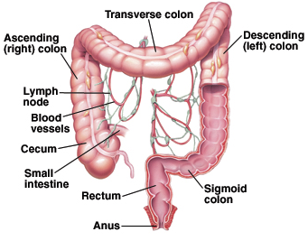
HER2 in Metastatic CRC
Usually left-sided
Homogeneous HER2 expression
Not mutually exclusive with RAS or BRAF mutations
Associated with lung and brain metastases
Resistant to EGFR antibodies(?)

Slide 7
HER2 in Metastatic CRC
Usually left-sided
Homogeneous HER2 expression
Not mutually exclusive with RAS or BRAF mutations
Associated with lung and brain metastases
Resistant to EGFR antibodies(?)

Slide 8
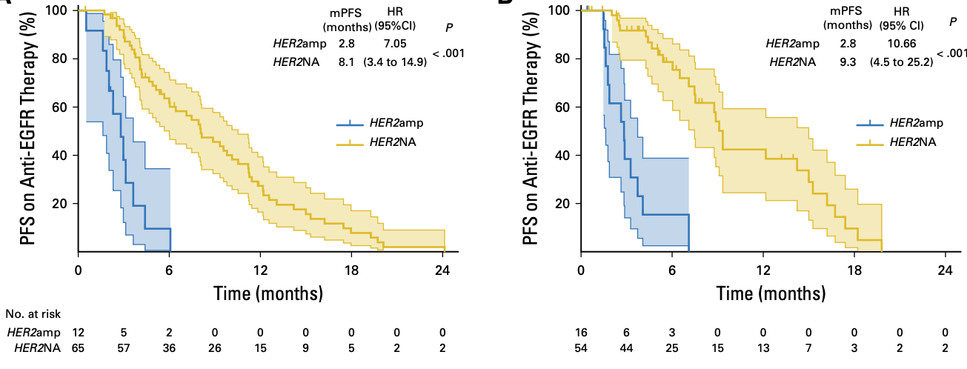
HER2 Amplification Is Associated with Resistance to Anti-EGFR Therapy
HER2+ associated with significantly shorter progression-free survival (PFS)

Slide 9
Clinical Characteristics of HER2+ Tumors in mCRC
OR predictor | Categories | Statistics [HER2+] / [HER2-] | Odds ratio | OR (95%CI) | P-value
Sex | Male : Female | [75:25] / [79:37] |  | 1.41 [0.77-2.55] | .265
Age at diagnosis* |  | [95(58.9)] / [116(58.4)] |  | 1.07 [0.87-1.32] | .531
Primary tumor site | Right : Left | [10:85] / [22:93] |  | 0.50 [0.22-1.11] | .088
Stage at initial diagnosis | M1 : M0 | [60:36] / [69:47] |  | 1.14 [0.65-1.98] | .654
Tumor grading | G2 : G1 G3 : G1 | [52:2] / [22:2] [25:2] / [22:2] |  | 0.96 [0.13-7.09] 1.14 [0.15-8.76] | .895
No. of metastatic sites |  | [96(2.0)] / [116(1.0)] |  | 1.48 [1.10-2.01] | .011
Liver metastases | Yes : No | [72:24] / [78:38] |  | 1.46 [0.80-2.67] | .217
Lung metastases | Yes : No | [43:53] / [33:83] |  | 2.04 [1.15-3.61] | .014
Lymph node metastases | Yes : No | [31:65] / [36:80] |  | 1.06 [0.59-1.90] | .845
Peritoneum metastases | Yes : No | [14:82] / [12:104] |  | 1.48 [0.65-3.37] | .351
Features of HER2-positive tumors versus HER2-negative controls:
More likely in the left colon (including rectum)
More likely to metastasize to the lungs
More likely to involve more metastatic sites
HER2+ less frequent
HER2+ more frequent
0
1
2
3
4

