Slide 1
Why Test for HER2 in Metastatic Colorectal Cancer: From Negative Predictive Biomarker to Emerging Oncotarget
John H. Strickler, MD
Associate Professor of Medicine
Duke Cancer Institute
Durham, NC

Slide 2
Disclaimer
The views and opinions expressed in this educational activity are those of the faculty and do not necessarily represent the views of TotalCME, Inc., the CME providers, or the companies providing educational grants. This presentation is not intended to define an exclusive course of patient management; the participant should use their clinical judgment, knowledge, experience, and diagnostic skills in applying or adopting for professional use any of the information provided herein. Any procedures, medications, or other courses of diagnosis or treatment discussed or suggested in this activity should not be used by clinicians without evaluation of their patient's conditions and possible contraindications or dangers in use, review of any applicable manufacturer’s product information, and comparison with recommendations of other authorities. Links to other sites may be provided as additional sources of information.

Slide 3
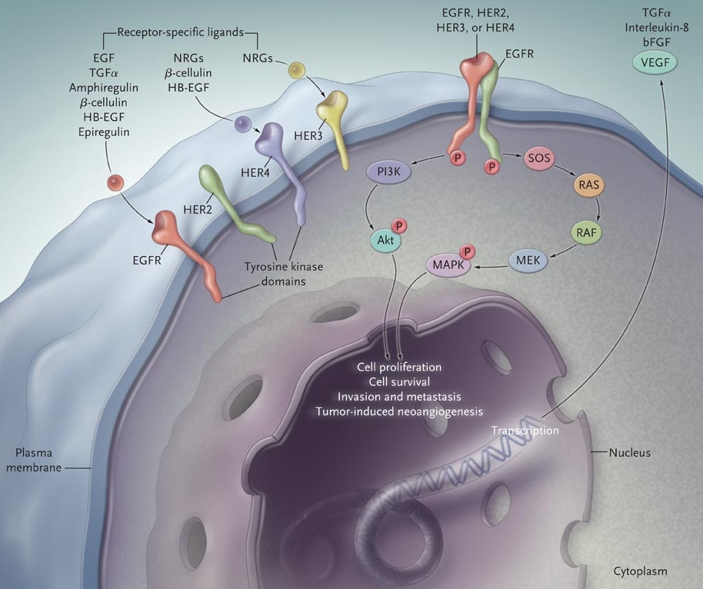
EGFR Is Critical to the Development and Growth of Colon Cancer
Adhesion
Angiogenesis
Cell proliferation
Cell survival
Invasion and metastasis

Slide 4
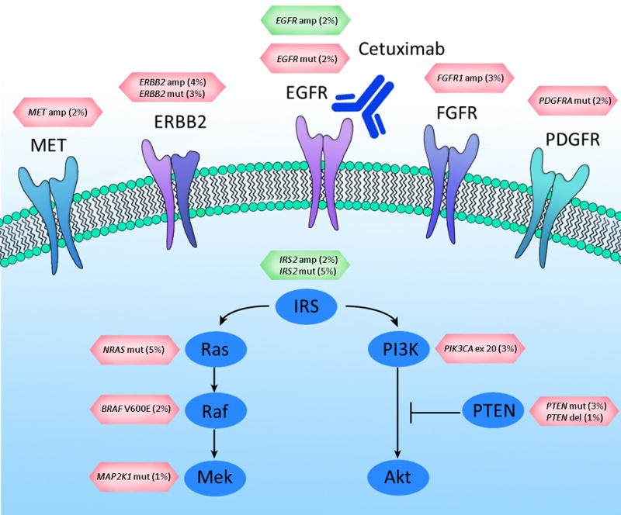
Mechanisms of Resistance to EGFR Inhibition
EGFR ECD mutations
RTK amplification
MAPK pathway alterations

Slide 5
Evolution of Mutational Landscape: Gene Amplifications

Slide 6
Prevalence of ERBB2 Amplification: Colorectal Cancer
Unselected
Dataset | Patients (n) | ERBB2 amplified
GENIE Cohort v12.1¹ | 137,166 | 2.3%
Foundation Medicine² | 5,127 | 3.0%
CARIS Life Sciences³ | 1,226 | 3.8%
TCGA⁴ | 615 | 3.1%

Slide 7
Prevalence of ERBB2 Amplification: Colorectal Cancer
Unselected
Biomarker enriched
Dataset | Patients (n) | ERBB2 amplified
GENIE Cohort v12.1¹ | 137,166 | 2.3%
Foundation Medicine² | 5,127 | 3.0%
CARIS Life Sciences³ | 1,226 | 3.8%
TCGA⁴ | 615 | 3.1%
Dataset | Patients (n) | ERBB2 amplified
HERACLES¹ | 914 KRAS exon 2 WT | 5.3%
MDACC² | 98 sequential KRAS/NRAS/BRAF WT | 13.3%
Duke University³ | 81 patients with RAS WT mCRC after anti-EGFR (ctDNA) | 12.3%
Sartore-Bianchi A, et al. Lancet Oncol. 2016;17(6):738-746.
Raghav K, et al. JCO Precis Oncol. 2019;3:1-13.
Jia J, et al. J Clin Oncol. 2018;36(suppl 15):3555.

Slide 8
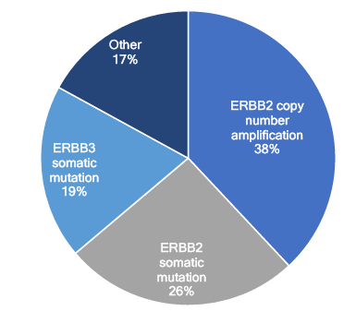
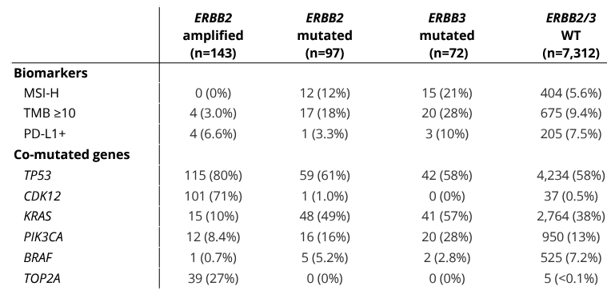
Type and Distribution of ERBB2/ERBB3 Genomic Alterations in CRC Tumors
Data from 7,688 patients with metastatic CRC (NGS with Tempus xT assay)
Prevalence
1.8%
1.3%
0.9%
95.1%

Slide 9
HER2/ERBB2 Testing
When?
  At time of diagnosis of metastatic disease
How?
  Tissue NGS, IHC/FISH, or ctDNA
What is the best way to detect ERBB2 amplification?
  All assays can identify patients appropriate for anti-HER2 therapy
  Choice of assay depends on reimbursement, available tissue, logistical considerations
Which IHC assay to use?
  Breast and gastric IHC criteria are concordant … either will work
  Standardized colon assay is available but is not clinically validated in the US
 | ERBB2 mutation | ERBB2 gene amp | HER2 over-expression
IHC |  |  | ●
FISH |  | ●
Tissue NGS | ● | ●
ctDNA (NGS) | ● | ●

Slide 10
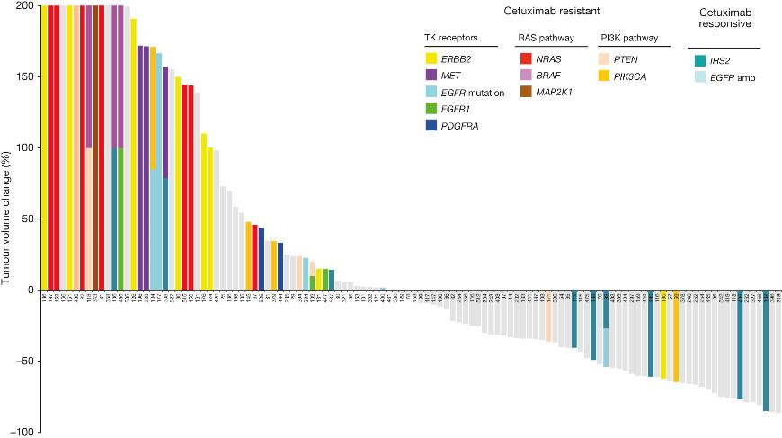
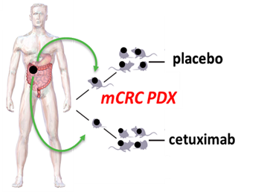

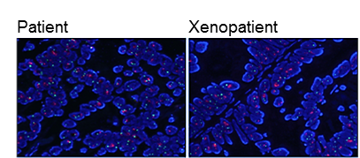

HER2 Amplification Drives EGFRi Resistance in mCRC PDXs

Slide 11
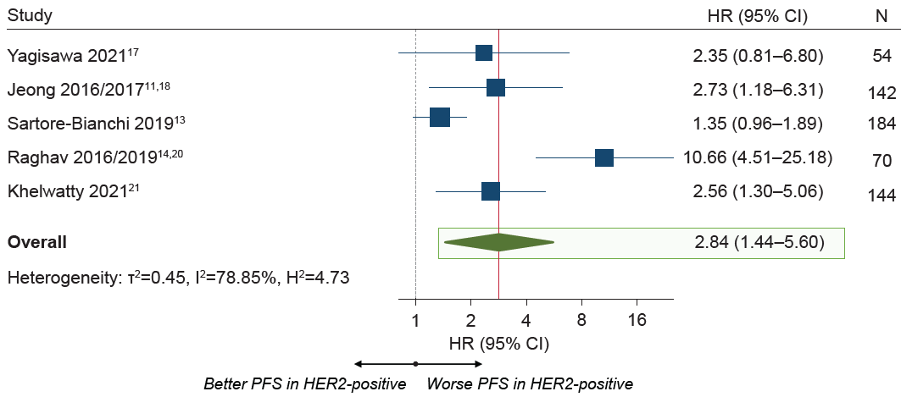
Meta-analysis of Anti-EGFR Treatment in RAS WT mCRC: PFS Worse for HER2+

Slide 12
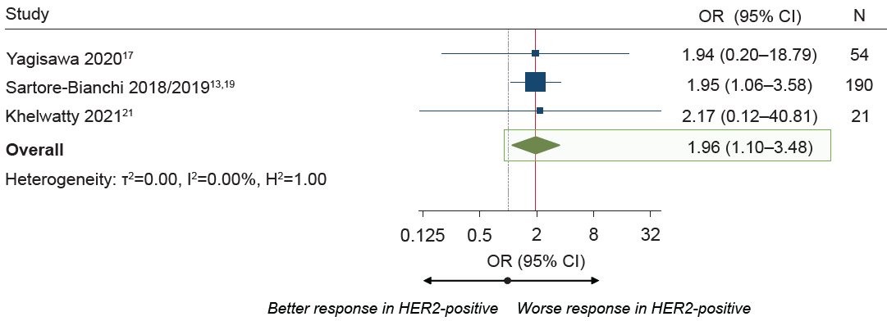
Meta-analysis of Anti-EGFR Treatment in RAS WT mCRC: ORR Lower for HER2+

