Slide 1
What Is the Evidence Supporting HER2-Targeted TKI-Based Combination Regimens in Metastatic Colorectal Cancer?
Andrea Cercek, MD
Section Head, Colorectal Cancer
Co-Director, Center for Young Onset Colorectal and Gastrointestinal Cancers
Memorial Sloan Kettering Cancer Center
New York, NY

Slide 2
Disclaimer
The views and opinions expressed in this educational activity are those of the faculty and do not necessarily represent the views of TotalCME, Inc., the CME providers, or the companies providing educational grants. This presentation is not intended to define an exclusive course of patient management; the participant should use their clinical judgment, knowledge, experience, and diagnostic skills in applying or adopting for professional use any of the information provided herein. Any procedures, medications, or other courses of diagnosis or treatment discussed or suggested in this activity should not be used by clinicians without evaluation of their patient's conditions and possible contraindications or dangers in use, review of any applicable manufacturer’s product information, and comparison with recommendations of other authorities. Links to other sites may be provided as additional sources of information.

Slide 3
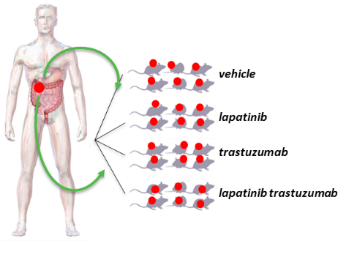
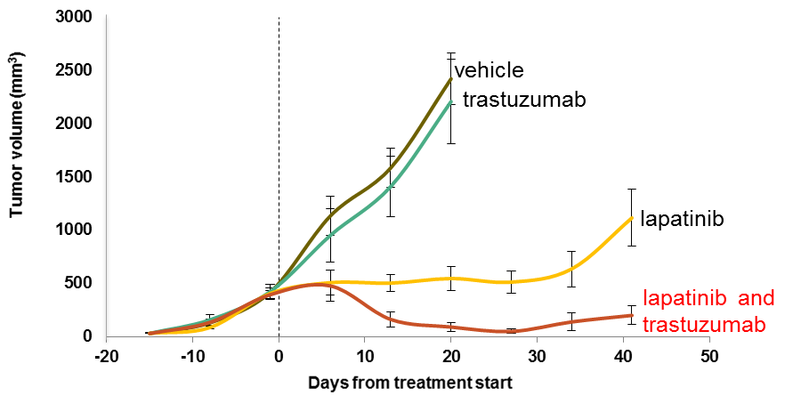
Anti-HER2 Preclinical Trials in HER2+ mCRC PDXs
HER2+ mCRC-PDXs are sensitive to dual HER2-blockade
with lapatinib + trastuzumab but not with either drug alone
mCRC PDX
CRC080
Image courtesy of S. Siena

Slide 4
HER2-Targeted Therapy in mCRC
HERACLES-A trial
Key eligibility criteria
≥2L+ mCRC
HER2+ according to HERACLES criteria
KRAS wild-type
Prior fluoropyrimidines, oxaliplatin, irinotecan, anti-EGFR mAb
Primary endpoint:
ORR (RECIST v1.1)
Secondary endpoints:
Progression-free survival and safety
Translational exploratory objectives:
Molecular determinants of response and resistance to study treatment
Lapatinib +
trastuzumab (n=32)
Progressive disease
Proof-of-concept, multicenter, open-label, phase 2 trial done with a stage 1 design
Lapatinib + trastuzumab combination based on preclinical findings in pertinent in vivo models
HER2 scoring based on a rigorous methodological effort for ad hoc molecular diagnosis (HERACLES criteria)

Slide 5
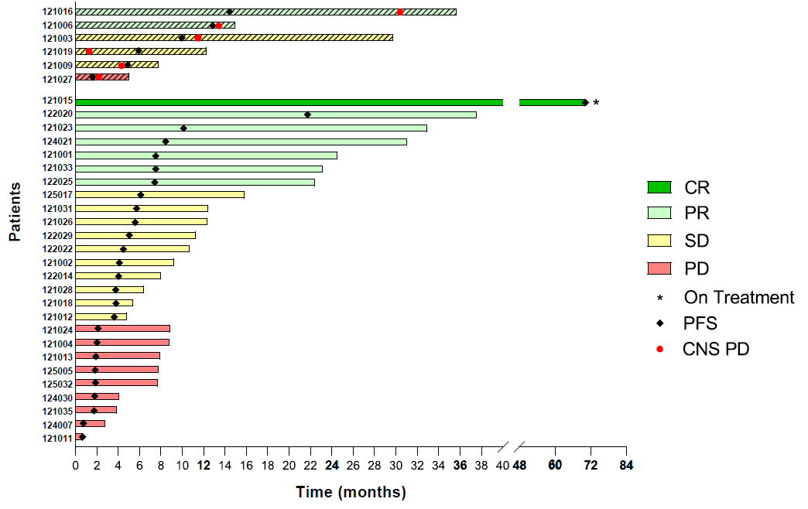
Long-term Clinical Outcome of HERACLES-A
(Trastuzumab + Lapatinib) for HER2-Positive mCRC
7 years of follow-up; 32 patients evaluable
28% ORR with 1 patient with 7-year CR
Median PFS=4.7 months
Median OS=10.0 months

Slide 6
MOUNTAINEER: Global, Open-Label, Phase 2 Trial
Key eligibility criteria
≥2L mCRC
HER2+ per local IHC/ISH/NGS testing
RAS wild-type
Measurable disease per RECIST 1.1
Prior fluoropyrimidines, oxaliplatin, irinotecan, and anti-VEGF mAb
Cohort A (n=45)
Tucatinib 300 mg PO BID
+
Trastuzumab 6 mg/kg Q3W (loading dose 8 mg/kg C1D1)^{a,b}
Cohort B (n=41)
Tucatinib 300 mg PO BID
+
Trastuzumab 6 mg/kg Q3W (loading dose 8 mg/kg C1D1)^{a,b}
Endpoints
Efficacy
Assessed in patients who received any amount of study treatment and had HER2+ tumors^{e}
Primary: Confirmed ORR in Cohorts A+B (RECIST 1.1 per BICR)
Secondary:
  Cohorts A+B: DOR per BICR, PFS per BICR, and OS
  Cohort C: ORR by 12 weeks of treatment (RECIST 1.1 per BICR)
Safety presented in Cohorts A+B who received any amount of study treatment
R^{c}
Expansion
Cohort C (n=31)
Tucatinib 300 mg
PO BID^{a,d}
MOUNTAINEER began as a US investigator-sponsored trial and initially consisted of a single cohort (Cohort A) and was expanded globally to include patients randomized to receive tucatinib + trastuzumab (Cohort B) or tucatinib monotherapy (Cohort C)

Slide 7
Key Baseline Patient Characteristics
Characteristics, n (%) |  | Tucatinib + trastuzumab | Tucatinib monotherapy
 |  | Cohorts A+B n=84ª | Cohort C n=30^{b}
Median age, years (range) |  | 55.0 (24, 77) | 59.5 (29, 75)
Sex | Male | 51 (60.7) | 15 (50.0)
 | Female | 33 (39.3) | 15 (50.0)
ECOG Performance Status | 0 | 50 (59.5) | 17 (56.7)
 | 1 | 31 (36.9) | 13 (43.3)
 | 2 | 3 (3.6) | 0
Primary tumor site | Left colon and rectum | 71 (84.5) | 27 (90.0)
 | All other primaries | 13 (15.5) | 3 (10.0)
 | Transverse colon | 7 (8.3) | 0
 | Right colon | 5 (6.0) | 3 (10.0)
 | Multiple/overlapping sites | 1 (1.2) | 0
Stage IV at initial diagnosis |  | 50 (59.5) | 19 (63.3)
Patients with liver metastases at study entry |  | 54 (64.3) | 15 (50.0)
Patients with lung metastases at study entry |  | 59 (70.2) | 20 (66.7)

Slide 8
Tucatinib + Trastuzumab: Efficacy Outcomes
Responses | Tucatinib + trastuzumab Cohorts A+B n=84
Best overall response per BICRª, n (%)
CR | 3 (3.6)
PR | 29 (34.5)
SD^{b} | 28 (33.3)
PD | 22 (26.2)
Not available^{c} | 2 (2.4)
cORR per BICR, % (95% CI)^{d} | 38.1 (27.7, 49.3)
cORR per investigator, % (95% CI)^{d} | 42.9 (32.1, 54.1)
Median time to objective response per BICR^{e}, months (range) | 2.1 (1.2, 9.8)
DCR^{f} per BICR, n (%) | 60 (71.4)
Median DOR per BICR, months (95% CI) | 12.4 (8.5, 20.5)

Slide 9
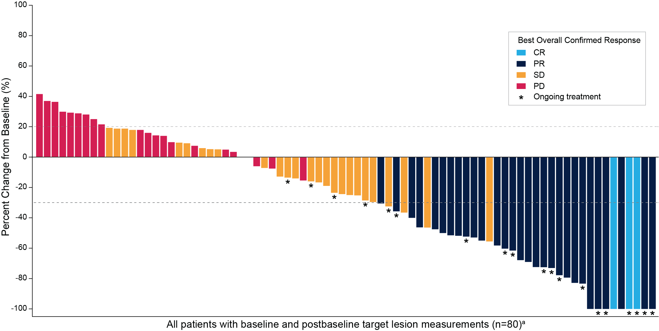
Tucatinib + Trastuzumab: Change in Tumor Size
Patients with reduction in tumor burden: n=52/80 (65.0%)

Slide 10
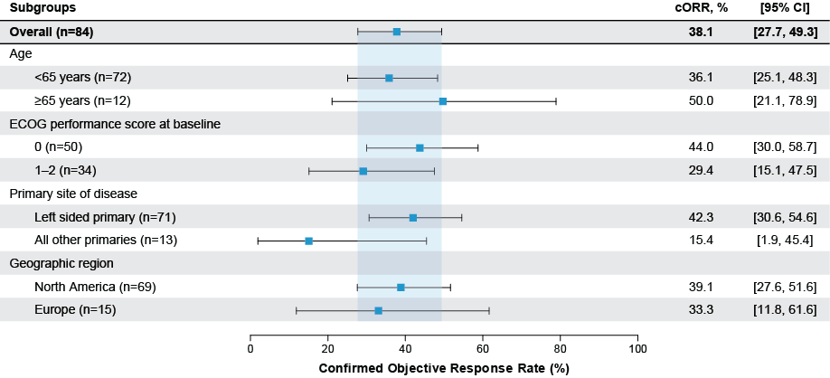
Tucatinib + Trastuzumab: cORR per BICR in Prespecified Subgroups

Slide 11
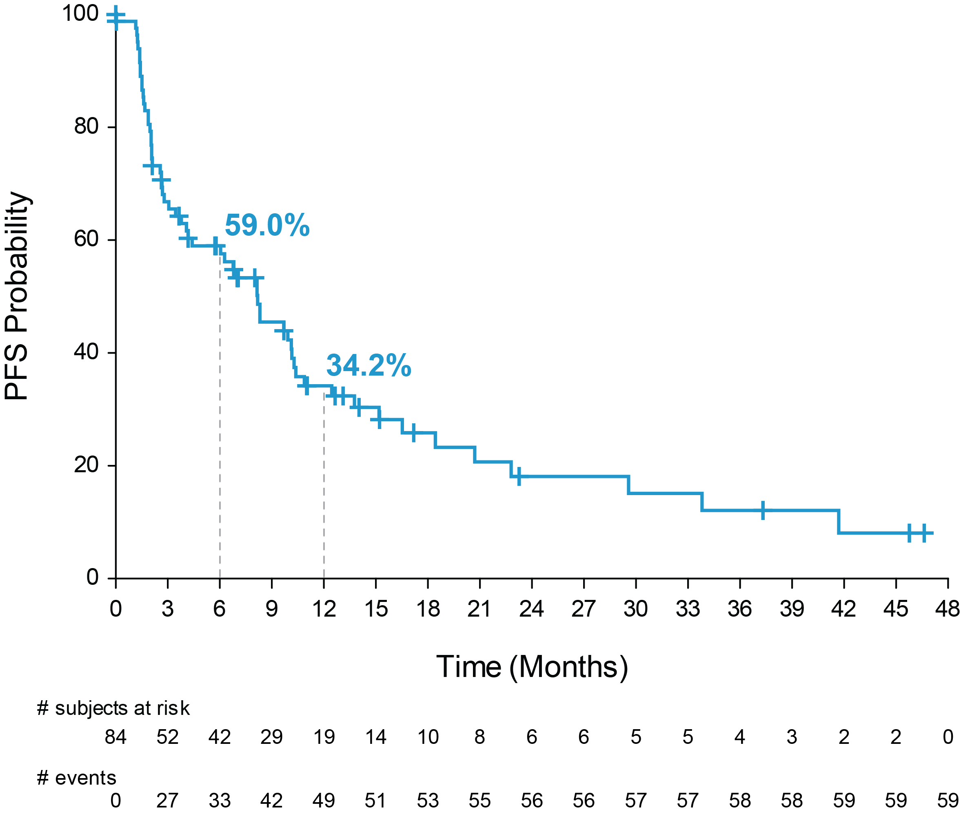
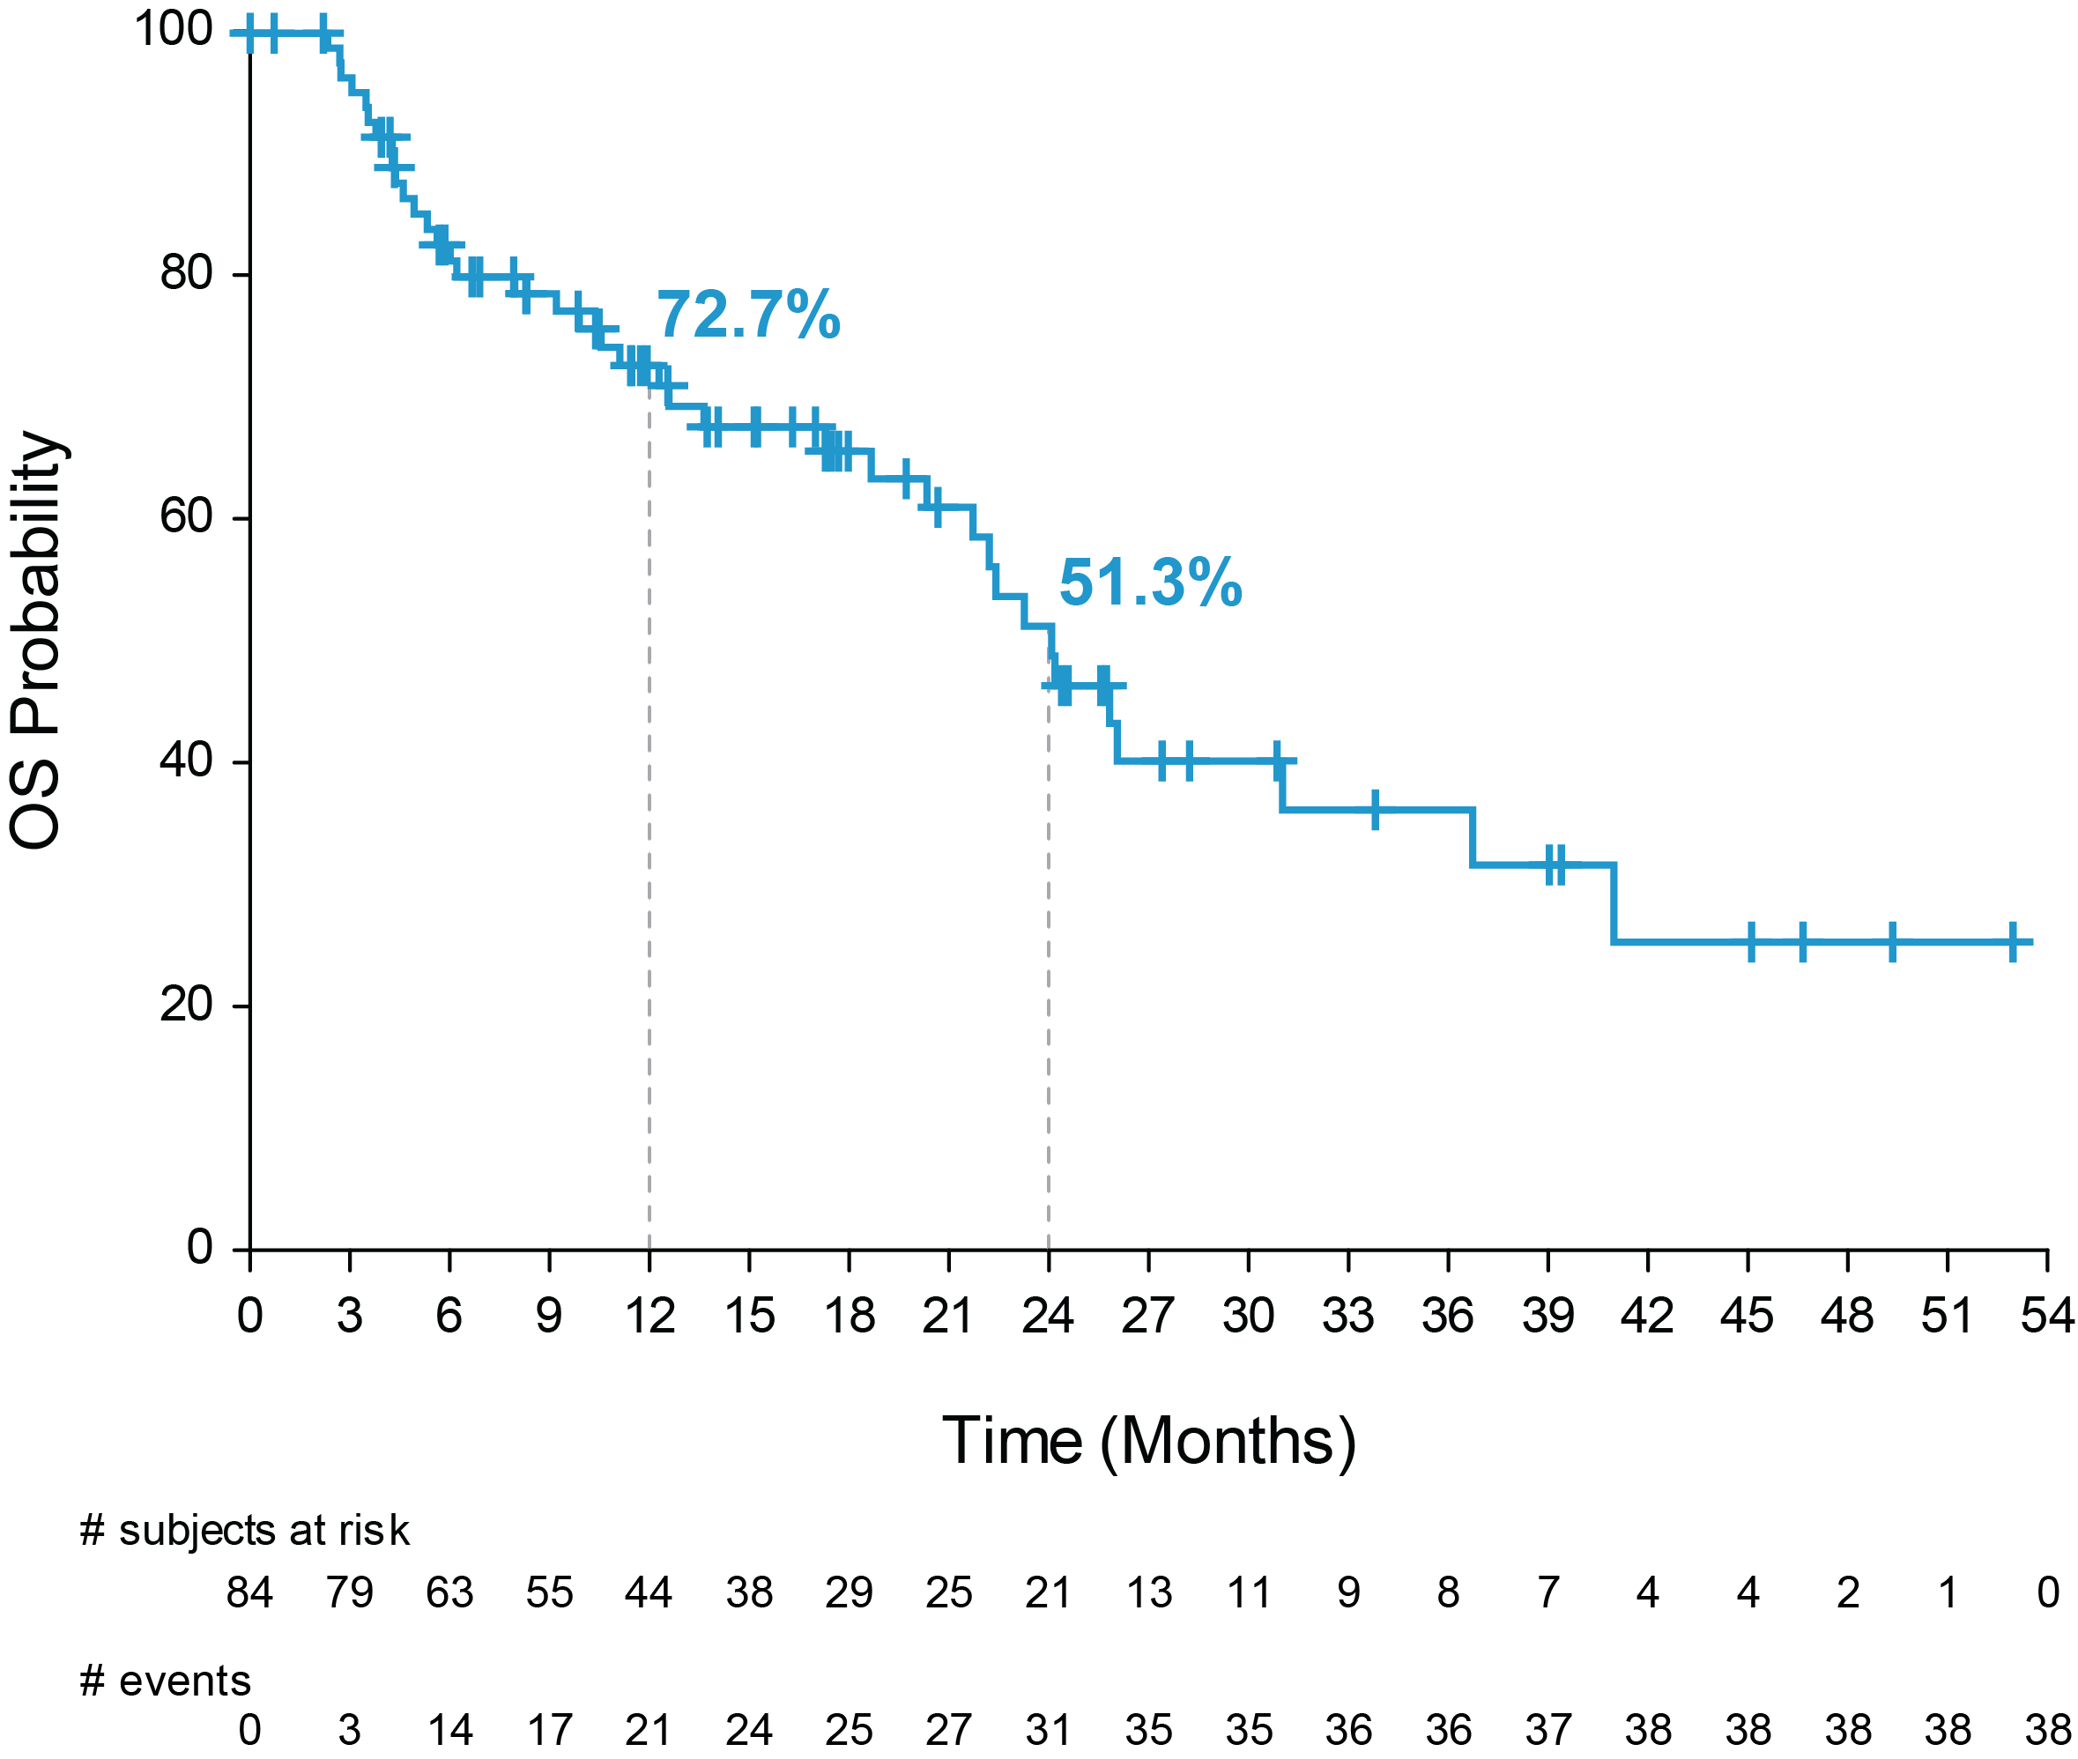
Tucatinib + Trastuzumab: PFS and OS
Progression-Free Survival per BICR
Overall Survival
Tucatinib + trastuzumab | Events | Median PFS | 95% CI
Cohorts A+B | 59/84 | 8.2 months | 4.2, 10.3
Tucatinib + trastuzumab | Events | Median OS | 95% CI
Cohorts A+B | 38/84 | 24.1 months | 20.3, 36.7
Median follow-up for Cohorts A+B was 20.7 months (IQR, 11.7, 39.0)
Data cutoff March 28, 2022.
IQR, interquartile range.
Strickler JH, et al. ESMO World GI 2022. Abstract LBA-2.

Slide 12
Results of Dual Anti-HER2 Clinical Trials in Patients with Treatment Refractory HER2+ Metastatic CRC
Clinical trial | Therapies | Patients (N) | Response rate | PFS (median)
HERACLES¹ | Lapatinib + trastuzumab | 32 | 28% | 4.7 months
MyPathway^{2,3} | Pertuzumab + trastuzumab | 68 (RAS WT) | 31% | 5.3 months*
MOUNTAINEER⁴ | Tucatinib + trastuzumab | 84 | 38% | 8.2 months
*Based on first 43 patients treated, not updated.

