Slide 1
Navigating New Waters in HER2+ mCRC: Selection of the Optimal Targeted Regimen, a Case-based Approach
John H. Strickler, MD
Associate Professor of Medicine
Duke University Medical Center
Durham, NC

Slide 2
Disclaimer
The views and opinions expressed in this educational activity are those of the faculty and do not necessarily represent the views of TotalCME, Inc., the CME providers, or the companies providing educational grants. This presentation is not intended to define an exclusive course of patient management; the participant should use their clinical judgment, knowledge, experience, and diagnostic skills in applying or adopting for professional use any of the information provided herein. Any procedures, medications, or other courses of diagnosis or treatment discussed or suggested in this activity should not be used by clinicians without evaluation of their patient's conditions and possible contraindications or dangers in use, review of any applicable manufacturer’s product information, and comparison with recommendations of other authorities. Links to other sites may be provided as additional sources of information.

Slide 3
Clinico-genomic Factors that Influence Anti-HER2 Treatment Choice
● Candidate treatment option
 | Lapatinib + trastuzumab | Pertuzumab + trastuzumab | Trastuzumab deruxtecan | Tucatinib + trastuzumab
HER2 IHC 3+ or 2+/FISH+ | ● | ● | ● | ●
RAS/ BRAF mutant detected in blood |  |  | ●
Pre-existing ILD | ● | ● |  | ●
Brain metastases | ● |  | ● | ●
High HER2 target specificity |  | ● | ● | ●
Prior anti-HER2 therapy |  |  | ●

Slide 4
Case 1: 58-Year-Old Man with Metastatic Rectal Cancer
Presented with lower gastrointestinal bleeding, fatigue, abdominal pain, and anemia
Rectal biopsy confirmed adenocarcinoma
CT scan demonstrated extensive hepatic metastases
Hotspot panel: KRAS/NRAS/BRAF WT; MSS
First line FOLFOX/bevacizumab
Oxaliplatin stopped after 4 months due to severe neuropathy
Treated with maintenance chemotherapy for 18 months → progressive disease
Second line FOLFIRI/panitumumab → progressive disease
Third line regorafenib-based clinical trial → progressive disease
Liquid biopsy obtained to examine mechanisms of resistance to anti-EGFR therapy

Slide 5
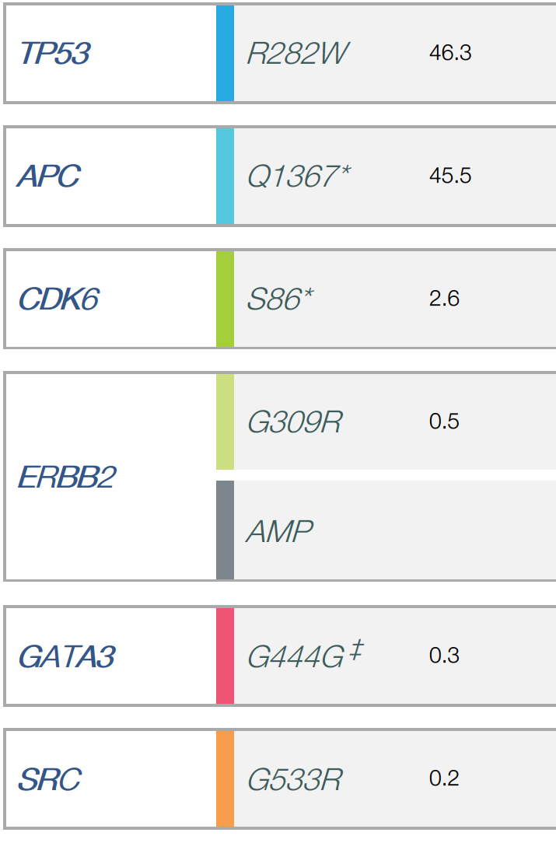
Case 1: 58-Year-Old Man with Metastatic Rectal Cancer
Blood Profiling
Tissue Profiling
Alteration
% cfDNA

Slide 6
Case 1: 58-Year-Old Man with Metastatic Rectal Cancer
Blood Profiling
Tissue Profiling
Alteration
% cfDNA
Tissue not Tested for HER2 Status
Ion Torrent panel does not include amplifications

Slide 7
Case 1: 58-Year-Old Man with Metastatic Rectal Cancer
Blood Profiling
Tissue Profiling
Alteration
% cfDNA
Tissue not Tested for HER2 Status
Ion Torrent panel does not include amplifications
ERBB2 activating mutation in extracellular domain
ERBB2 (HER2) copy number amplification

Slide 8
Case 1: 58-Year-Old Man with Metastatic Rectal Cancer
Blood Profiling
Tissue Profiling
Alteration
% cfDNA
Tissue not Tested for HER2 Status
Ion Torrent panel does not include amplifications
ERBB2 activating mutation in extracellular domain
ERBB2 (HER2) copy number amplification
Tissue Confirmation (FISH)
AMPLIFIED for the HER2/neu gene HER2/neu to centromere 17 ratio=10.59 +/-4.22 (mean +/-1 SD)

Slide 9
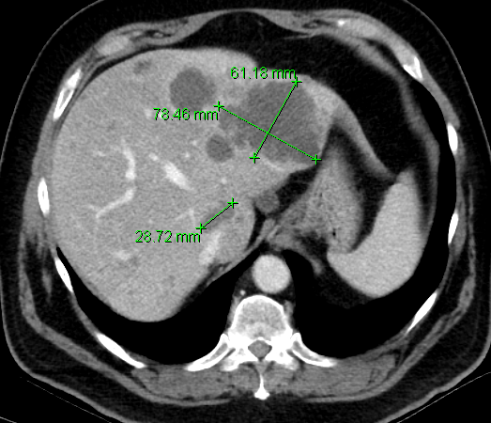
Case 1: Treatment with Lapatinib + Trastuzumab
Baseline
After 6 cycles lapatinib + trastuzumab

Slide 10
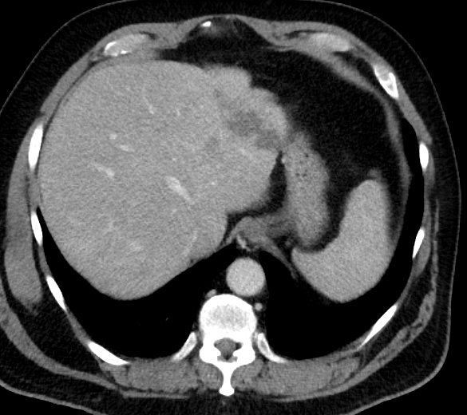
Case 1: Treatment with Lapatinib + Trastuzumab
Treatment-related side effects: Rash, diarrhea
Baseline
After 6 cycles lapatinib + trastuzumab

Slide 11
Case 2: 49-Year-Old Man with Metastatic Colon Cancer
Presented to ER with large bowel obstruction
CT c/a/p: Extensive hepatic metastases and abdominal lymphadenopathy
Colonoscopy: Partially obstructing mass found in the sigmoid colon
Due to poor performance status, patient declined palliative chemotherapy
Molecular testing ordered

Slide 12
Case 2: 49-Year-Old Man with Metastatic Colon Cancer
Presented to ER with large bowel obstruction
CT c/a/p: Extensive hepatic metastases and abdominal lymphadenopathy
Colonoscopy: Partially obstructing mass found in the sigmoid colon
Due to poor performance status, patient declined palliative chemotherapy
Molecular testing ordered
Commercial Tissue NGS Testing
Gene | Variant
APC | V1320fs*11
CDK12 | Inversion exons 3-4
TP53 | C238S
ERBB2 | Amplified
MSS
TMB = 1 Muts/MB

Slide 13
Case 2: 49-Year-Old Man with Metastatic Colon Cancer
Pertuzumab
Trastuzumab
Tucatinib
Patient declined chemotherapy
Diagnosed with metastatic colon cancer
Progression: New brain metastases
Resection + RT of brain metastases

Slide 14
Case 2: 49-Year-Old Man with Metastatic Colon Cancer
Pertuzumab
Trastuzumab
Tucatinib
Patient declined chemotherapy
Tissue NGS: ERBB2 amp
Diagnosed with metastatic colon cancer
Progression: New brain metastases
Resection + RT of brain metastases

Slide 15
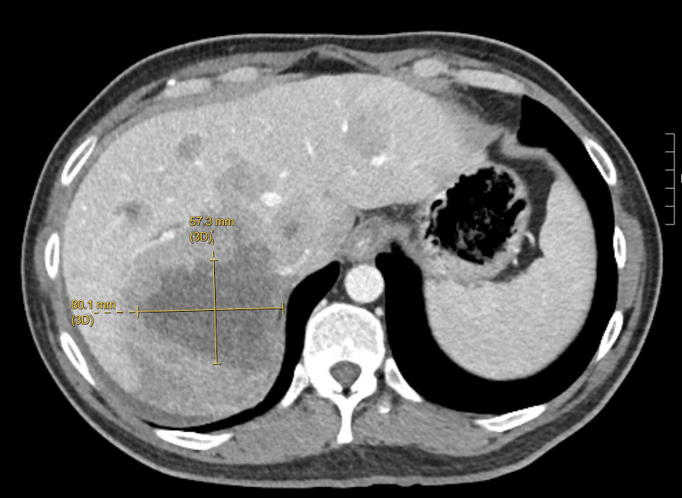
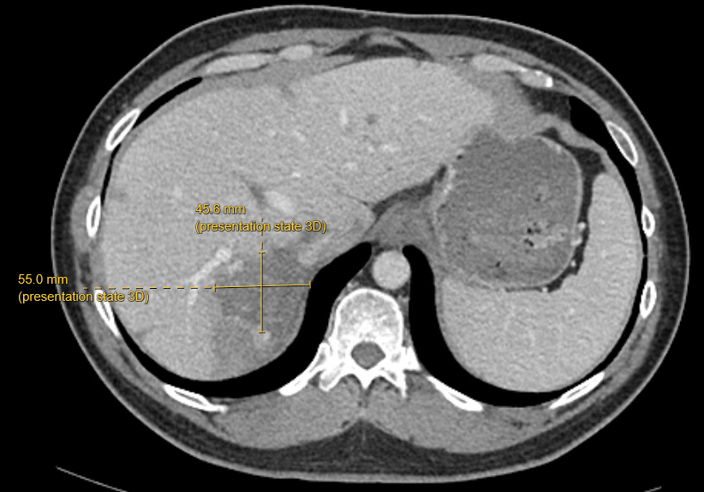
Case 2: 49-Year-Old Man with Metastatic Colon Cancer
Treatment-related side effects: Diarrhea
Baseline
CEA=1,724
After 3 months tucatinib + trastuzumab
CEA=25

