Slide 1
HER2-Directed TKI Combinations in mCRC: Improving Adherence Through Proactive ADR Monitoring and Management
John H. Strickler, MD
Associate Professor of Medicine
Duke University Medical Center
Durham, NC

Slide 2
Disclaimer
The views and opinions expressed in this educational activity are those of the faculty and do not necessarily represent the views of TotalCME, Inc., the CME providers, or the companies providing educational grants. This presentation is not intended to define an exclusive course of patient management; the participant should use their clinical judgment, knowledge, experience, and diagnostic skills in applying or adopting for professional use any of the information provided herein. Any procedures, medications, or other courses of diagnosis or treatment discussed or suggested in this activity should not be used by clinicians without evaluation of their patient's conditions and possible contraindications or dangers in use, review of any applicable manufacturer’s product information, and comparison with recommendations of other authorities. Links to other sites may be provided as additional sources of information.

Slide 3
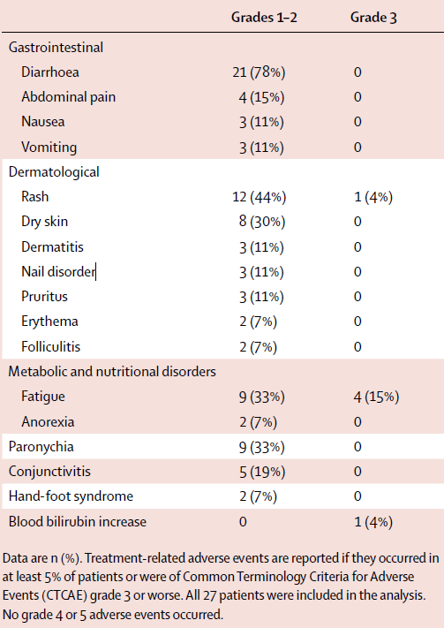
Lapatinib + Trastuzumab: Safety Summary
Most common AEs: Diarrhea, rash, fatigue, paronychia, and conjunctivitis
No treatment-related grade 4/5 adverse events
Six patients (22%) had grade 3 AEs: 4 patients had fatigue, 1 patient had a skin rash, and 1 patient had increased bilirubin
No treatment-related cardiotoxicity
No patients interrupted treatment
Dose of lapatinib was reduced in 3 patients (11%)

Slide 4
Tucatinib Is Highly Selective for HER2
Inhibition of EGFR is associated with diarrhea and rash
Tucatinib is a potent inhibitor of HER2, but has limited inhibition of EGFR
Lapatinib and neratinib inhibit HER2 and are potent inhibitors of EGFR
Selective inhibition of HER2 may decrease rash, diarrhea
 | HER2 IC₅₀* (nmol/L) | EGFR IC₅₀* (nmol/L)
Tucatinib | 6.9 | 449
Lapatinib | 109 | 48
Neratinib | 5.6 | 1.8

Slide 5
Tucatinib + Trastuzumab: Safety Summary
TEAEs, n (%) | Tucatinib + trastuzumab
 | Cohorts A+B (n=86)
Any grade AEs | 82 (95.3)
Tucatinib-related | 63 (73.3)
Trastuzumab-related | 58 (67.4)
Grade ≥3 AEs | 33 (38.4)
Tucatinib-related | 8 (9.3)
Trastuzumab-related | 6 (7.0)
SAEs | 19 (22.1)
Tucatinib-related | 3 (3.5)
Trastuzumab-related | 2 (2.3)
AEs leading to study treatment discontinuation^{a,b} | 5 (5.8)
AEs leading to tucatinib dose modification | 22 (25.6)
Deaths due to AEs | 0

Slide 6
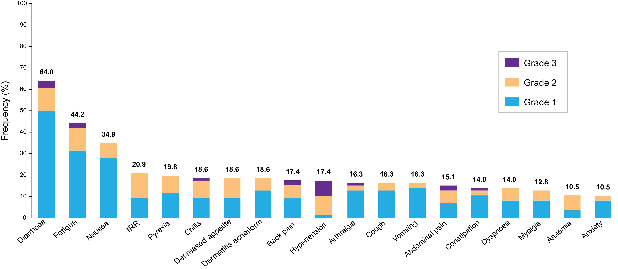
Most Common TEAEs (≥10%) for Tucatinib + Trastuzumab
Most Common Treatment-emergent Adverse Events (≥10%)
Most common tucatinib-related AEs (≥10%): Diarrhea (52.3%), fatigue (29.1%), nausea (18.6%), and dermatitis acneiform (17.4%)
  Grade ≥3 tucatinib-related AEs (≥2%): Alanine aminotransferase increase (2.3%) and diarrhea (2.3%)

Slide 7
Adverse Events of Special Interest for Tucatinib + Trastuzumab
Diarrhea
  Most common TEAE: Grade 1, 50.0%; Grade 2, 10.5%; Grade 3, 3.5%
    No treatment discontinuations due to diarrhea
    Tucatinib dose modifications for diarrhea: Dose reduction, 2.3%; dose hold, 3.5%
  Antidiarrheal prophylaxis was not mandated
Hepatotoxicity
  Grade ≥3: Increased ALT (3.5%), increased AST (2.3%), and hypertransaminasemia (1.2%)
  Hepatotoxicity leading to tucatinib modification or discontinuation occurred in 5.8%
  No Hy’s Law cases identified
Cardiotoxicity
  Asymptomatic LVEF decrease leading to dose modification or discontinuation occurred in 3.5%

Slide 8
Improving Adherence to TKIs: Best Practices
Patient education
Involvement of the entire care team (patient, doctor, pharmacist, nurses, family, caregivers, etc.)
Increased clinic visits and/or nurse outreach during first 1-2 months
Proactive use of antidiarrheals
Dose modifications for intolerable rash or fatigue

