Slide 1

Where Do Antibody-Drug Conjugates Fit in the Current Urothelial Cancer Treatment Paradigm?
Vadim S Koshkin, MD
Assistant Professor
Helen Diller Family Comprehensive Cancer Center
University of California, San Francisco
San Francisco, CA
@koshkin85

Slide 2
Disclaimer
The views and opinions expressed in this educational activity are those of the faculty and do not necessarily represent the views of TotalCME, Inc., the CME providers, or the companies providing educational grants. This presentation is not intended to define an exclusive course of patient management; the participant should use their clinical judgment, knowledge, experience, and diagnostic skills in applying or adopting for professional use any of the information provided herein. Any procedures, medications, or other courses of diagnosis or treatment discussed or suggested in this activity should not be used by clinicians without evaluation of their patient's conditions and possible contraindications or dangers in use, review of any applicable manufacturer’s product information, and comparison with recommendations of other authorities. Links to other sites may be provided as additional sources of information.

Slide 3
Treatment Landscape in Metastatic Urothelial Carcinoma Prior to 2019
Cisplatin-eligible
patients
Platinum-based Chemotherapy
for
4-6 cycles
Immune Checkpoint Inhibitors
If PD: Multiple ICIs approved for platinum-refractory disease: Pembrolizumab (level I evidence), Nivolumab, Avelumab
Carboplatin-eligible
patients
Cisplatin-ineligible patients with high PD-L1 Expression
(Pembrolizumab/Atezolizumab)
Platinum-ineligible
patients
(Pembrolizumab/Atezolizumab)
1st line therapy
2nd line therapy

Slide 4
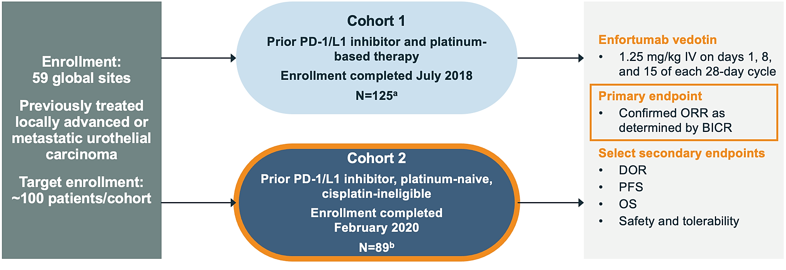
EV-201: Single-Arm, Pivotal Phase 2 Trial

Slide 5
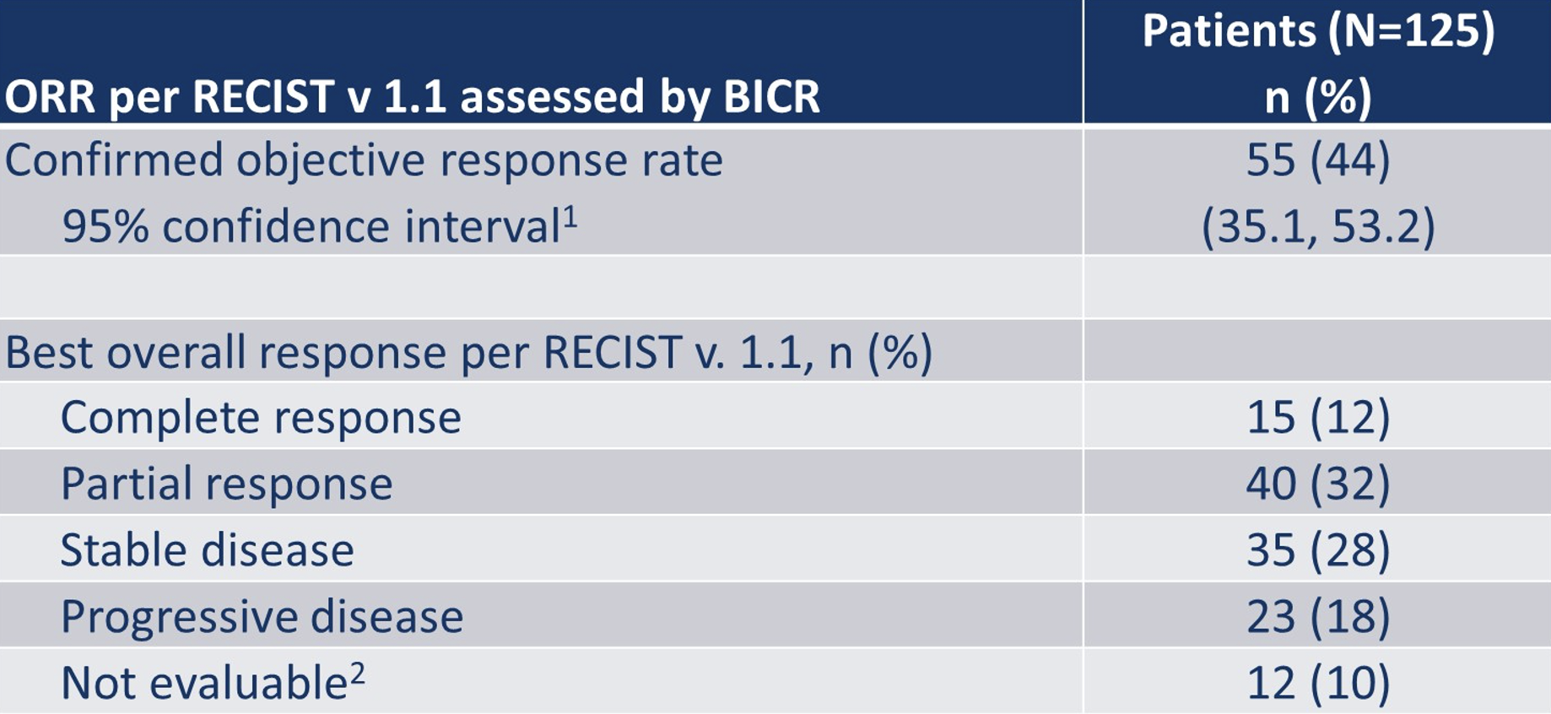
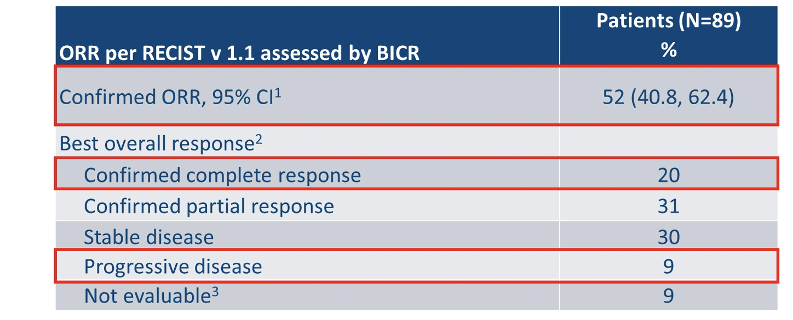
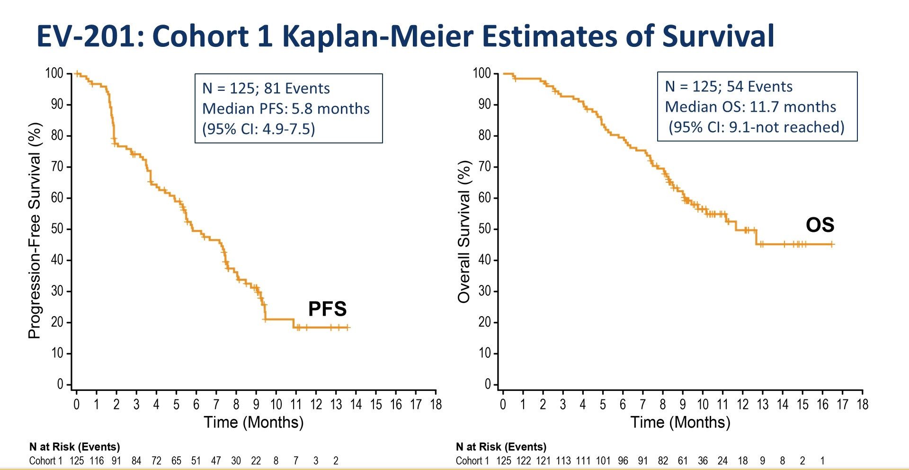
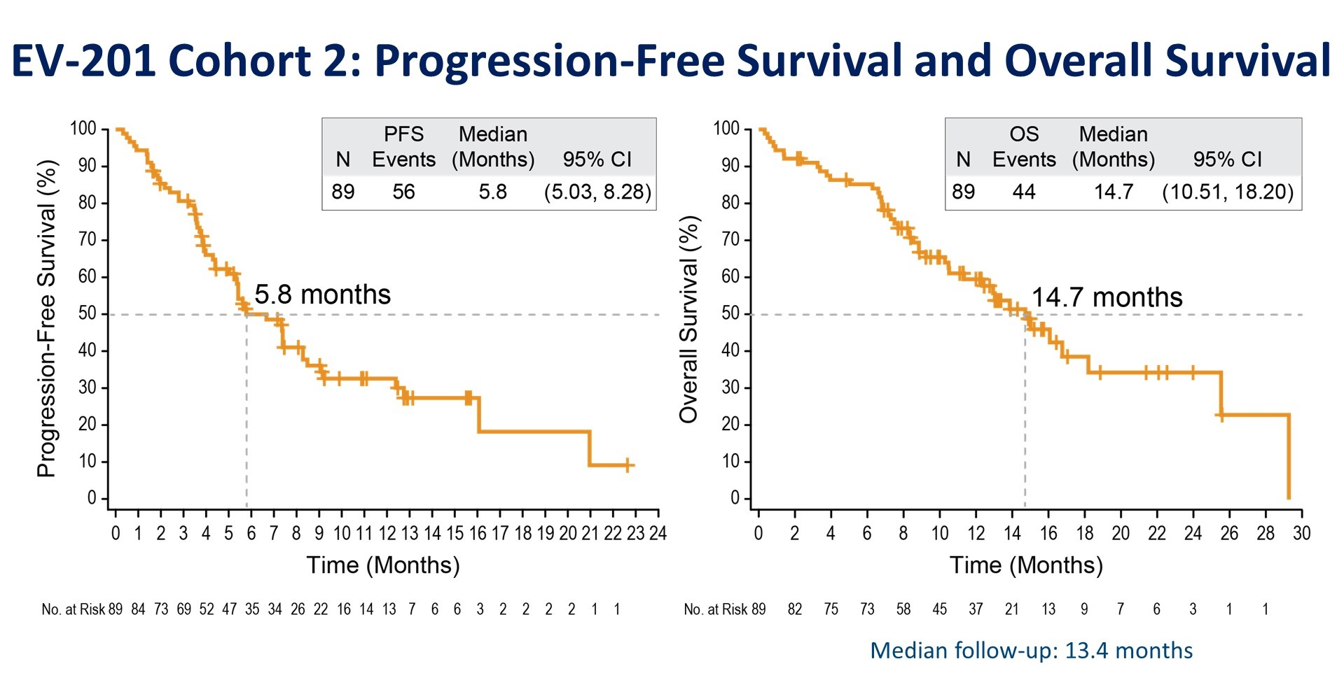
EV-201 Outcomes and Survival
Cohort 1 (Platinum-based chemo and IO-refractory)¹
Cohort 2 (IO-refractory)²
EV-201 Cohort 1: Best ORR per BICR
EV-201 Cohort 2: Best Overall Response per BICR

Slide 6
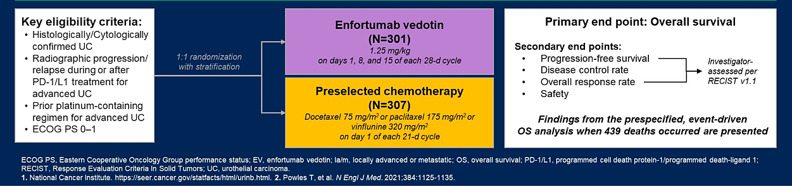
EV-301 Open-Label Phase 3 Trial Design

Slide 7
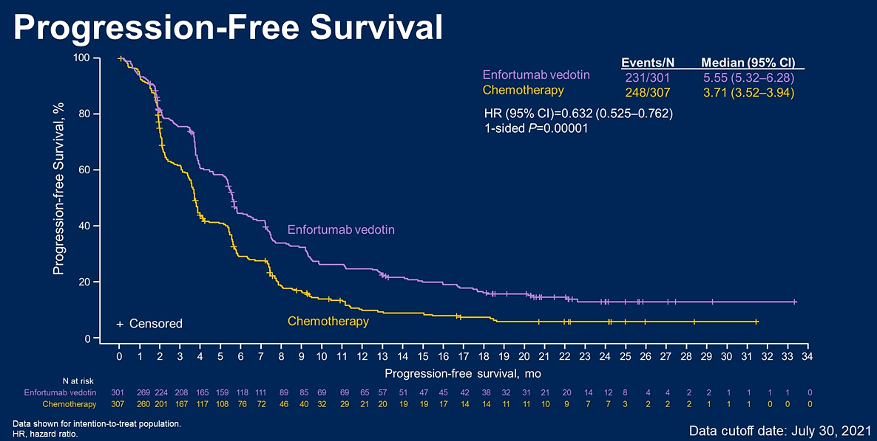
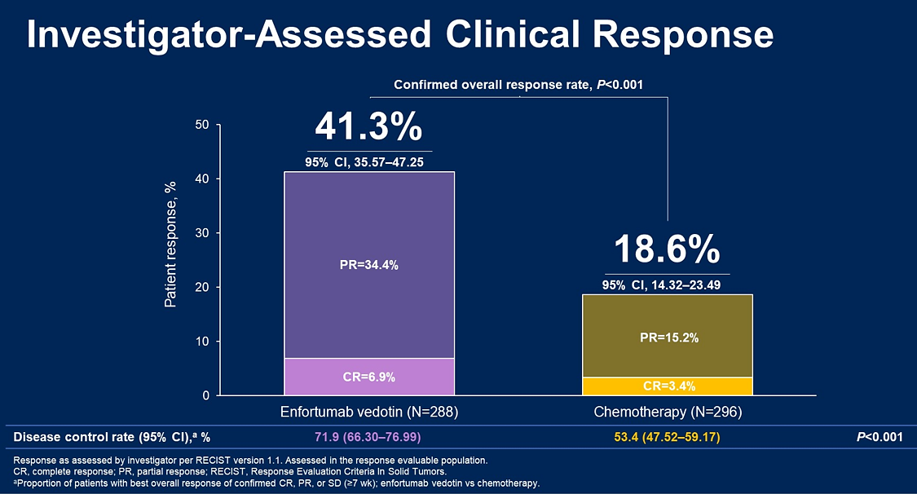
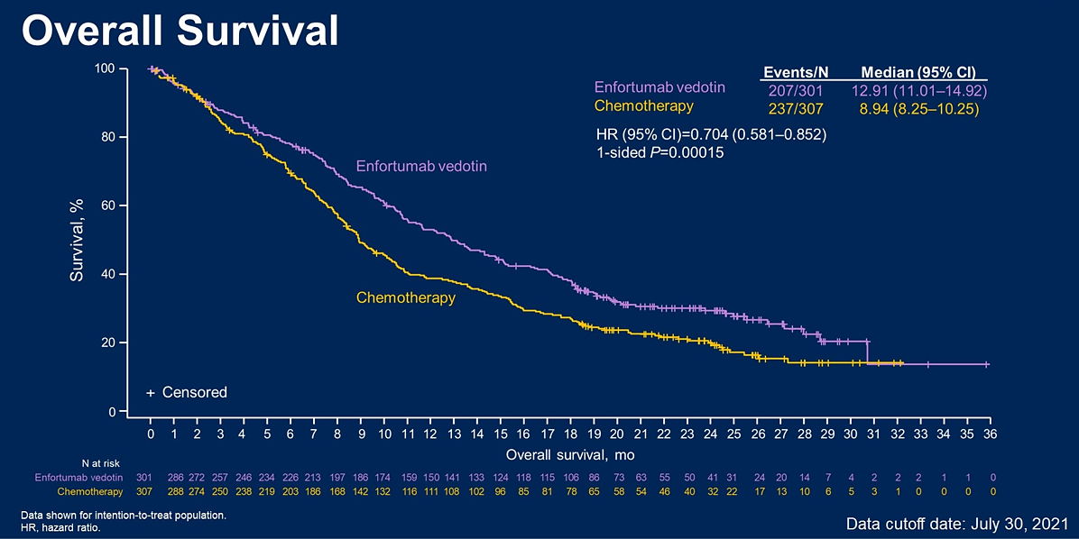
EV-301 Outcomes and Survival

Slide 8
EV-301: Long-Term Outcomes

Slide 9
EV-301: Long-Term Outcomes

Slide 10
EV-301: Long-Term Outcomes

Slide 11
TROPHY-U-01 Is a Registrational, Open-Label, Multicohort Phase 2 Trial in Patients with mUC
Cohort 1* (~100 patients): patients with mUC who progressed after prior platinum-based and CPI-based therapies
SG 10 mg/kg
Days 1 and 8, every 21 days
Continue treatment in the absence of unacceptable toxicity or disease progression
Primary Endpoint:
Objective response rate by investigator review per RECIST 1.1 criteria
Key Secondary Endpoints: Safety/tolerability, DOR, PFS, OS
Cohort 2 (~40 patients): patients with mUC who were ineligible for platinum-based therapy and progressed after prior CPI-based therapies
SG 10 mg/kg
Days 1 and 8, every 21 days
Cohort 3 (up to 61 patients): mUC CPI naïve patients who progressed after prior platinum-based therapies
SG 10 mg/kg
Days 1 and 8, every 21 days
Pembrolizumab 200 mg
day 1 every 21 days
SG
Days 1 and 8, every 21 days
Cohort 4 (up to 60 patients): mUC platinum-naïve patients
Continue until a maximum of 6 cycles has been completed, disease progression, lack of clinical benefit, toxicity, or withdrawal of consent
Maintenance avelumab (800 mg every 2 weeks) with SG (Days 1 and 8 every 21 days) for those without disease progression
Cisplatin
Cohort 5 (up to 60 patients): mUC platinum-naïve patients
SG
Days 1 and 8, every 21 days
Cisplatin
Avelumab 800 mg every 2 weeks
Key Inclusion Criteria: Age ≥18 years, ECOG of 0/1, creatinine clearance (CrCl) ≥30 mL/min, and adequate hepatic function
Key Exclusion Criteria: Immunodeficiency, active Hepatitis B or C, active secondary malignancy, or active brain metastases

Slide 12
TROPHY-U-01: Sacituzumab Govitecan in Platinum- and Immune Checkpoint Inhibitor–Refractory Settings
Reduction in Tumor Size
Cohort 1 Response
77%
Endpoint | Cohort 1 (N = 113)
ORR, n (%) CR, n (%) PR, n (%) SD, n (%) | 31 (27) 6 (5) 25 (22)
000
Median follow-up of 9.1 months:
  Median DOR: 7.2 months
  Median PFS: 5.4 months
  Median OS: 10.9 months

Slide 13
Phase 3 TROPiCS-04: Study Design of Confirmatory Trial
Study Population
Locally advanced unresectable or metastatic UC
Upper/lower tract tumors
Mixed histology types allowed if the urothelial type is predominant
Progression after platinum-based chemotherapy and anti−PD-1/PD-L1 therapy
OR
Progression within 12 mo and subsequent immune checkpoint inhibitor after platinum-based chemo in neo/adj setting
Sacituzumab govitecan
10 mg/kg
days 1 and 8 of 21-day cycle
Treatment until
loss of
clinical benefit or unacceptable toxicity
R
N = 482
Physician’s choice
docetaxel 75 mg/m²
OR
paclitaxel 175 mg/m²
OR
vinflunine 320 mg/m²
on day 1 of 21-day cycle

Slide 14
Comparison Between Enfortumab Vedotin and Sacituzumab Govitecan
 | Enfortumab vedotin^{1,2} | Sacituzumab govitecan³
Phase | III (Randomized) | II (Non-Randomized)
N | 301 | 113
Treatment Population | Post platinum and ICI | Post platinum and ICI
Median Follow-Up | 23.8 months | 9.1 months
Response Rate | 41% | 27%
mPFS | 5.6 months | 5.4 months
mOS | 12.9 months | 10.9 months
Common toxicities | Skin toxicities, neuropathies | Loose stools, cytopenias

Slide 15
Treatment Landscape in Metastatic Urothelial Carcinoma Using ADCs
Cisplatin-eligible
patients
Platinum-based Chemotherapy
for
4-6 cycles
Immune Checkpoint Inhibitors
Sacituzumab Govitecan
Unselected Population
Enfortumab Vedotin
Unselected Population
Can be used as 2nd line
Carboplatin-eligible
patients
Immune Checkpoint Inhibitors
Cisplatin-ineligible patients with high PD-L1 Expression
(Pembrolizumab/Atezolizumab)
Platinum-ineligible
patients
(Pembrolizumab/Atezolizumab)

Slide 16
Ongoing Questions and Future Directions
How can treatments be appropriately sequenced when multiple treatment options are available?
  EV before SG or vice versa?
  Retrospective studies and real-world data to help provide answers
Biomarkers predicting treatment responses are urgently needed
ADCs moving into earlier treatment spaces

Slide 17

Thank you!
vadim.koshkin@ucsf.edu
@koshkin85

