Slide 1
What Do Patients/Caregivers Need To Know About ADCs in Advanced/Metastatic Urothelial Cancer?
Shilpa Gupta, MD
Director, Genitourinary Oncology Program
Cleveland Clinic Taussig Cancer Institute
Cleveland, OH

Slide 2
Disclaimer
The views and opinions expressed in this educational activity are those of the faculty and do not necessarily represent the views of TotalCME, Inc., the CME providers, or the companies providing educational grants. This presentation is not intended to define an exclusive course of patient management; the participant should use their clinical judgment, knowledge, experience, and diagnostic skills in applying or adopting for professional use any of the information provided herein. Any procedures, medications, or other courses of diagnosis or treatment discussed or suggested in this activity should not be used by clinicians without evaluation of their patient's conditions and possible contraindications or dangers in use, review of any applicable manufacturer’s product information, and comparison with recommendations of other authorities. Links to other sites may be provided as additional sources of information.

Slide 3

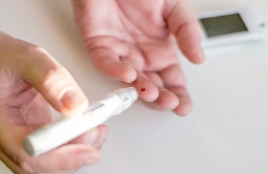

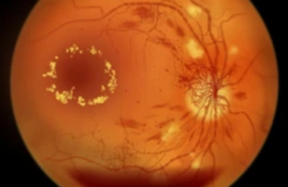

Key Adverse Events with Enfortumab Vedotin (EV)
Skin reactions
Hyperglycemia
Peripheral neuropathy
Ocular disorders
Alopecia

Slide 4
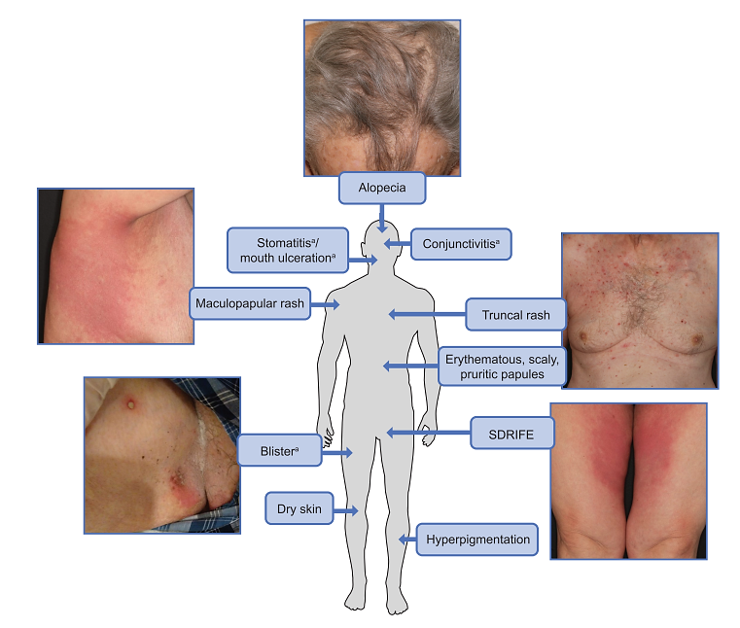
Skin Reactions: Rash and Severe Cutaneous Adverse Reactions (SCAR)
Skin reactions very common ~ 54%
  Majority- mild to moderate
  Maculopapular rash is the most common
  Typically early onset- first cycle of treatment
  Grade 3-4 skin reactions ~13%
Serious events like SJS & TEN with fatal outcome have been reported
Other serious rashes: Symmetrical drug-related intertriginous and flexural exanthema (SDRIFE), bullous dermatitis, exfoliative dermatitis, and palmar-plantar erythrodysesthesia (PPE)
SDRIFE presents with pustules, papules, and blistering and does not involve the mucosa

Slide 5
Hyperglycemia
Peripheral Neuropathy
Rate: ~14%, 7% grade 3-4
5% required insulin
Risk factors: high BMI, elevated baseline HbA1c
Median time to onset: 0.6 months
Rate: ~52%, 4% grade 3-4
Sensory, motor, motor weakness
Median time to onset of grade ≥2 peripheral neuropathy was 4.6 months
Tx discontinuation in 5% of patients

Slide 6

Ocular Disorders
Rate: ~40 %
Dry eye, blurred vision, keratitis
Median time to onset- 1.6 months
Referral to Ophthalmologist is recommended at baseline in patients with ocular issues and when patients experience new or worsening symptoms
Consider artificial tears for prophylaxis of dry eyes

Slide 7
Key Adverse Events with Sacituzumab Govitecan (SG)
Diarrhea (65%); severe diarrhea (~10%)
Nausea (66%)
Fatigue (62%)

Slide 8
Key Adverse Events with Sacituzumab Govitecan (SG)
Neutropenia (61%), severe or life-threatening neutropenia (47%), febrile neutropenia (7%)
Hypersensitivity reactions (37%), severe (2%)
Increased risk of adverse reactions in patients with reduced UGT1A1 activity

