Slide 1
Carfilzomib-Based Regimens for Early Relapse Multiple Myeloma
Noa Biran, MD
Associate Professor of Medicine
Hackensack Meridian Health
John Theurer Cancer Center, Multiple Myeloma Division
Hackensack, NJ

Slide 2



Resource Information
About This Resource
These slides are one component of a continuing education program available online at MedEd On The Go titled Early Relapse in Multiple Myeloma: Modern Management Strategies
Program Learning Objectives:
Distinguish between relapse and progression of disease in multiple myeloma
Compare the efficacy and safety of carfilzomib- and pomalidomide-based regimens in the treatment of relapsed multiple myeloma
Apply current and emerging treatment approaches to multiple myeloma patients in early relapse
Recognize common adverse events seen with combination regimens used to treat early relapsed multiple myeloma
MedEd On The Go®
www.mededonthego.com
This content or portions thereof may not be published, posted online or used in presentations without permission.
This content can be saved for personal use (non-commercial use only) with credit given to the resource authors.
To contact us regarding inaccuracies, omissions or permissions please email us at support@MedEdOTG.com

Slide 3
Disclaimer
The views and opinions expressed in this educational activity are those of the faculty and do not necessarily represent the views of Total CME, LLC, the CME providers, or the companies providing educational grants. This presentation is not intended to define an exclusive course of patient management; the participant should use their clinical judgment, knowledge, experience, and diagnostic skills in applying or adopting for professional use any of the information provided herein. Any procedures, medications, or other courses of diagnosis or treatment discussed or suggested in this activity should not be used by clinicians without evaluation of their patient's conditions and possible contraindications or dangers in use, review of any applicable manufacturer’s product information, and comparison with recommendations of other authorities. Links to other sites may be provided as additional sources of information.

Slide 4
Case: DT, 55-Year-Old man
DT is a 55-year-old man who was diagnosed with IgA Kappa multiple myeloma. DS 2A, ISS 2, R-ISS 2. He presented with an L3 compression fracture and a corrected calcium of 10.8. Hemoglobin was 11 g/dL from baseline of 14.5 g/dL. Bone marrow evaluation revealed 50 to 60% kappa-restricted plasma cells by IHC, Congo Red negative. Aspirate flow confirmed kappa-restricted plasma cells. Normal cytogenetics. CD-138 selected FISH shows 1p deletion and 13q deletion.
Comorbidities included type 2 DM (peripheral neuropathy and retinopathy) and well controlled hypertension
He was treated with 4 cycles of carfilzomib, lenalidomide, and dexamethasone followed by autologous-stem cell transplantation and lenalidomide maintenance. The lenalidomide was dose reduced after 2 years because of profuse and unpredictable diarrhea. While on dose-reduced lenalidomide, the disease markers confirmed biochemical progression 2 years and 5 months after autologous-stem cell transplant

Slide 5
Factors most important in determining therapy:
Biology of relapse: Timing? High-risk?
Comorbidities: Which drugs to avoid?
Organ damage: Ca, Cr, Bones, Infections, Hgb?
Response to prior therapies: LEN-exposed vs refractory?
Great candidate for a carfilzomib-based regimen!

Slide 6
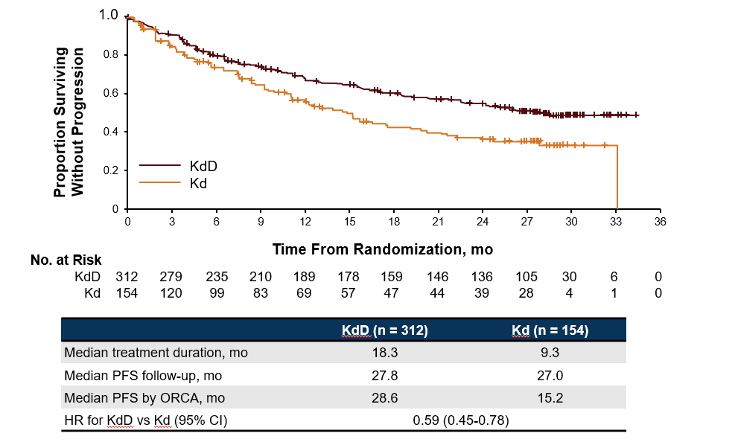
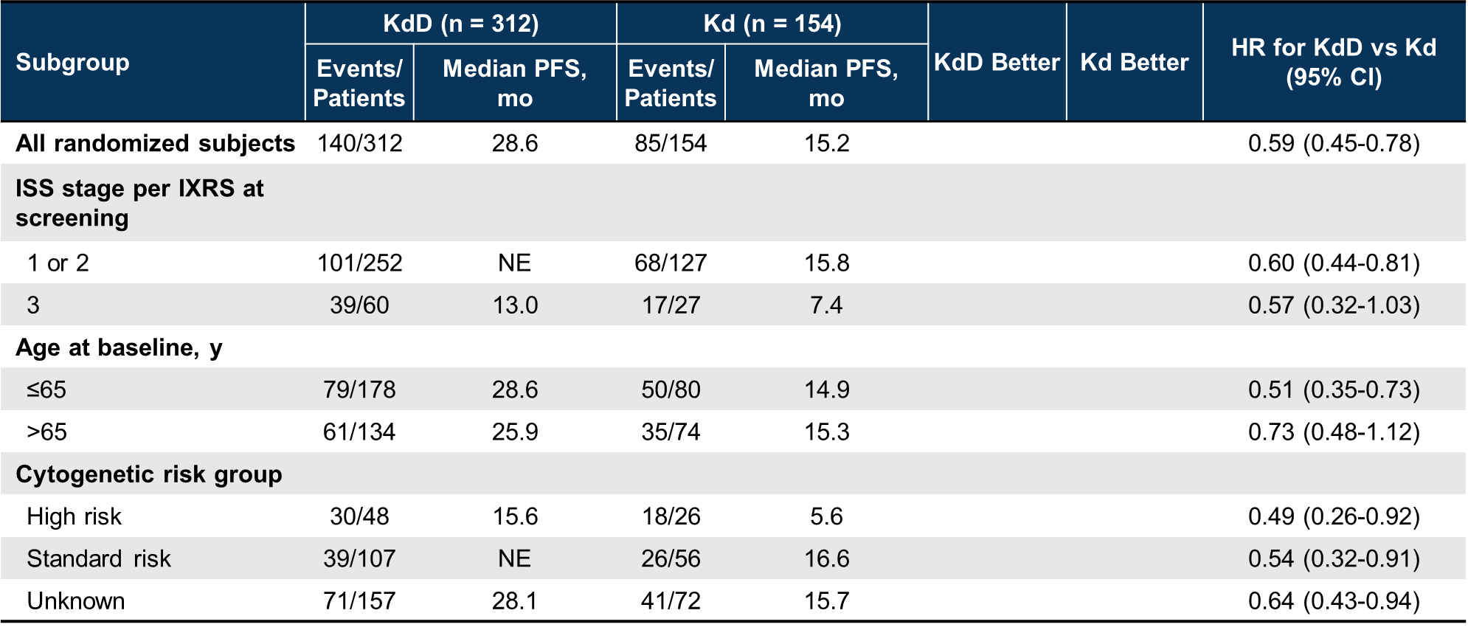
CANDOR: KDd Prolongs PFS vs Doublet in RRMM
LEN-refractory 39%/48% in KDd/Kd
Pom refractory 3%/4% in KDd/Kd
High-risk by FISH 15%/17%
Efficacy Across Subgroups:

Slide 7
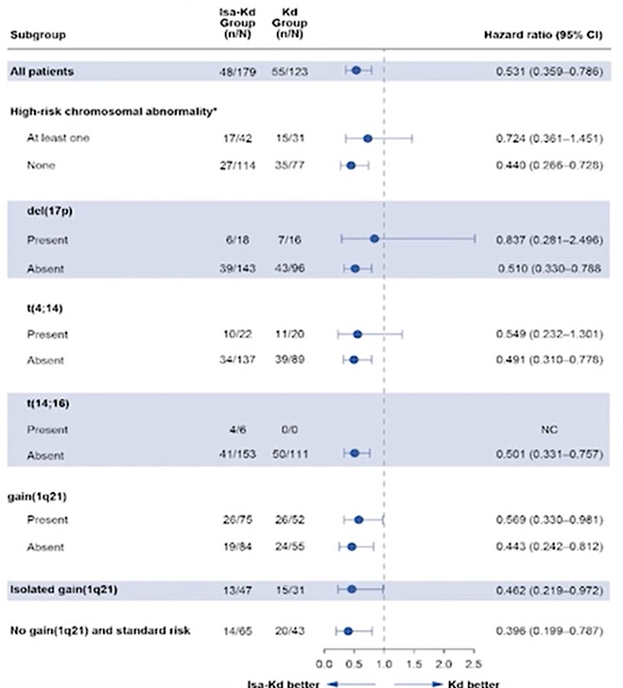
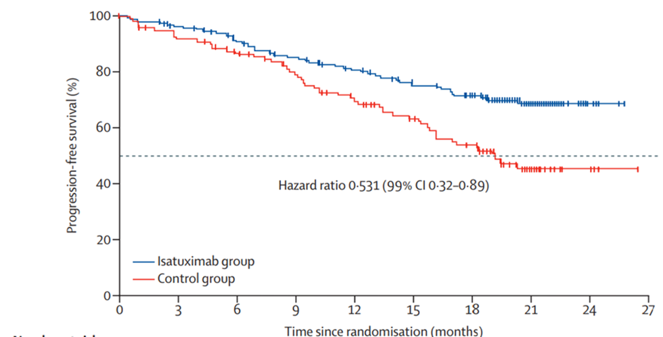
IKEMA: Isatuximab/Car/Dex versus Car/Dex in MM Patients with 1-3 Prior Lines
Subgroup Analysis of High-Risk
IKEMA: Progression-Free Survival
LEN-refractory 32/34% in Isa-Kd/Kd
IMiD –refractory 44%/47% in DKd/Kd
High-risk by FISH 23%/25%
Benefit was observed in patients with 1q21 amplification (HR 0.531; 95% CI 0.15 – 1.878
Median PFS 35.7 vs 19.2 months (HR 0.58; 95.4% CI, 0.42 – 0.79)

Slide 8
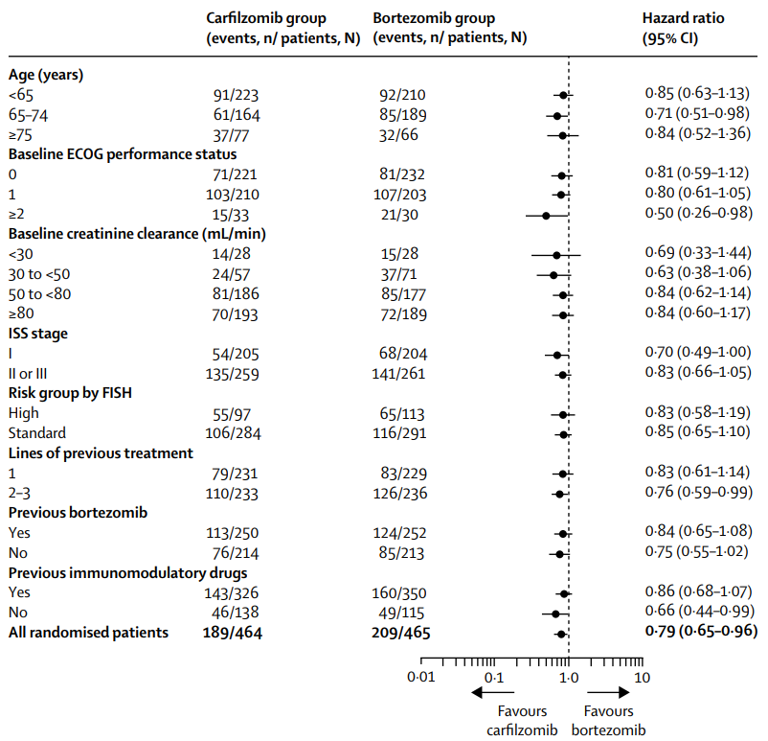
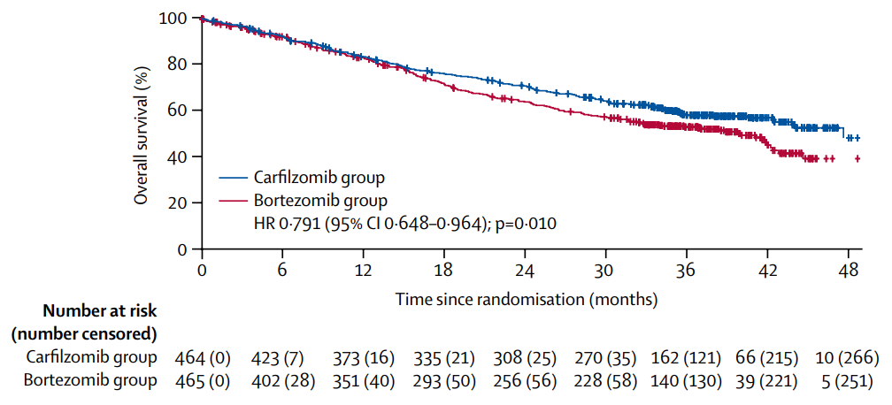
ENDEAVOR: Carfilzomib/Dex or Bortezomib/Dex in Relapsed or Refractory Myeloma
1-3 prior lines
Prior IMiD 70%/75% Kd vs Vd
High risk 21%/24% Kd vs Vd
Prior bortezomib 54%/54% Kd vs Vd
Treatment-related deaths 1%/<1% Kd vs Vd

Slide 9
Summary
When selecting therapy for a patient with relapsed myeloma, it is important to consider biology of disease, patient comorbidities, prior treatment response, and the presence of organ damage
The combination of carfilzomib with a CD-38 monoclonal antibody and dexamethasone in patients with MM and 1-3 prior lines has shown median PFS rates of 28.6 – 35.7 months
In multiple myeloma patients with 1-3 prior lines of therapy, carfilzomib/dex showed an OS benefit over bortezomib/dex

Slide 10



Looking for more resources
on this topic?
CME/CE in minutes
Congress highlights
Late-breaking data
Quizzes
Webinars
In-person events
Slides & resources
www.MedEdOTG.com

