Slide 1
Monoclonal Antibody-Based Regimens for Early Relapse Multiple Myeloma
Noa Biran, MD
Associate Professor of Medicine
Hackensack Meridian Health
John Theurer Cancer Center, Multiple Myeloma Division
Hackensack, NJ

Slide 2



Resource Information
About This Resource
These slides are one component of a continuing education program available online at MedEd On The Go titled Early Relapse in Multiple Myeloma: Modern Management Strategies
Program Learning Objectives:
Distinguish between relapse and progression of disease in multiple myeloma
Compare the efficacy and safety of carfilzomib- and pomalidomide-based regimens in the treatment of relapsed multiple myeloma
Apply current and emerging treatment approaches to multiple myeloma patients in early relapse
Recognize common adverse events seen with combination regimens used to treat early relapsed multiple myeloma
MedEd On The Go®
www.mededonthego.com
This content or portions thereof may not be published, posted online or used in presentations without permission.
This content can be saved for personal use (non-commercial use only) with credit given to the resource authors.
To contact us regarding inaccuracies, omissions or permissions please email us at support@MedEdOTG.com

Slide 3
Disclaimer
The views and opinions expressed in this educational activity are those of the faculty and do not necessarily represent the views of Total CME, LLC, the CME providers, or the companies providing educational grants. This presentation is not intended to define an exclusive course of patient management; the participant should use their clinical judgment, knowledge, experience, and diagnostic skills in applying or adopting for professional use any of the information provided herein. Any procedures, medications, or other courses of diagnosis or treatment discussed or suggested in this activity should not be used by clinicians without evaluation of their patient's conditions and possible contraindications or dangers in use, review of any applicable manufacturer’s product information, and comparison with recommendations of other authorities. Links to other sites may be provided as additional sources of information.

Slide 4
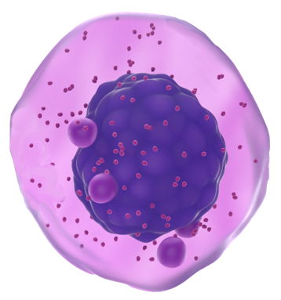
Monoclonal Antibodies Have Myeloma-Directed and Immunomodulatory Effects
Daratumumab binds to CD38
On-tumor effects
CDC, ADCC, ADCP, apoptosis
Depletes CD38+ immunosuppressive regulatory cells; promotes T-cell expansion, activation
Elotuzumab binds to SLAMF7/CS1
On-tumor effects
CDC, ADCC, ADCP, apoptosis
Myeloma Cell
Isatuximab binds to CD38
On-tumor effects
CDC, ADCC, ADCP, apoptosis
Direct NK cell activation, CD16-mediated ADCC independent
Immunomodulation, inhibition of ectoenzyme activity

Slide 5
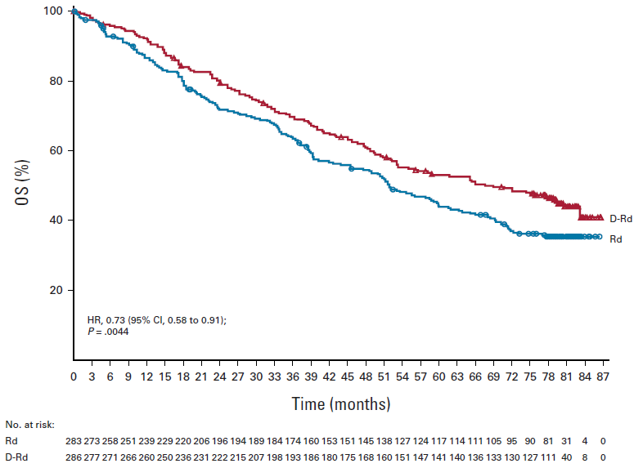
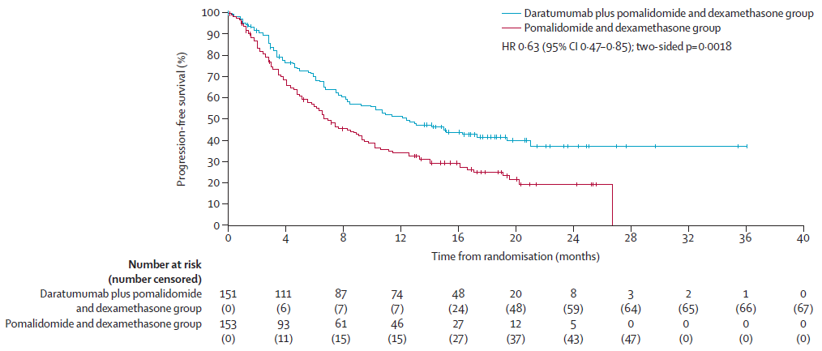
Daratumumab +IMiD + Dex in Early Relapsed MM
POLLUX¹: > 6.5-year follow-up – median PFS with DRd vs Rd 38.8 vs 18.6 months
APOLLO²: Phase III DPd vs Pd
1 prior LOT 11%, 2-3 LOT 75%
79% LEN-refractory!
DPd is effective in RRMM regardless of prior exposure to lenalidomide

Slide 6
Daratumumab + PI + Dex in Early Relapsed MM
CANDOR Phase 3¹
Dara+carfilzomib+dex vs
Carfilzomib+dex
CANDOR | DKd (N=312) | Kd (N=154)
Median PFS (mo) | 28.4 | 15.2
HR for DKd vs Kd | 0.64 (0.49 – 0.83), P<0.001
Median follow-up 50 month
CASTOR Phase 3²
Dara+bortezomib+dex vs
Bortezomib+dex
CASTOR | DVd (N=251) | Vd (N=247)
Median PFS (mo) | 16.7 | 7.1
HR for DVd vs Vd | 0.31 (95% CI, 0.25 – 0.40), P<0.0001
Median follow-up 40 month

Slide 7
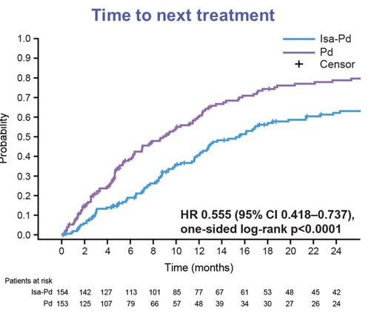
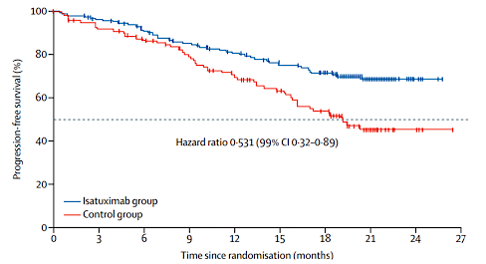
Isatuximab in Early Relapsed MM
ICARIA-MM Phase III Isa-Pd vs Pd
IKEMA: Phase III Isa-Kd vs Kd
>2 prior lines including lenalidomide and PI
LEN-refractory 94% vs 92% in Isa-Pd vs Pd
1-3 prior therapies, Median 2 prior lines, 93% prior PI, 76% prior len, 20% refractory to IMiD and PI.
Median PFS NR v 19.15 months, HR = 0.53, median f/u 20.7
With prolonged follow-up, Isa-Pd continues to improve PFSª:
mPFS 11.1 months vs 5.8 months with Pd alone (HR 0.599, p<0.0001)

Slide 8
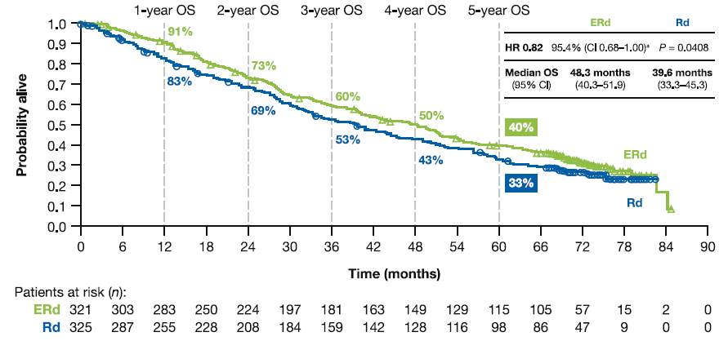
Elotuzumab in RRMM
ELOQUENT-2: Phase 3 ERd vs Rd^{1,2}
ELOQUENT-3³ – Phase 2 EPd (N=60) vs Pd (N=57)
90% and 84% LEN-refractory in EPd vs Pd
Median PFS 10.3 vs 4.7 months (HR 0.54, 95% CI 0.34 – 0.86, P=0.008)
After minimum follow-up of 45 months, median OS 29.8 vs 17.4 months, EPd vs Pd (HR 0.59, 95% CI, 0.37-0.93, P=.0217)⁴
5%/6% prior lenalidomide in ERd/Rd

Slide 9
Summary
Isatuximab or daratumumab with carfilzomib and dexamethasone have demonstrated impressive median progression-free-survival to date in patients with early relapsed multiple myeloma
The POLLUX trial has one of the longest median follow-ups of all studies evaluating monoclonal antibody combinations in early relapsed myeloma. With >6.4 year follow-up, median PFS with DRd
vs Rd 38.8 vs 18.6 months
The phase 2 ELOQUENT-3 study which included >85% lenalidomide-refractory patients, demonstrated a 2-year PFS of 41% versus 27% with elotuzumab, pomalidomide,
dex versus pomalidomide and dex alone

Slide 10



Looking for more resources
on this topic?
CME/CE in minutes
Congress highlights
Late-breaking data
Quizzes
Webinars
In-person events
Slides & resources
www.MedEdOTG.com

