Slide 1
Case Study:
Treatment Sequencing in Platinum-Resistant Relapse of ES-SCLC
Jacob Sands, MD
Thoracic Medical Oncologist, Dana-Farber Cancer Institute
Assistant Professor, Harvard Medical School
Boston, MA

Slide 2



Resource Information
About This Resource
These slides are one component of a continuing education program available online at MedEd On The Go titled ES-SCLC: Sequencing Strategies in Previously Treated Patients
Program Learning Objectives:
Apply the latest evidence and guidelines to individualize second-line treatment plans for patients with extensive-stage small-cell lung cancer
Implement evidence-based strategies to prevent, monitor, and manage adverse effects in patients receiving second-line treatment for extensive-stage small-cell lung cancer
MedEd On The Go®
www.mededonthego.com
This content or portions thereof may not be published, posted online or used in presentations without permission.
This content can be saved for personal use (non-commercial use only) with credit given to the resource authors.
To contact us regarding inaccuracies, omissions or permissions please email us at support@MedEdOTG.com

Slide 3
Disclaimer
The views and opinions expressed in this educational activity are those of the faculty and do not necessarily represent the views of Total CME, LLC, the CME providers, or the companies providing educational grants. This presentation is not intended to define an exclusive course of patient management; the participant should use their clinical judgment, knowledge, experience, and diagnostic skills in applying or adopting for professional use any of the information provided herein. Any procedures, medications, or other courses of diagnosis or treatment discussed or suggested in this activity should not be used by clinicians without evaluation of their patient's conditions and possible contraindications or dangers in use, review of any applicable manufacturer’s product information, and comparison with recommendations of other authorities. Links to other sites may be provided as additional sources of information.

Slide 4
Clinical Case
68-year-old man with a PMHx of COPD and 50-pack year smoking history (quit 10 years ago) presented to his primary with an increasing cough
Chest x-ray showed a large right lung mass, leading to CT scan imaging that showed metastatic disease in right adrenal, liver, and bone
MRI brain showed no evidence of any metastatic disease
First-line treatment with carboplatin, etoposide, and atezolizumab x 4 cycles followed by atezolizumab maintenance
~5 months of chemotherapy-free interval before scans showed progression

Slide 5
NCCN Guidelines
Subsequent Systemic Therapy for SCLC
SCLC SUBSEQUENT SYSTEMIC THERAPY (PS 0-2) Consider dose reduction or growth factor support for patients with PS 2.
CHEMOTHERAPY-FREE INTERVAL (CTFI) >6 MONTHS
Preferred Regimens Clinical trial enrollment Re-treatment with platinum-based doublet Other Recommended Regimens Lurbinectedin Topotecan oral (PO) or intravenous (IV) Irinotecan
CTFI ≤6 MONTHS
Preferred Regimens Clinical trial enrollment Lurbinectedin Topotecan oral (PO) or intravenous (IV) Irinotecan Re-treatment with platinum-based doublet may be considered for CTFI 3-6 months Other Recommended Regimens Nivolumab or pembrolizumab (if not previously treated with an ICI) Paclitaxel Temozolomide Cyclophosphamide/doxorubicin/vincristine (CAV) Docetaxel Gemcitabine Oral etoposide
Approved in individuals with chemotherapy-free interval (CTFI) of >45 days after 1st line chemotherapy
Newer second-line option (independent of CTFI)
Only if no prior immunotherapy

Slide 6
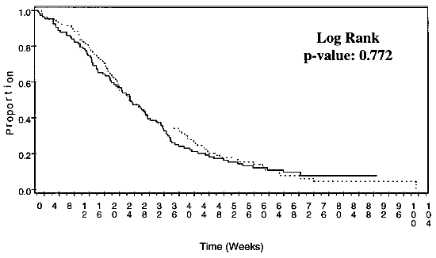
Topotecan Efficacy
Cumulative Proportion Alive
Topotecan 2.3 mg/m2/d PO for days 1-5 every
21 days¹
  Eligibility included chemotherapy-free interval of at least 45 days after 1st line therapy
Topotecan 1.5 mg/m2/d IV for days 1-5 every
21 days versus cyclophosphamide, adriamycin,
and vincristine²
  Eligibility included chemotherapy-free interval of at least 60 days after 1st line therapy
Proportion
1. O’Brien MER, et al. J Clin Oncol. 2006;4(34):5441-7; 2. Pawel JV, et al. Clin Oncol. 1999;17(2):658-67.

Slide 7
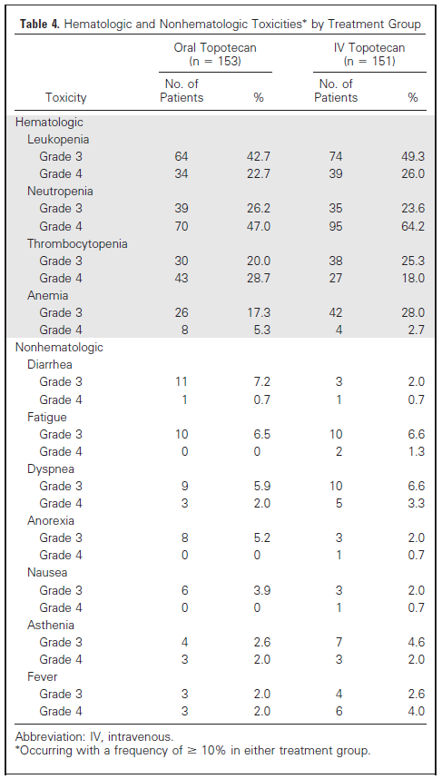
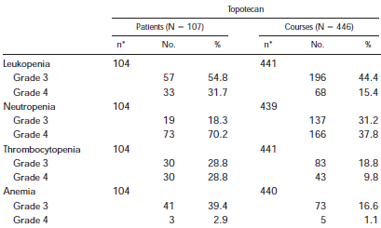
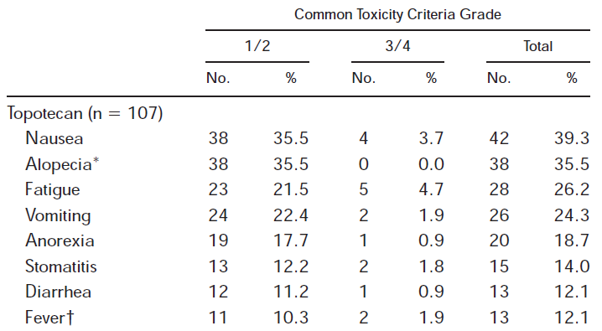
Topotecan Toxicities
Topotecan 2.3 mg/m2/d PO for days 1-5 every 21 days¹
Topotecan 1.5 mg/m2/d IV for days 1-5 every 21 days²

Slide 8
Irinotecan Efficacy and Toxicity Profile
Worst Toxicity by 15 Patients on CPT-11
15 patients (5 limited stage,
10 extensive stage):
  0 CR (0%), 7 PR (47%)
    3 responses in limited disease
    4 responses in extensive disease
Median duration of response:
  58 days (28-156)
Median overall survival
  187 days
Toxicity | WHO Grade 1 2 3 4 |  |  |  | No. of Patients With Grade ≥ 3 | %
Leukopenia | 4 | 5 | 4 | 1 | 5 | 33
Thrombocytopenia | 0 | 1 | 0 | 0 | 0 | 0
Anemia | 6 | 1 | 3 | 0 | 3 | 20
Nausea/vomiting | 5 | 2 | 2 | 0 | 2 | 13
Diarrhea | 7 | 3 | 1 | 0 | 1 | 7
Constipation | 1 | 0 | 0 | 1 | 1 | 7
Alopecia* | 2 | 2 | 0 | 0 | 0 | 0
Pulmonary toxicity | 0 | 0 | 1 | 1 | 2 | 13
ECG abnormality | 0 | 1 | 0 | 0 | 0 | 0
Fever | 0 | 0 | 0 | 0 | 0 | 0
Elevation of serum creatinine | 0 | 0 | 0 | 0 | 0 | 0
Elevation of transaminases | 2 | 0 | 0 | 0 | 0 | 0
*N = 14.

Slide 9
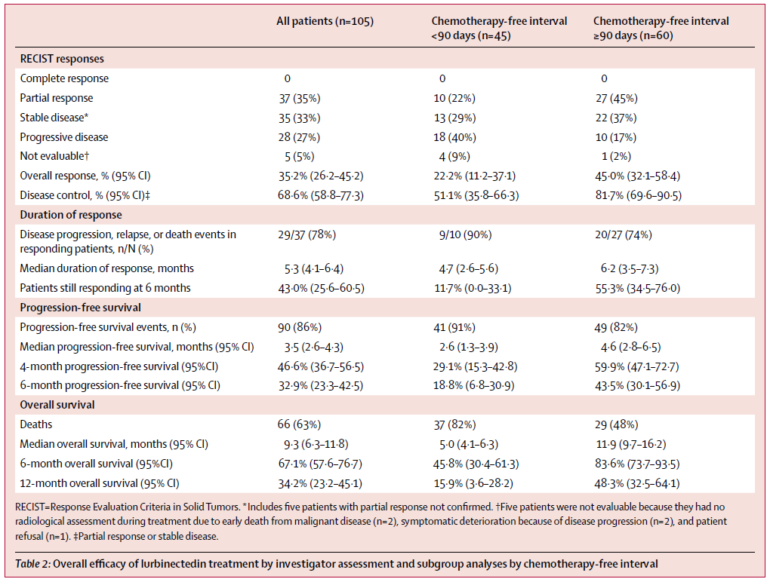
Lurbinectedin Phase 2 in Second-Line SCLC*
Single arm Phase 2 in second-line small cell lung cancer
Patient randomization
  Sensitive disease:
  CFTI ≥90 days
  Resistant disease:
  CFTI ≤90 days

Slide 10
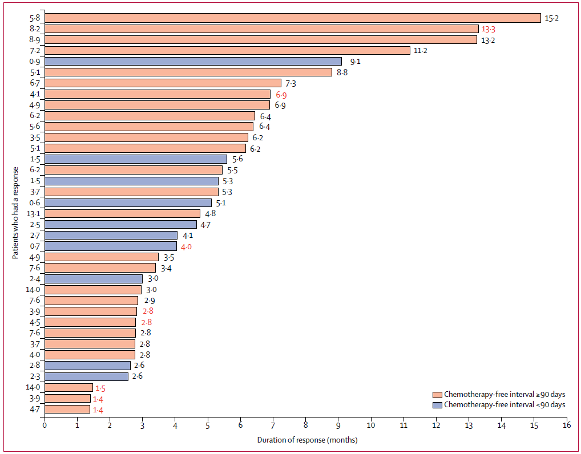
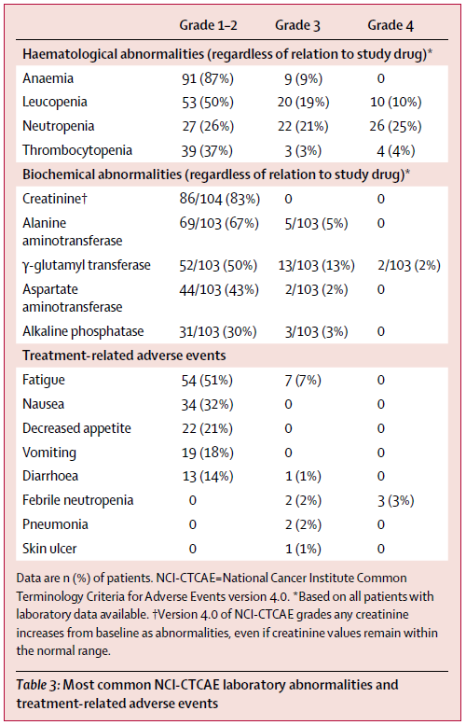
Lurbinectedin Efficacy and Side Effects Profile

Slide 11
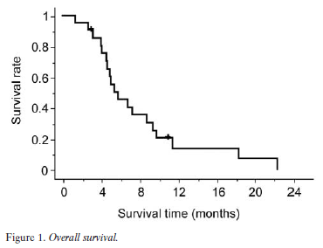
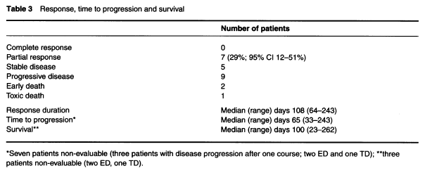
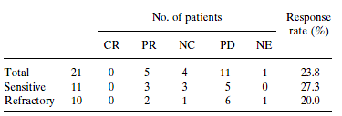
Paclitaxel Efficacy in SCLC
Paclitaxel 80 mg/m2 weekly x6 weeks for 8-week cycles (n=21)²
Paclitaxel 175 mg/m2 Q3 weeks (n=21)¹
Overall Survival
Response, time to progression and survival
Response Data

Slide 12
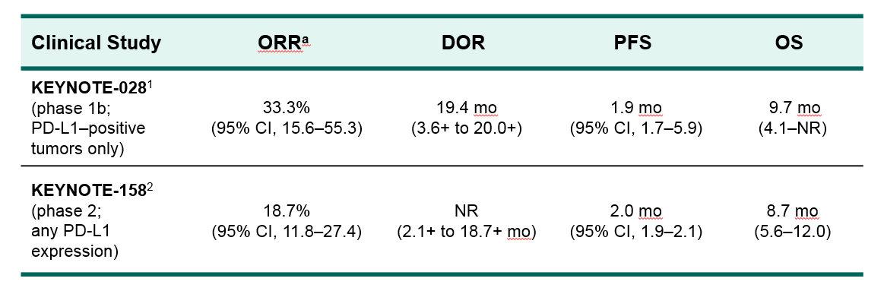
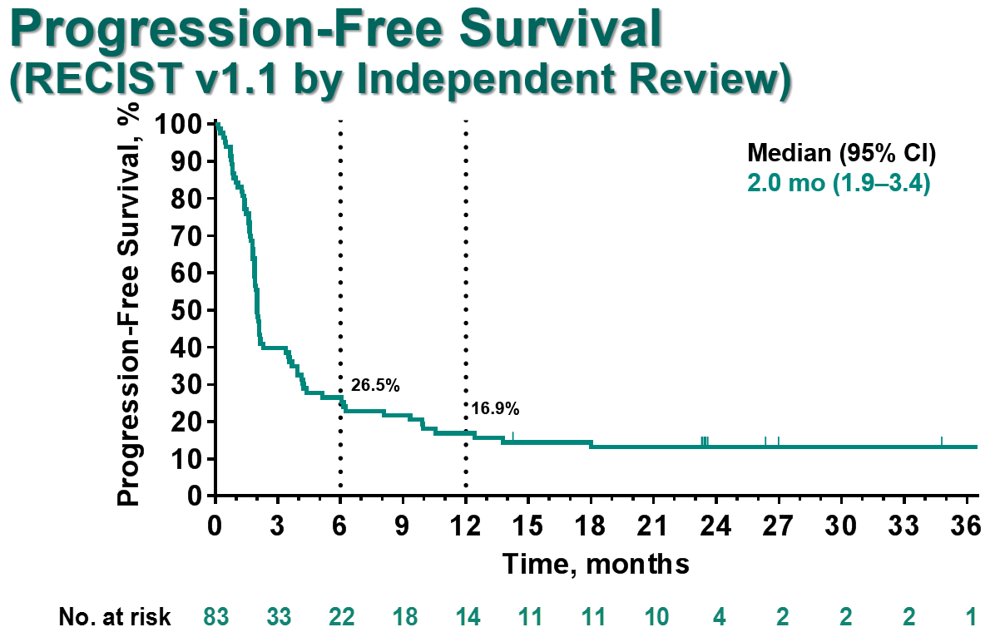
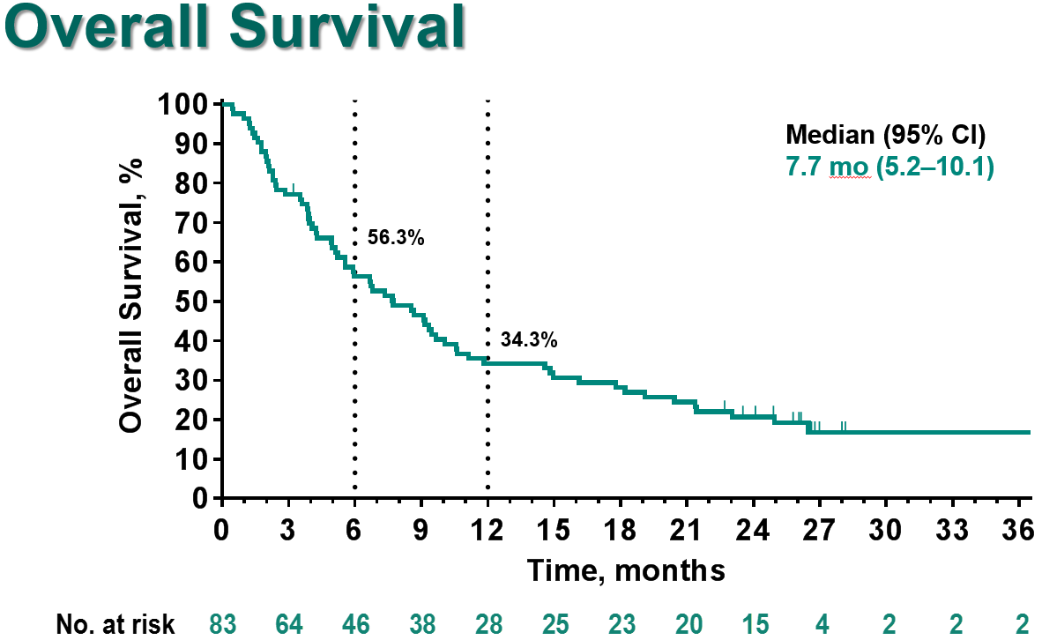
KEYNOTE-028 and KEYNOTE-158: SCLC

Slide 13
Clinical Case
68-year-old man with a PMHx of COPD and 50-pack year smoking history (quit 10 years ago) presented to his primary with an increasing cough
Chest x-ray showed a large right lung mass, leading to CT scan imaging that showed metastatic disease in right adrenal, liver, and bone
MRI brain showed no evidence of any metastatic disease
First-line treatment with carboplatin, etoposide, and atezolizumab x 4 cycles followed by atezolizumab maintenance
~7 months of chemotherapy free-interval before scans showed progression

Slide 14
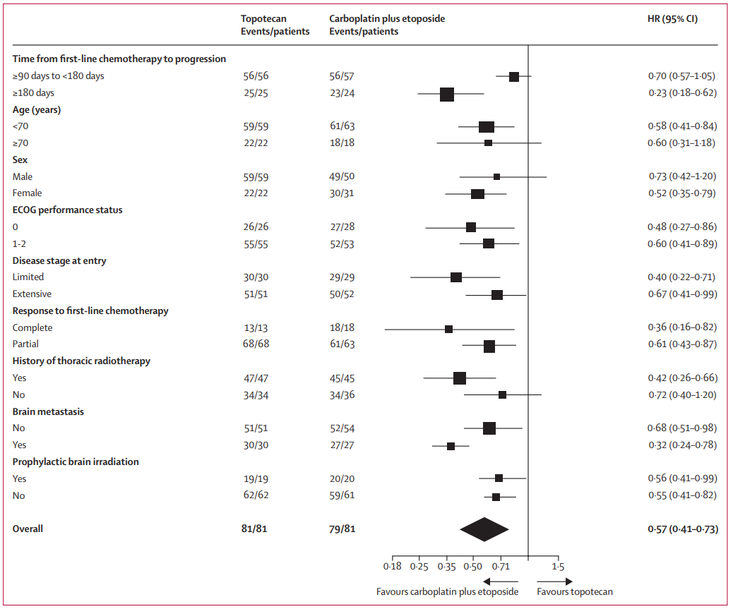
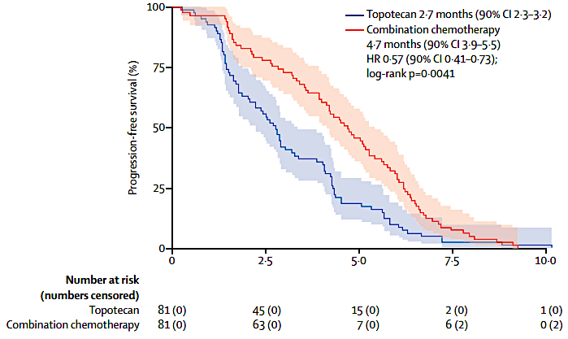
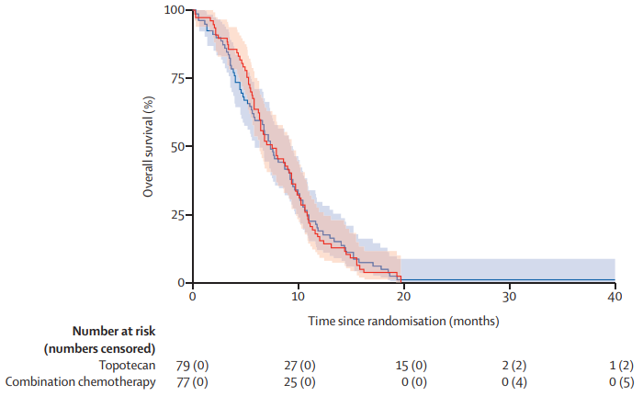
Platinum Etoposide Versus Topotecan Re-Treatment
Chemotherapy-free interval ≥3 months
Randomized topotecan versus platinum/etoposide

Slide 15
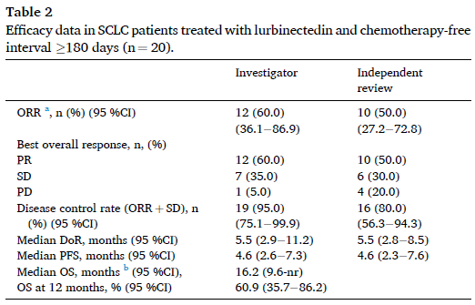
Lurbinectedin Efficacy in SCLC
CTFI ≥180 days
Only 20 individuals
ORR: 60%
Median PFS: 4.6 months
Median OS: 16.2 months

Slide 16
Summary
Clinical trial enrollment continues to be an important option for treatment of small cell lung cancer in the 2nd line and beyond
Lurbinectedin represents a 2nd line treatment option of Q3 week dosing that is well tolerated
Topotecan (FDA approved) or irinotecan represent additional
2nd line options
Paclitaxel is commonly utilized and NCCN supported
Temozolomide is an option with good CNS penetration

Slide 17



Looking for more resources
on this topic?
CME/CE in minutes
Congress highlights
Late-breaking data
Quizzes
Webinars
In-person events
Slides & resources
www.MedEdOTG.com

