Slide 1
Analyzing Key Data from LAG-3 Combinations in the Treatment of Metastatic Melanoma
Hussein Tawbi, MD, PhD
Professor
Deputy Chair, Department of Melanoma Medical Oncology
Co-Director, Andrew M. McDougall Brain Metastasis Clinic & Program
Melanoma Medical Oncology, Investigational Cancer Therapeutics
Houston, TX

Slide 2



Resource Information
About This Resource
These slides are one component of a continuing education program available online at MedEd On The Go titled Leveraging LAG-3: Innovative Immunotherapy Combinations for First-Line Metastatic Melanoma Treatment
Program Learning Objectives:
Describe the synergistic interaction between LAG-3 and other immune checkpoints
Evaluate recent practice-changing data on the use of LAG-3/PD-1 combination ICI therapy in patients with
metastatic melanoma
Select appropriate evidence-based dual ICI treatment regimens for newly diagnosed patients with metastatic melanoma
Recognize and manage treatment-related adverse events associated with the use of LAG-3/PD-1 combination ICI regimens
MedEd On The Go®
www.mededonthego.com
This content or portions thereof may not be published, posted online or used in presentations without permission.
This content can be saved for personal use (non-commercial use only) with credit given to the resource authors.
To contact us regarding inaccuracies, omissions or permissions please email us at support@MedEdOTG.com

Slide 3
Disclaimer
The views and opinions expressed in this educational activity are those of the faculty and do not necessarily represent the views of Total CME, LLC, the CME providers, or the companies providing educational grants. This presentation is not intended to define an exclusive course of patient management; the participant should use their clinical judgment, knowledge, experience, and diagnostic skills in applying or adopting for professional use any of the information provided herein. Any procedures, medications, or other courses of diagnosis or treatment discussed or suggested in this activity should not be used by clinicians without evaluation of their patient's conditions and possible contraindications or dangers in use, review of any applicable manufacturer’s product information, and comparison with recommendations of other authorities. Links to other sites may be provided as additional sources of information.

Slide 4
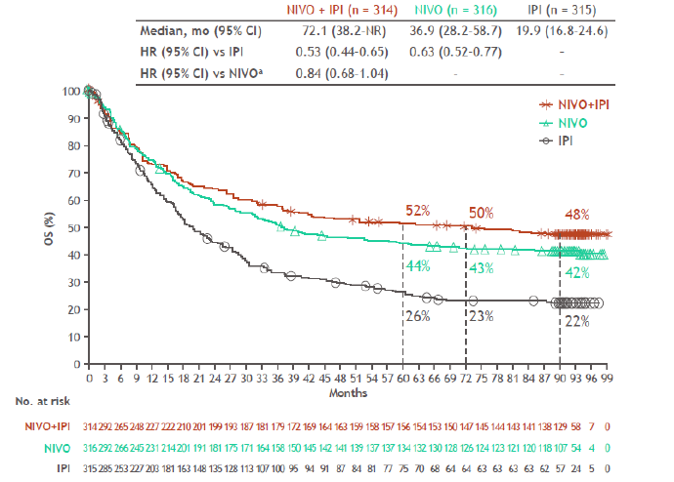
CheckMate 067: 7.5-Year Overall Survival

Slide 5
Combination CTLA-4 + PD-1 Blockade
Improved activity in several settings: Brain metastases, neo-adjuvant, rate melanoma subtypes (mucosal, acral, uveal)
Role in other malignancies:
  NSCLC
  RCC
  MSI-H CRC
  Durvalumab + tremelimumab in HCC
At the cost of increased toxicity: ~60% grade 3 to 4 irAEs

Slide 6
CheckMate 067: 7.5-Year Overall Survival
NIV
O
+
IP
I
(
n
=
3
1
4
)
NIV
O
(
n
=
3
1
6
)
IP
I
(
n
=
3
1
5
)
Me
d
i
a
n
(
9
5
%
C
I
)
,
mo
72.
1
(
38.
2
–
NR)
36.
9
(
28.
2
–
58.
7)
19.
9
(
16.
8
–
100
24.
6)
HR
(
9
5
%
C
I
)
v
s
I
PI
0.
52
(
0.
43
–
0.
64)
0.
63
(
0.
52
–
0.
76)
–
90
HR
(
a
9
5
%
C
I
)
v
s
NIV
O
0.
84
(
0.
67
–
1.
04)
–
–
80
70
)
60
52%
%
50%
49%
(
S
50
O
40
44%
43%
42%
30
20
NI
V
O
+
I
26%
P
I
23%
23%
10
NI
V
O
IP
I
0
0
3
6
9
12
15
18
21
24
27
30
33
36
39
42
45
48
51
54
57
60
63
66
69
72
75
78
81
84
87
Mo
n
t
h
No
s
.
a
t
r
i
s
k
314
2
9
NI
V
O
+
I
2
265
248
227
222
210
201
199
193
187
181
179
172
169
164
163
159
158
157
156
154
153
150
147
145
138
66
10
0
P
I
NI
V
O
316
292
266
245
231
214
201
191
181
175
171
164
158
150
145
142
141
139
137
137
134
132
130
128
126
124
117
59
3
0
IP
I
315
285
253
227
203
181
163
148
135
128
113
107
100
95
94
91
87
84
81
77
75
70
68
64
64
63
61
32
7
0

Slide 7
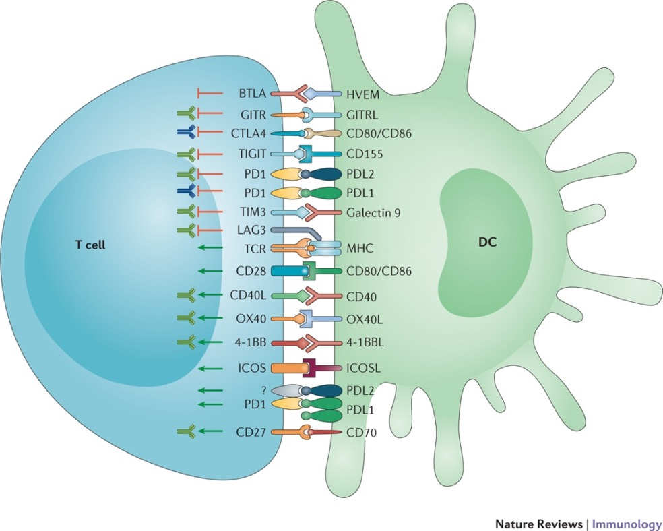
Checkpoints!… Agonists!... What Next?

Slide 8
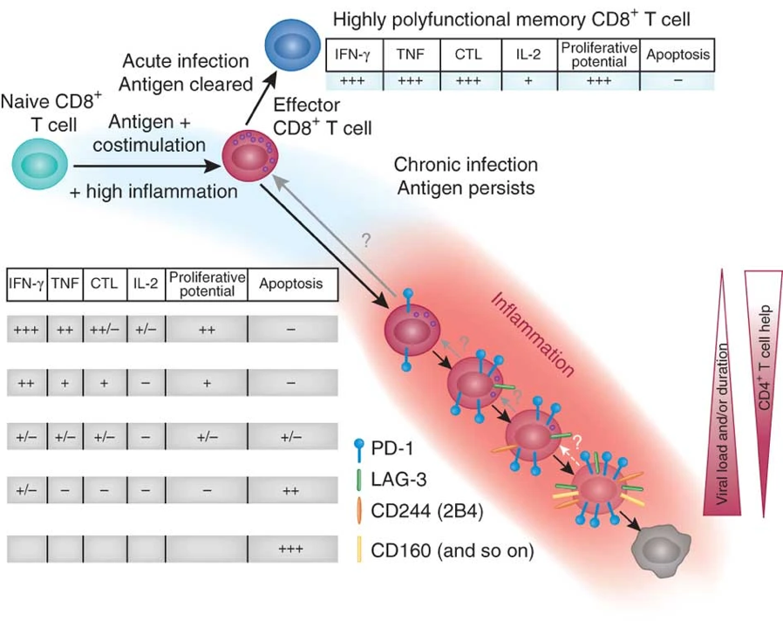
LAG-3 a Marker of T Cell Exhaustion
With chronic antigen stimulation, T cells progressively co-express inhibitory checkpoints
Expressed on CD4+ and CD8+ T cells
Also expressed on B cells, NK cells, T_{regs} and pDCs

Slide 9
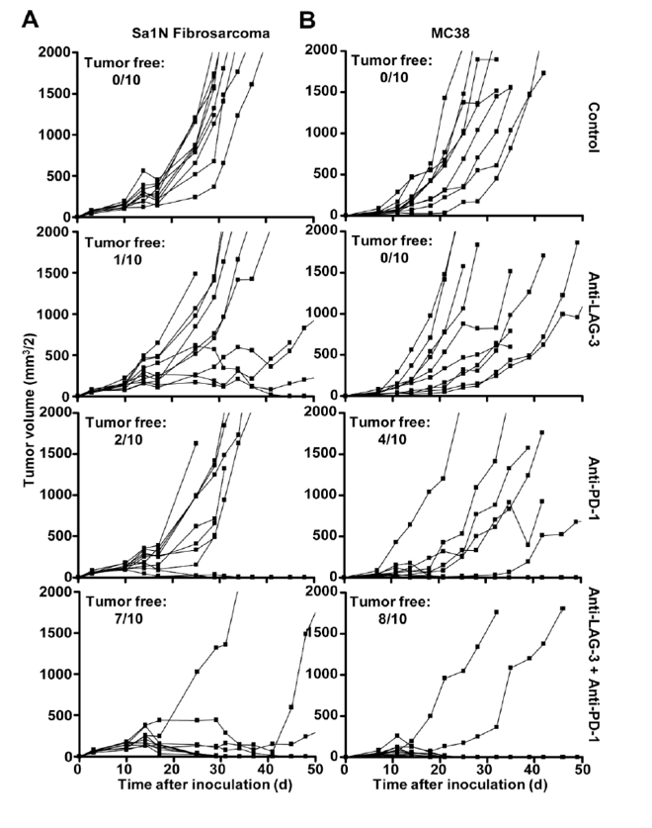
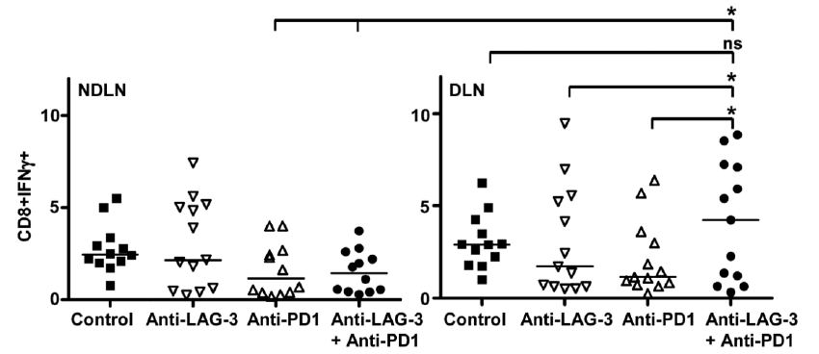
Anti-PD1/LAG-3 Combo in MC38, B16 models
Single agent Anti-LAG-3 relatlimab has little anti- tumor activity or T cell potentiation
Combination Anti-LAG-3 + Anti-PD1 synergistic with impressive tumor control correlative with increased CD8+ T cell activity

Slide 10
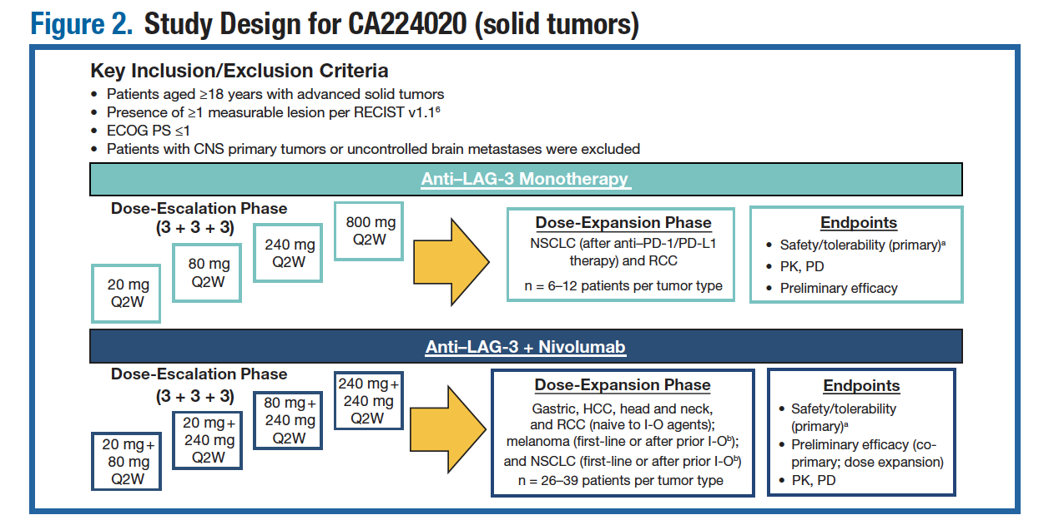
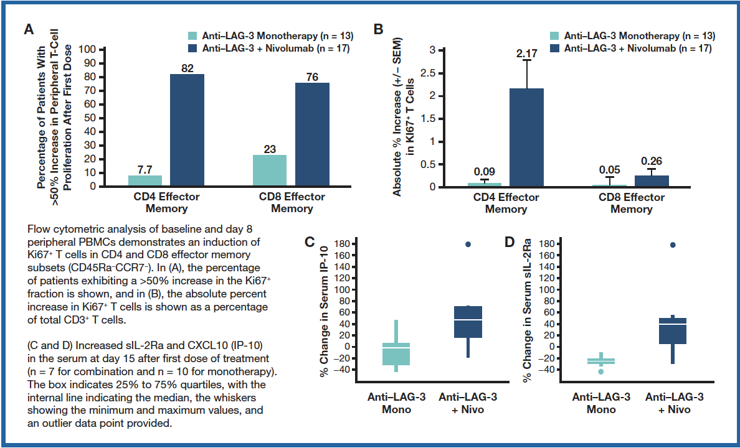
RELATIVITY-020: Monotherapy Versus Combination with Anti-PD-1
No activity in PD-1 refractory pts for single agent
Pharmacodynamic effects also indicating combo carries the impact

Slide 11
RELATIVITY-020: Efficacy in PD-1 Refractory Patients
Responses were more likely in patients with LAG-3 expression 1% or greater
PD-L1 expression did not appear to enrich for response
Among the overall study population, any-grade and grade 3 to 4 TRAEs were reported in 51% and 10% of patients, respectively
The safety profile of the melanoma prior PD-1 / PD-L1 cohort was similar to that of the overall population
LAG-3 ≥ 1%
n = 29
LAG-3 < 1%
n = 17
LAG-3 unknown
n = 8
100
100
100
80
45% with tumor reduction
80
24% with tumor reduction
80
13% with tumor reduction
60
60
60
40
40
40
Best % change in sum of target lesion diameters from baseline
20
20
20
0
0
0
-20
-20
-20
-40
-40
-40
-60
-60
-60
-80
-80
-80
-100
-100
-100
LAG-3 ≥ 1%
n = 29
LAG-3 < 1%
n = 17
LAG-3 unknown
n = 8
Pink: PD-L1 ≥ 1%
Blue: PD-L1 < 1%
Gray: PD-L1 unknown
100
80
60
: appearance of new lesions
40
Best % change in sum of target lesion diameters from baseline
20
0
-20
-40
-60
-80
-100
0
5
10
15
20
25
30
35
40
45
0
5
10
15
20
25
30
35
40
45
0
5
10
15
20
25
30
35
40
45
Weeks

Slide 12
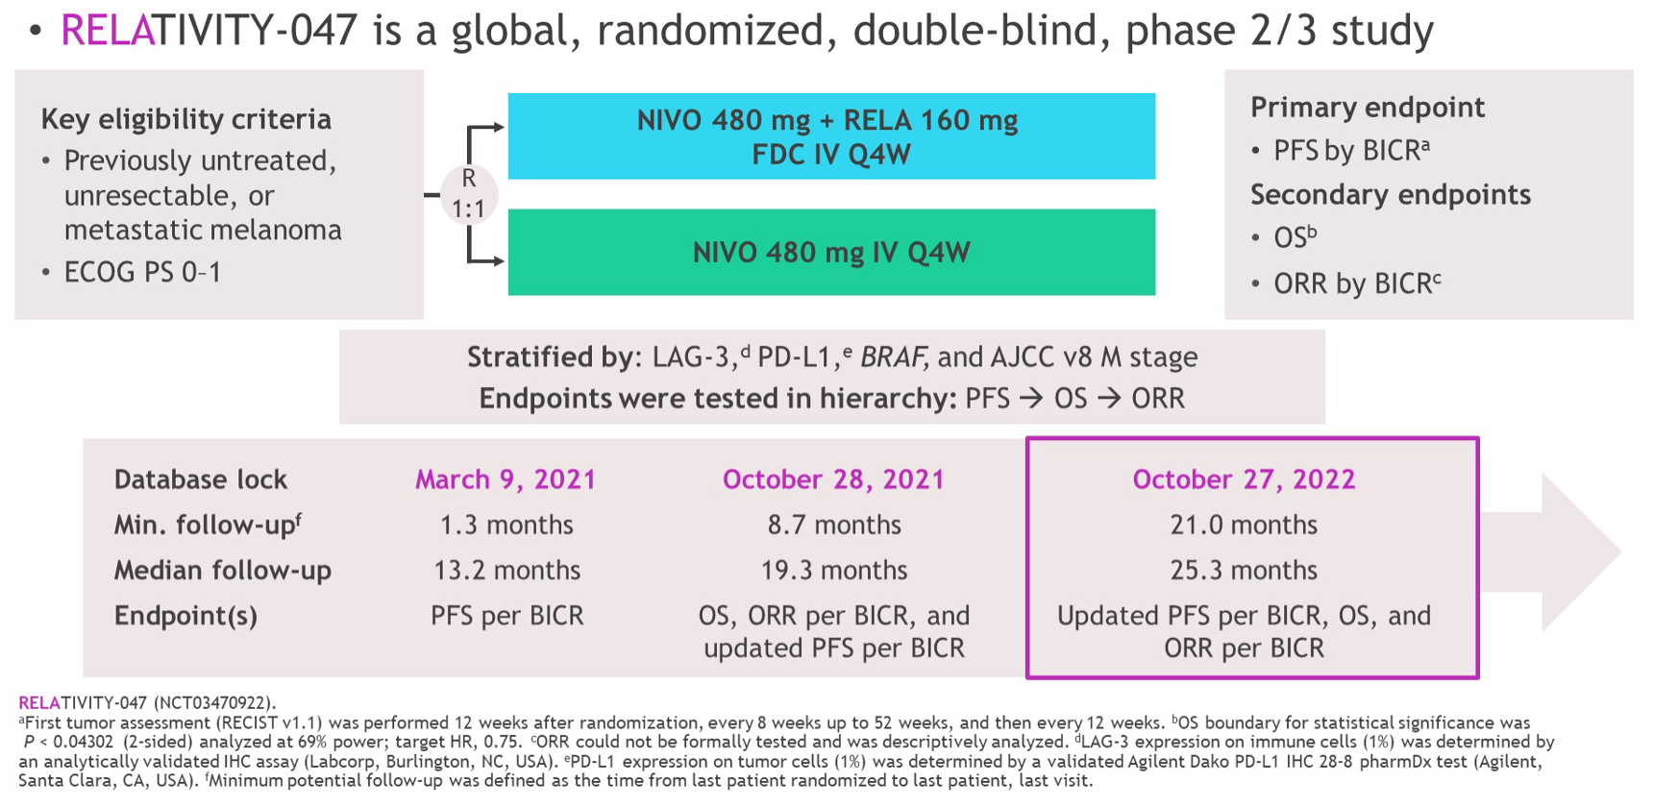
Study Design

Slide 13
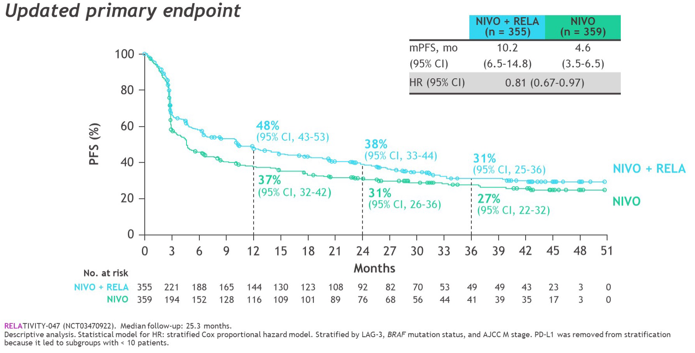
PFS by BICR

Slide 14
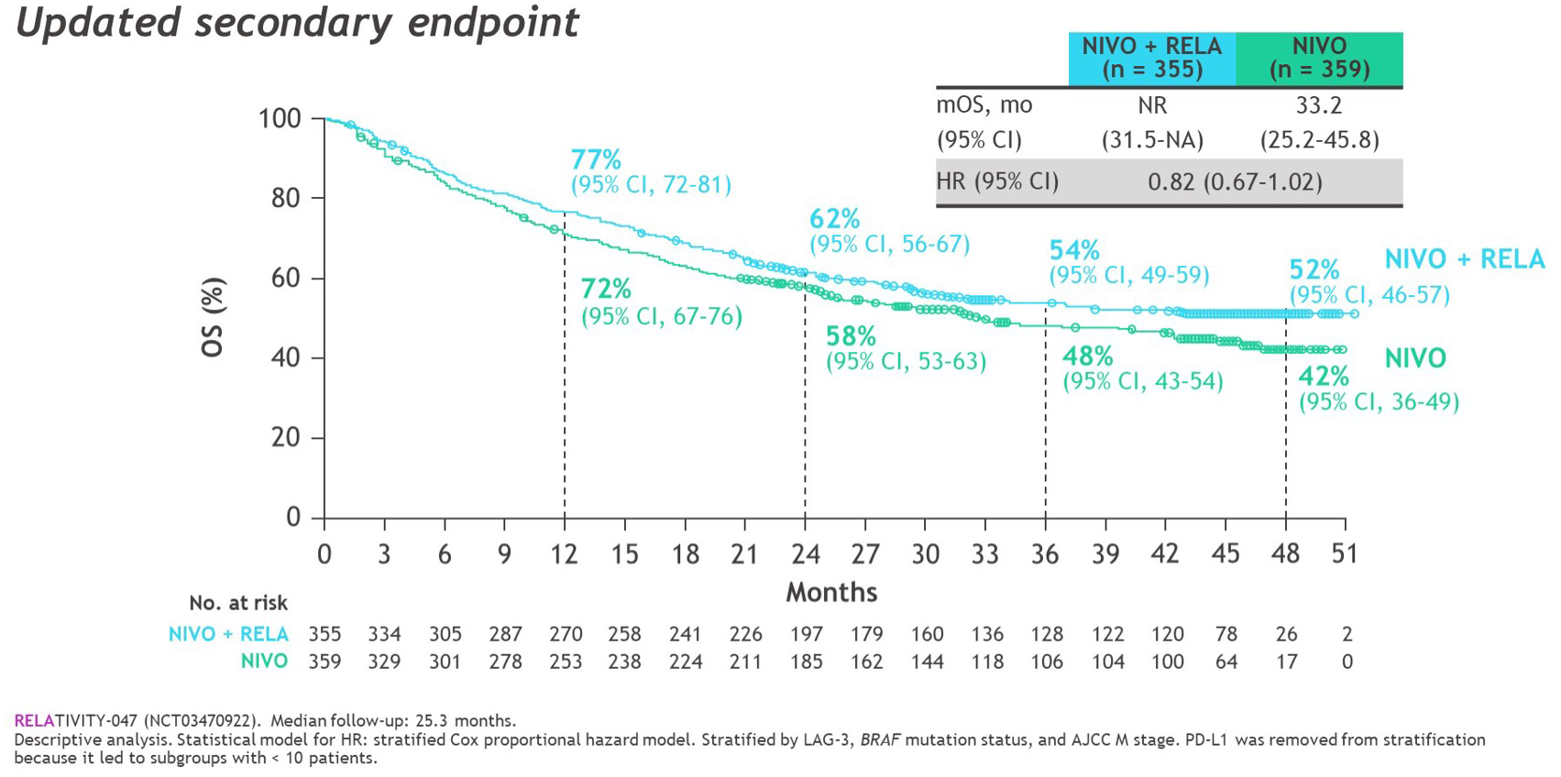
OS

Slide 15
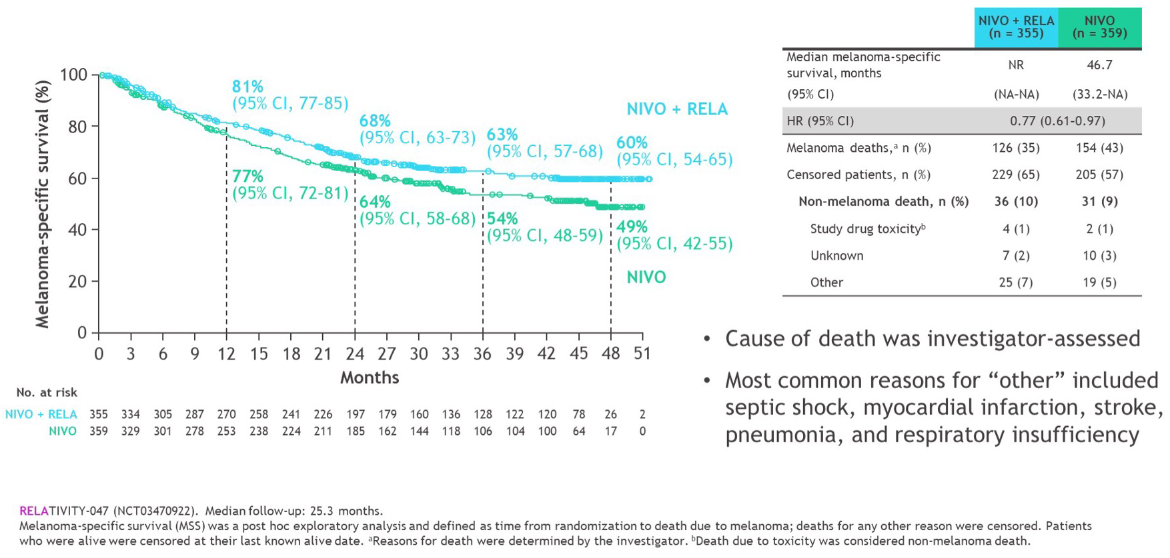
Melanoma-Specific Survival

Slide 16
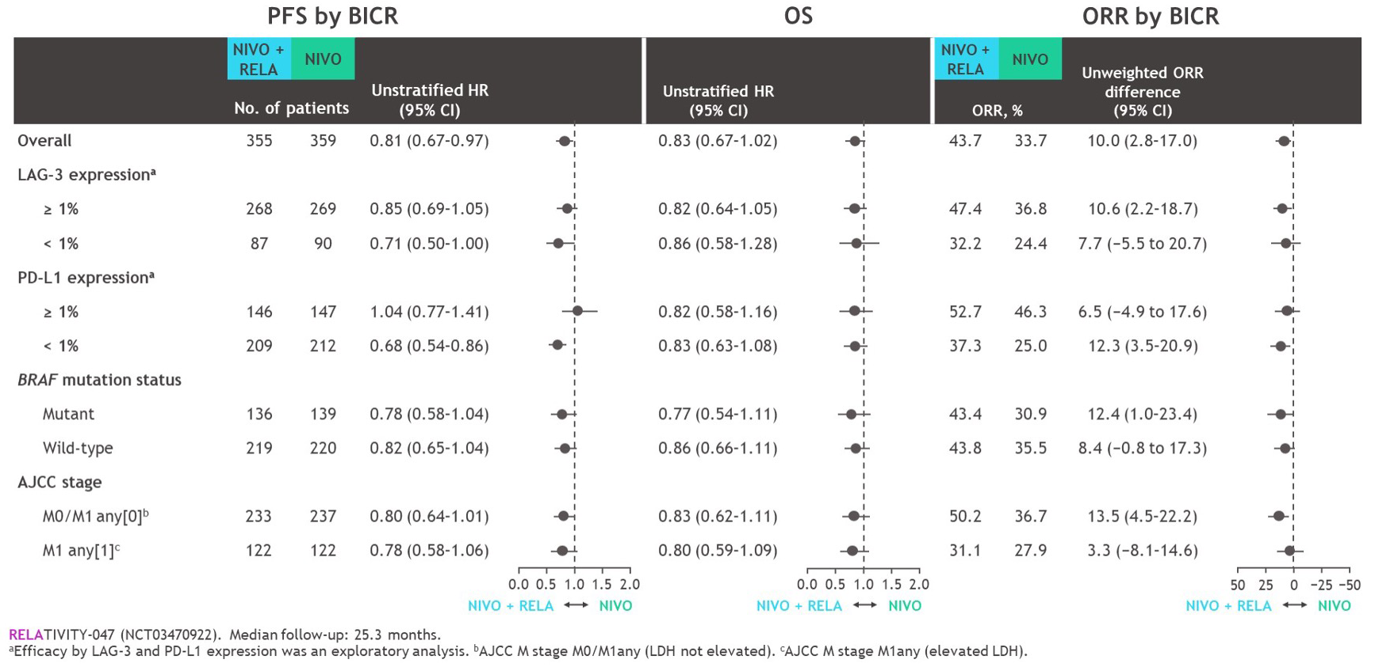
PFS, OS, and ORR by Stratification Factors

Slide 17
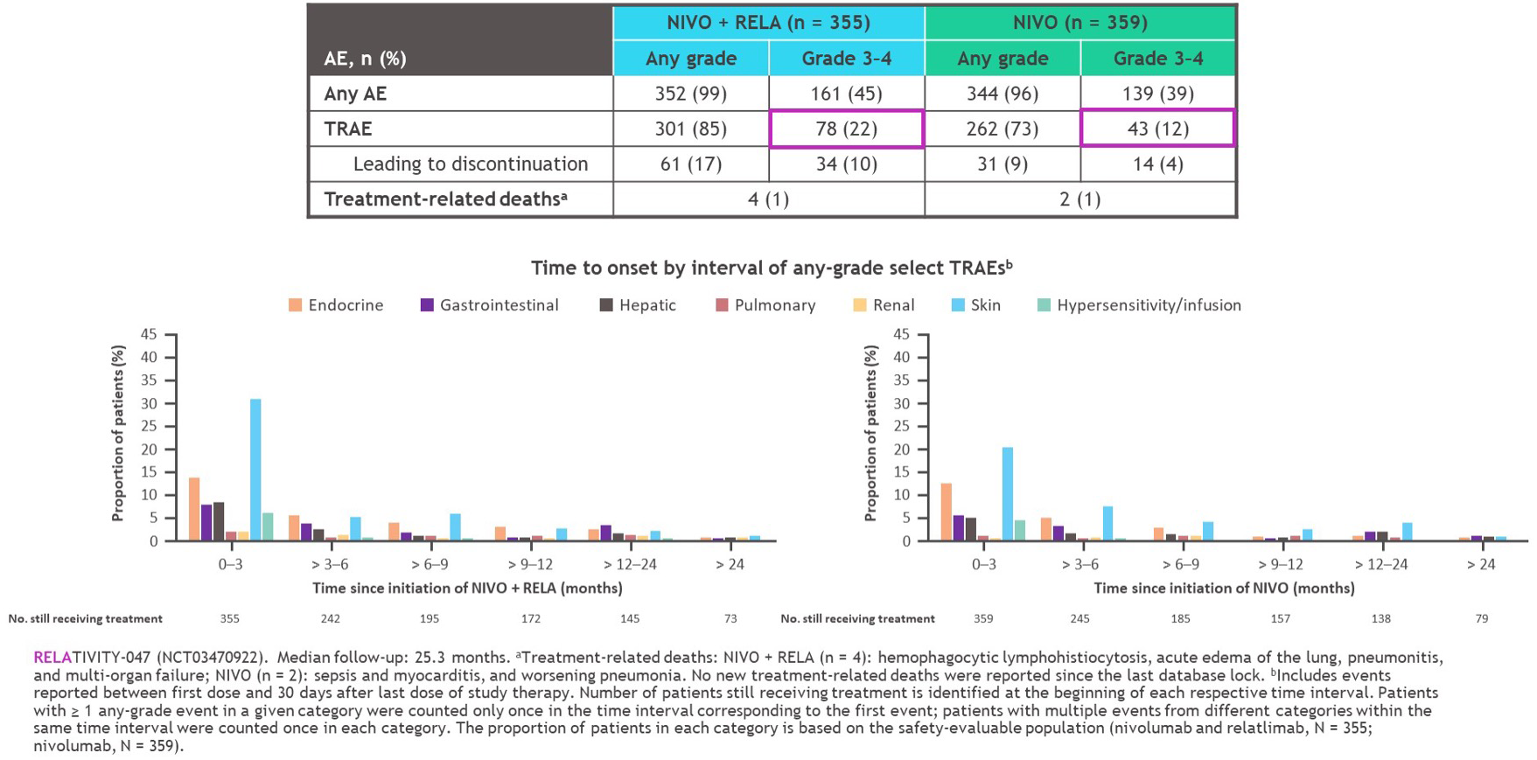
Safety Summary

Slide 18
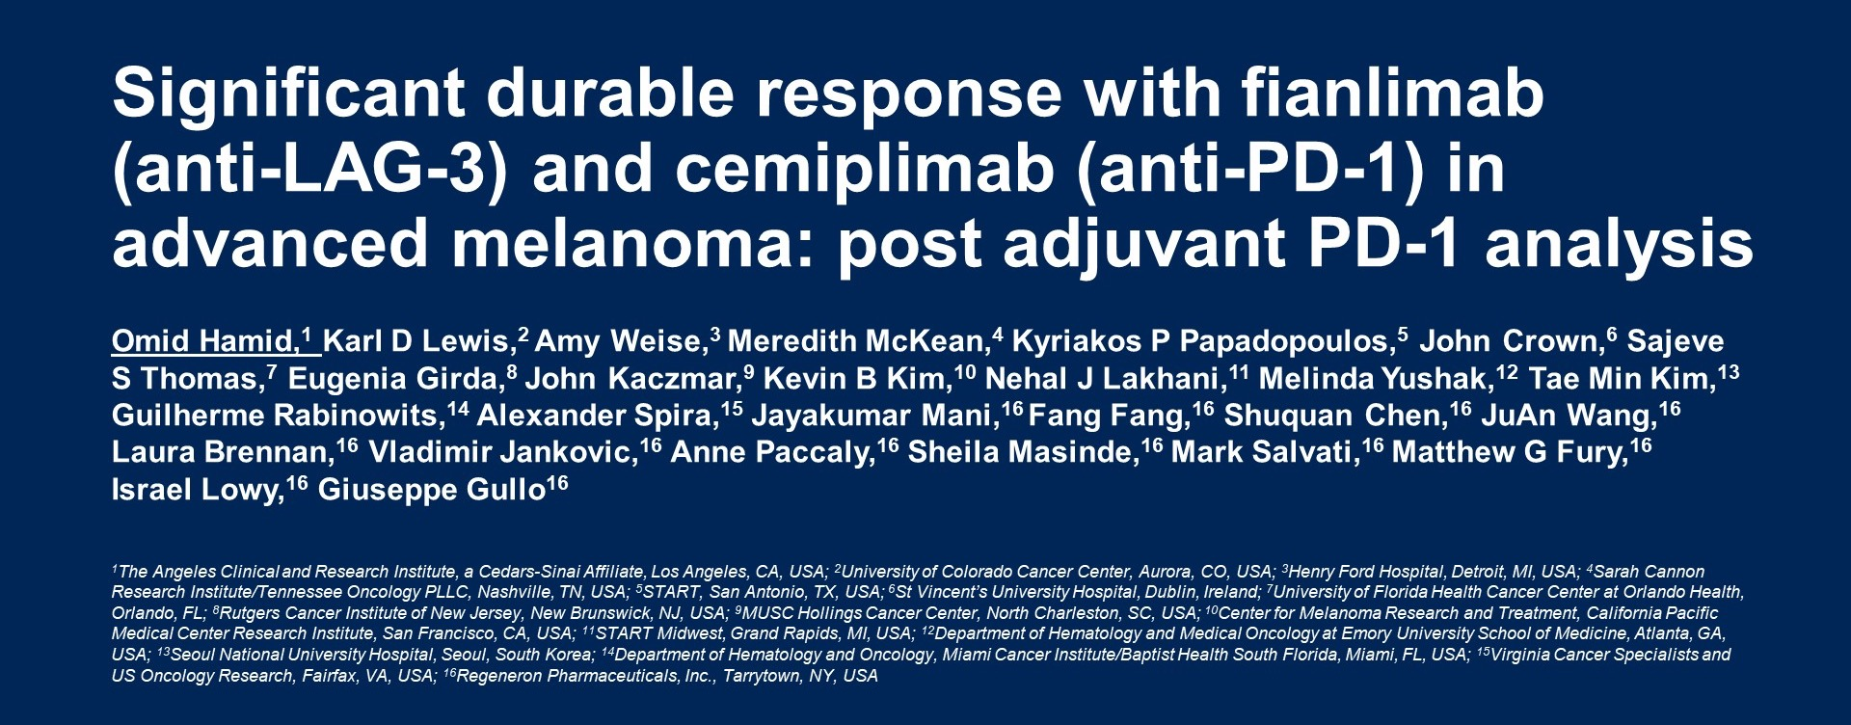
Significant durable response with fianlimab <br />(anti-LAG-3) and cemiplimab (anti-PD-1) in advanced melanoma: post adjuvant PD-1 analysis

Slide 19
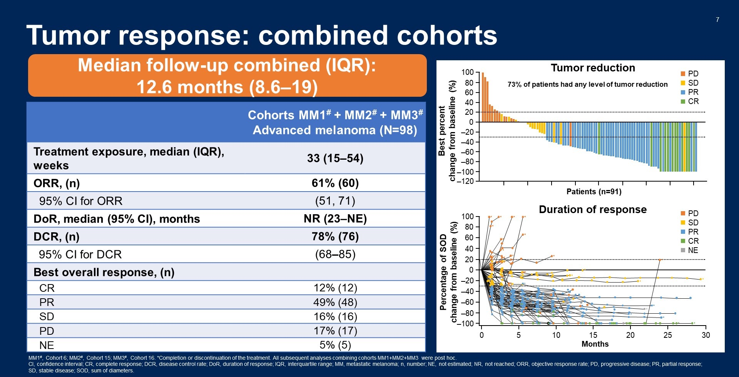
Tumor response: combined cohorts

Slide 20
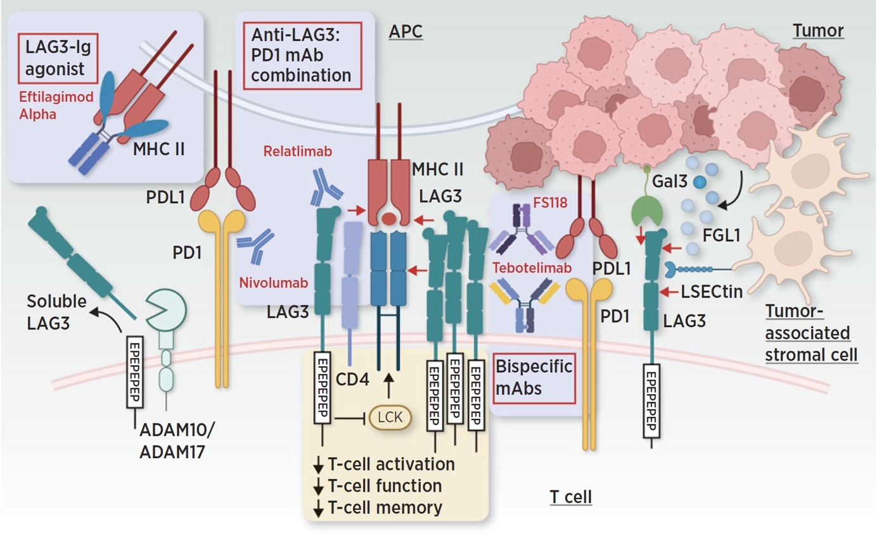
Agents in Development Targeting LAG-3

Slide 21
Summary
LAG-3 is a novel checkpoint with unique immune suppressive properties
LAG-3 blockade is now validated as a therapeutic target in combination with anti-PD-1
The relatlimab/nivolumab combination significantly improved PFS and ORR compared to nivolumab monotherapy
FDA approval in melanoma starts a new era of melanoma treatment

Slide 22



Looking for more resources
on this topic?
CME/CE in minutes
Congress highlights
Late-breaking data
Quizzes
Webinars
In-person events
Slides & resources
www.MedEdOTG.com

