Slide 1
Patient Case: Tailoring First-Line Treatment for a Patient with Metastatic Melanoma and Impaired Performance Status
Hussein Tawbi, MD, PhD
Professor
Deputy Chair, Department of Melanoma Medical Oncology
Co-Director, Andrew M. McDougall Brain Metastasis Clinic & Program
Melanoma Medical Oncology, Investigational Cancer Therapeutics
Houston, TX

Slide 2



Resource Information
About This Resource
These slides are one component of a continuing education program available online at MedEd On The Go titled Leveraging LAG-3: Innovative Immunotherapy Combinations for First-Line Metastatic Melanoma Treatment
Program Learning Objectives:
Describe the synergistic interaction between LAG-3 and other immune checkpoints
Evaluate recent practice-changing data on the use of LAG-3/PD-1 combination ICI therapy in patients with
metastatic melanoma
Select appropriate evidence-based dual ICI treatment regimens for newly diagnosed patients with metastatic melanoma
Recognize and manage treatment-related adverse events associated with the use of LAG-3/PD-1 combination ICI regimens
MedEd On The Go®
www.mededonthego.com
This content or portions thereof may not be published, posted online or used in presentations without permission.
This content can be saved for personal use (non-commercial use only) with credit given to the resource authors.
To contact us regarding inaccuracies, omissions or permissions please email us at support@MedEdOTG.com

Slide 3
Disclaimer
The views and opinions expressed in this educational activity are those of the faculty and do not necessarily represent the views of Total CME, LLC, the CME providers, or the companies providing educational grants. This presentation is not intended to define an exclusive course of patient management; the participant should use their clinical judgment, knowledge, experience, and diagnostic skills in applying or adopting for professional use any of the information provided herein. Any procedures, medications, or other courses of diagnosis or treatment discussed or suggested in this activity should not be used by clinicians without evaluation of their patient's conditions and possible contraindications or dangers in use, review of any applicable manufacturer’s product information, and comparison with recommendations of other authorities. Links to other sites may be provided as additional sources of information.

Slide 4
Patient Case: 65-Year-Old Woman with Metastatic Melanoma
Pertinent medical history:
Initially diagnosed stage IIIB and received adjuvant NIVO following resection, presenting with recurrence in lung 2 years later
Assessment and diagnosis
Imaging
Metastatic disease to the lung, lymph nodes, no brain metastases
ECOG PS/LDH
PS 1 (uses a cane)/LDH normal
BRAF status
BRAF mutant
Comorbidities
Diabetes, hypertension
NIVO + RELA
Why?
What systemic therapy would you consider?
Stage: M1b disease
No brain mets
No precluding comorbidities
NIVO + IPI
PD-1 monotherapy
BRAF/MEK Inhibitors
4

Slide 5
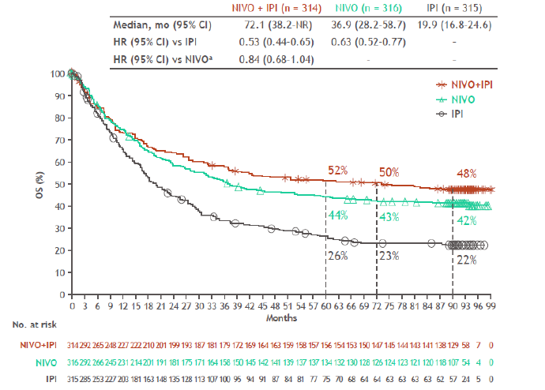
CheckMate 067: 7.5-Year Overall Survival

Slide 6
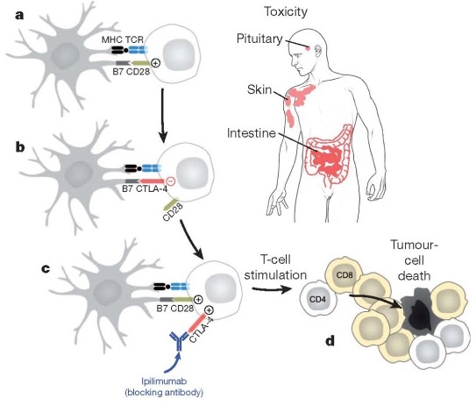
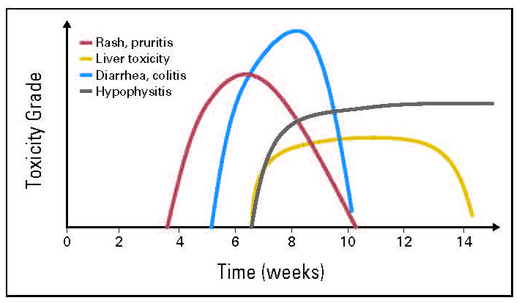
Toxicity: Organs, Incidence, and Patterns

Slide 7
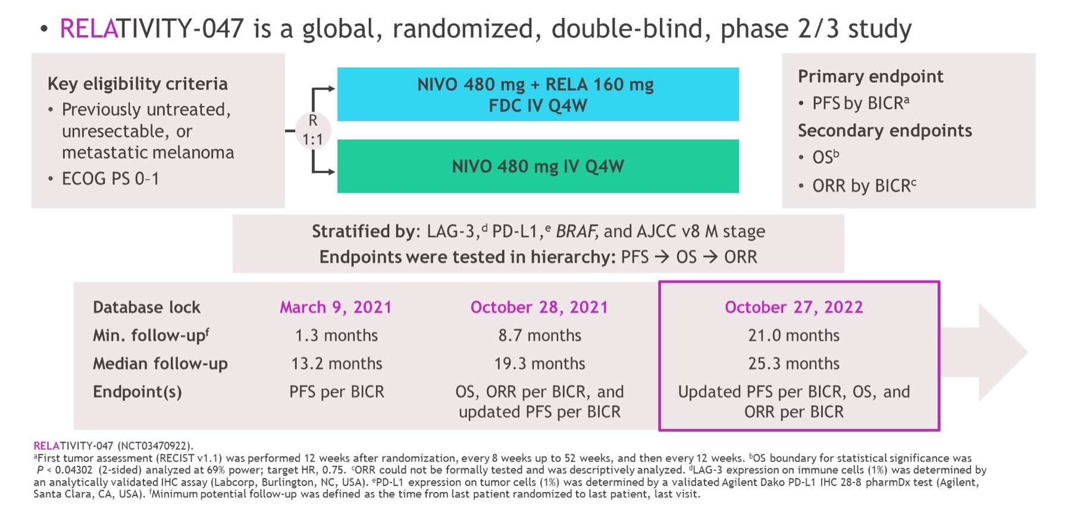
RELATIVITY-047: Study Design

Slide 8
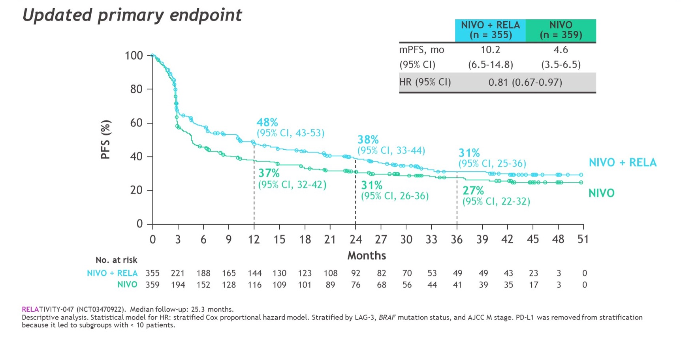
RELATIVITY-047: Progression Free Survival by BICR

Slide 9
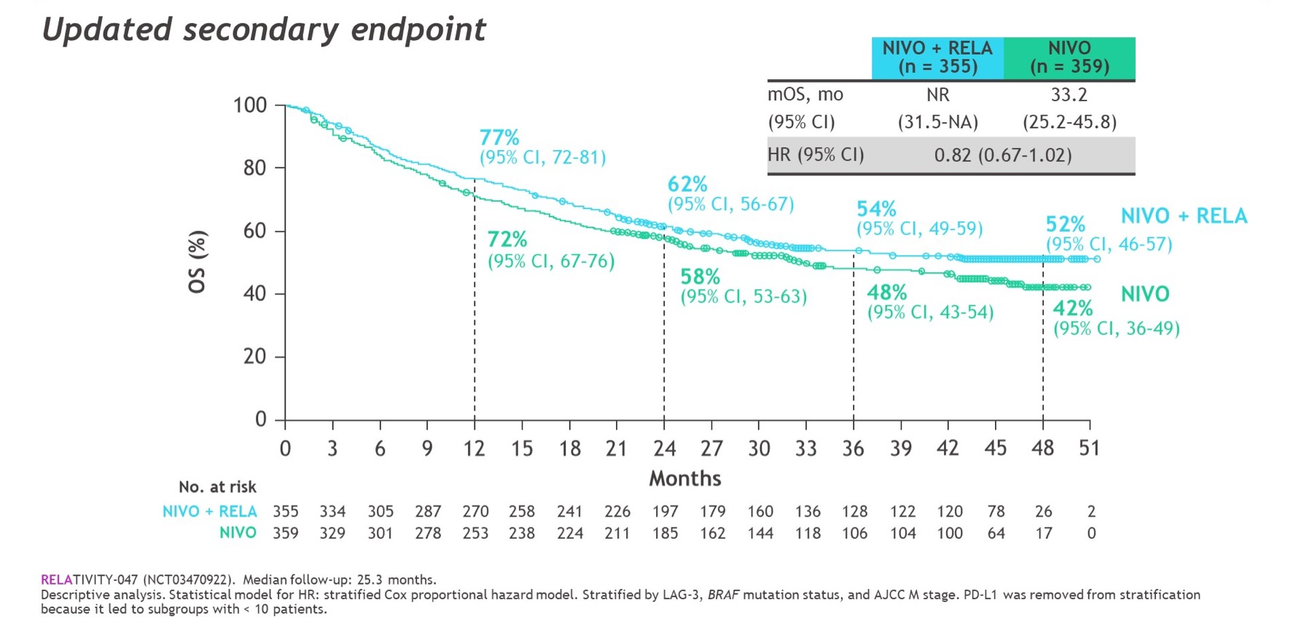
RELATIVITY-047: Overall Survival

Slide 10
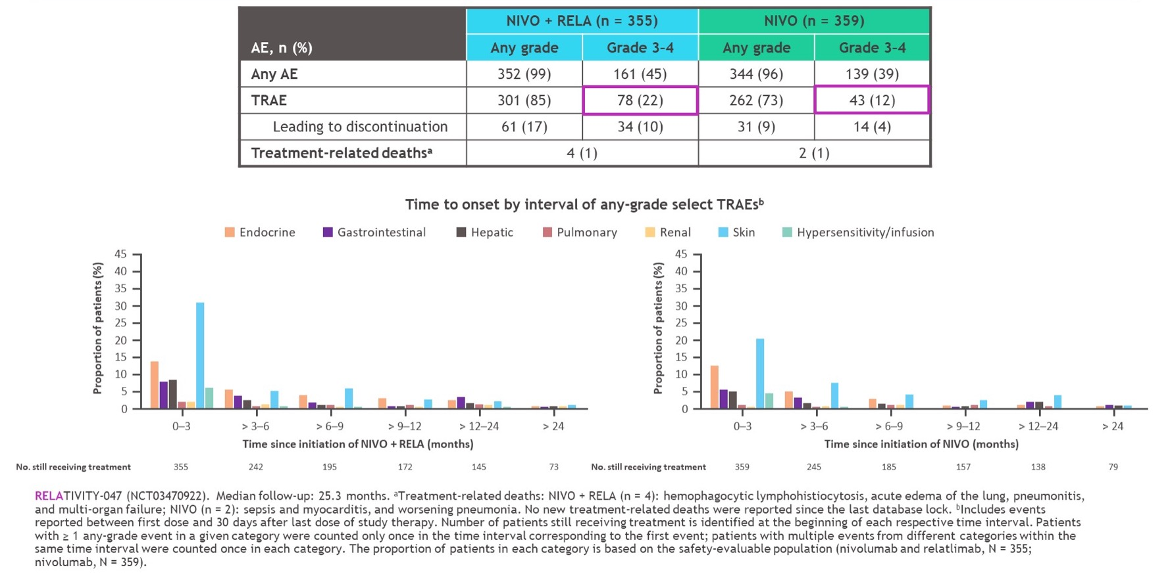
RELATIVITY-047 Safety Summary

Slide 11
RELATIVITY-020: Efficacy in PD-1 Refractory
Responses were more likely in patients with LAG-3 expression 1% or greater
PD-L1 expression did not appear to enrich for response
Among the overall study population,ª any-grade and grade 3 to 4 TRAEs were reported in 51% and 10% of patients, respectively
The safety profile of the melanoma prior PD-1/PD-L1 cohort was similar to that of the overall population
LAG-3 ≥ 1%
n = 29
LAG-3 < 1%
n = 17
LAG-3 unknown
n = 8
100
100
100
80
45% with tumor reduction
80
24% with tumor reduction
80
13% with tumor reduction
60
60
60
40
40
40
Best % change in sum of target lesion diameters from baseline^{b,c}
20
20
20
0
0
0
-20
-20
-20
-40
-40
-40
-60
-60
-60
-80
-80
-80
-100
-100
-100
LAG-3 ≥ 1%
n = 29
LAG-3 < 1%
n = 17
LAG-3 unknown
n = 8
Pink: PD-L1 ≥ 1%
Blue: PD-L1 < 1%
Gray: PD-L1 unknown
100
80
60
: appearance of new lesions
40
Best % change in sum of target lesion diameters from baseline^{b}
20
0
-20
-40
-60
-80
-100
0
5
10
15
20
25
30
35
40
45
0
5
10
15
20
25
30
35
40
45
0
5
10
15
20
25
30
35
40
45
Weeks

Slide 12
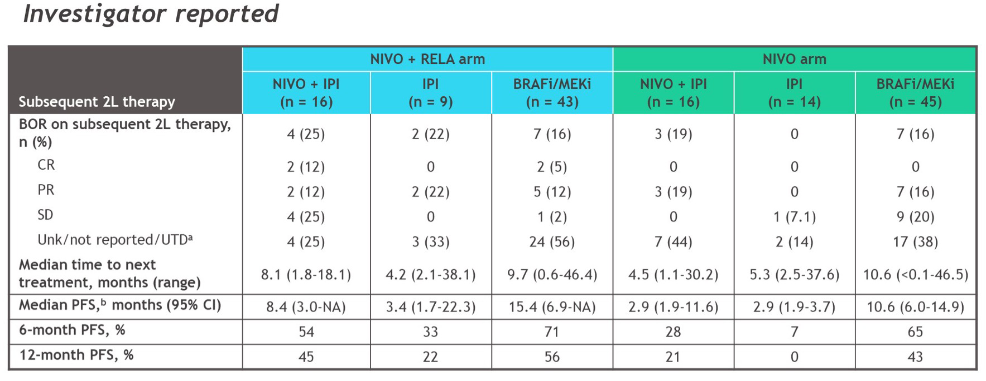
Efficacy on 2L Systemic Therapy Following Progression

Slide 13
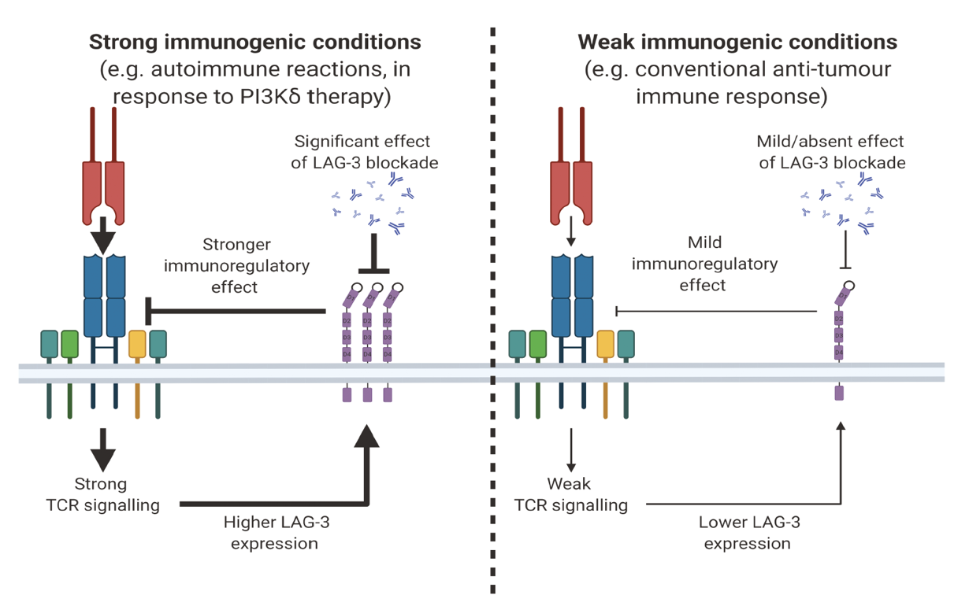
Why Increased Activity in First Line?
Given its impact on modulating TCR signaling, effect is amplified in conditions of strong immunogenic signaling
Earlier stage of disease has less T cell exhaustion, more TCR signaling

Slide 14
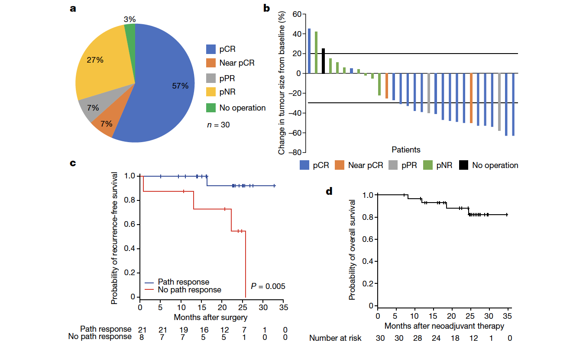
Neoadjuvant Relatlimab + Nivolumab
pCR of 57%
No grade 3 to 4 toxicity in neoadjuvant phase
pCR associated with excellent RFS

Slide 15

Phase II of Nivo + Rela in Untreated MBM (BLUEBONNET)
Cohort
Safety MRI to monitor intracranial disease at
4 weeks*
Efficacy MRI to monitor intracranial response at
12 weeks
NIVO 480mg+RELA 160mg q4w
NIVO 480mg+RELA 160mg q4w x 2 doses
n = 30
NIVO 480mg+RELA 160mg q4w
Clinically stable
Responders
*Not a response imaging evaluation, asymptomatic progression will be allowed to continue.
◊SRS allowed at progression as needed
Key eligibility:
1 or greater measurable, unirradiated MBM (0.5-3.0 cm)
Prior SRT in 5 or less MBM
Previous treatment with BRAFi/MEKi permitted
No prior checkpoint inhibitor therapy for advanced disease
Exclusion criteria: Neurological symptoms; steroids greater than 10 days; WBRT; prior treatment with checkpoint inhibitors; leptomeningeal disease
  Primary endpoint: Intracranial ORR by modified RECIST
  Select secondary endpoints: CBR, PFS, OS
  Exploratory endpoint: SRS-assisted PFS
  Hypothesis: Nivo + rela is safe and will result in higher intracranial efficacy comparable to nivo alone
  Statistics- 82% power to detect difference between 20% and 40%, BOP2 futility monitoring

Slide 16
Summary
Nivolumab/relatlimab:
  Provides an ORR and PFS benefit over anti-PD-1 monotherapy in the treatment of metastatic melanoma
  Demonstrates rates of grade 3/4 toxicity significantly less than that seen with combined anti-CTLA4/anti-PD-1 therapy
  Offers the benefit of dual checkpoint inhibition with reduced toxicity
  First line may be most effective
  Data in other populations being generated
FDA approval of nivolumab/relatlimab provides a dual checkpoint inhibition option for those who have reduced performance status and/or are not candidates for anti-CTLA4/anti-PD-1 therapy

Slide 17



Looking for more resources
on this topic?
CME/CE in minutes
Congress highlights
Late-breaking data
Quizzes
Webinars
In-person events
Slides & resources
www.MedEdOTG.com

