Slide 1
Unlocking Synergy: Exploring the Interaction Between LAG-3 and Other Immune Checkpoints
Hussein Tawbi, MD, PhD
Professor
Deputy Chair, Department of Melanoma Medical Oncology
Co-Director, Andrew M. McDougall Brain Metastasis Clinic & Program
Melanoma Medical Oncology, Investigational Cancer Therapeutics
UT MD Anderson Cancer Center
Houston, TX

Slide 2
Resource Information
About This Resource
These slides are one component of a continuing education program available online at MedEd On The Go titled Leveraging LAG-3: Innovative Immunotherapy Combinations for First-Line Metastatic Melanoma Treatment
Program Learning Objectives:
Describe the synergistic interaction between LAG-3 and other immune checkpoints
Evaluate recent practice-changing data on the use of LAG-3/PD-1 combination ICI therapy in patients with metastatic melanoma
Select appropriate evidence-based dual ICI treatment regimens for newly diagnosed patients with metastatic melanoma
Recognize and manage treatment-related adverse events associated with the use of LAG-3/PD-1 combination ICI regimens
MedEd On The Go®
www.mededonthego.com
This content or portions thereof may not be published, posted online or used in presentations without permission.
This content can be saved for personal use (non-commercial use only) with credit given to the resource authors.
To contact us regarding inaccuracies, omissions or permissions please email us at support@MedEdOTG.com

Slide 3
Disclaimer
The views and opinions expressed in this educational activity are those of the faculty and do not necessarily represent the views of Total CME, LLC, the CME providers, or the companies providing educational grants. This presentation is not intended to define an exclusive course of patient management; the participant should use their clinical judgment, knowledge, experience, and diagnostic skills in applying or adopting for professional use any of the information provided herein. Any procedures, medications, or other courses of diagnosis or treatment discussed or suggested in this activity should not be used by clinicians without evaluation of their patient's conditions and possible contraindications or dangers in use, review of any applicable manufacturer’s product information, and comparison with recommendations of other authorities. Links to other sites may be provided as additional sources of information.

Slide 4
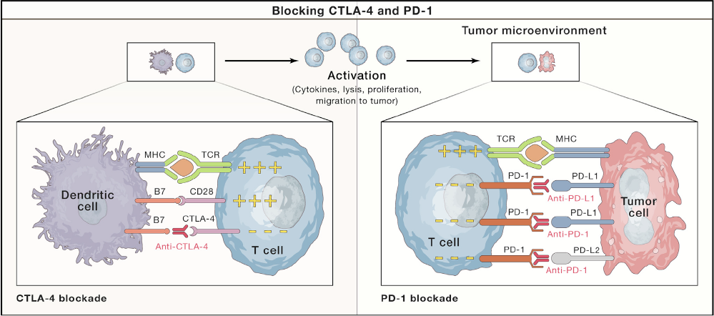
Regulation of Interactions Between Antigen-Presenting Cells, Tumor Cells, and T Cells by the CTLA-4 and PD-1 Pathways

Slide 5
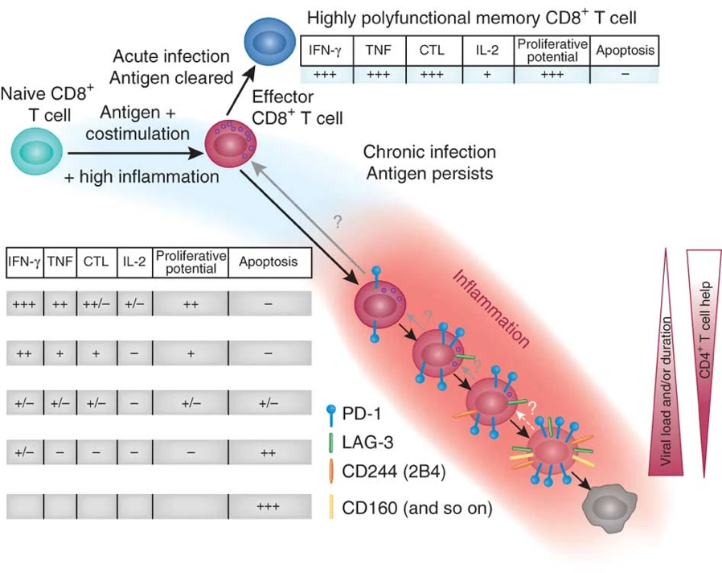
LAG-3: A Marker of T Cell Exhaustion
With chronic antigen stimulation, T cells progressively co-express inhibitory checkpoints
Expressed on CD4+ and CD8+ T cells
Also expressed on B cells, NK cells, T_{regs} and pDCs

Slide 6
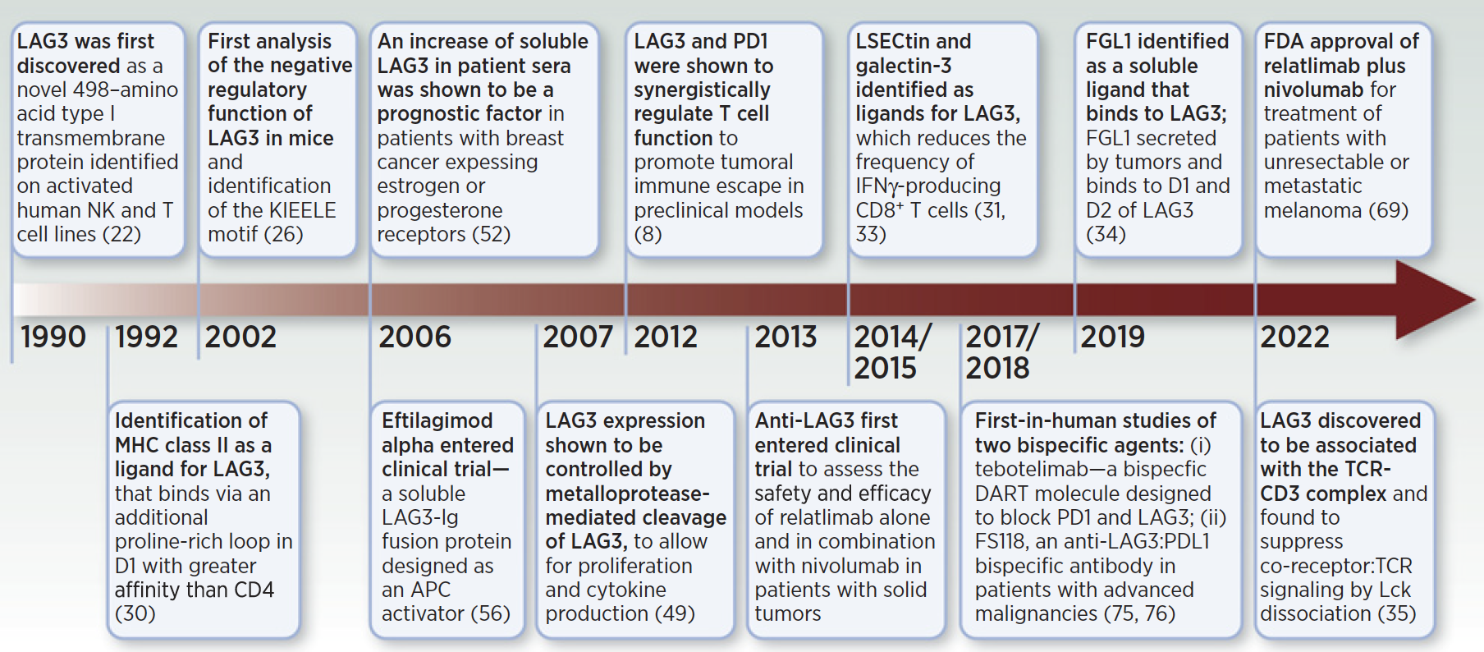
Milestones in LAG-3 Blockade

Slide 7
Milestones in LAG-3 Blockade

Slide 8
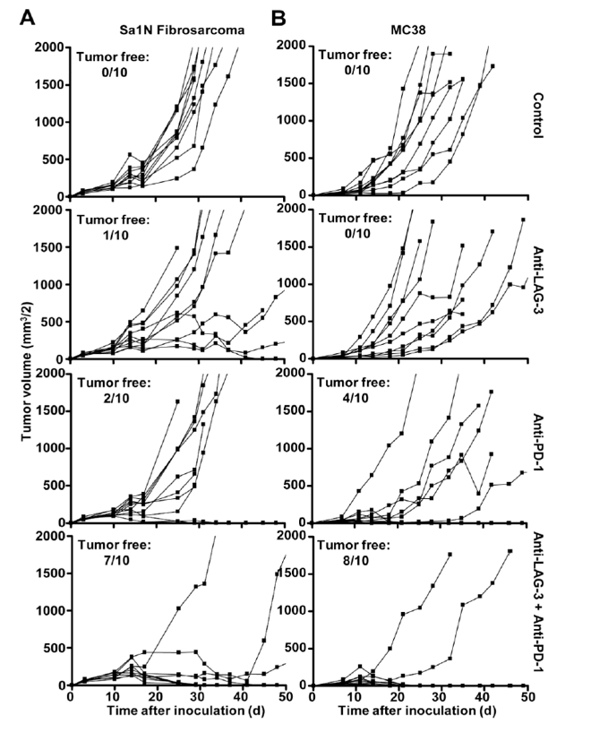
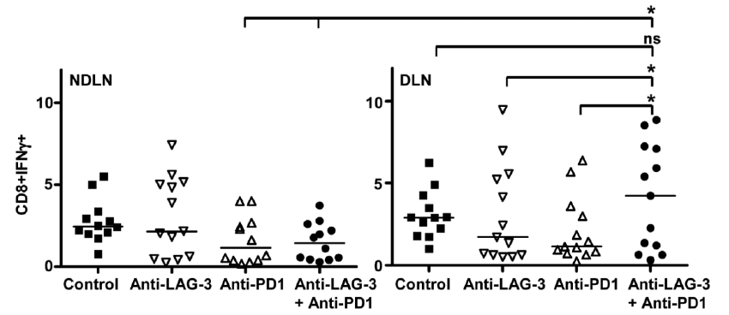
Anti-PD1/LAG-3 Combination in MC38, B16 Models
Single agent anti-LAG-3 relatlimab has little anti- tumor activity or T cell potentiation
Combination anti-LAG-3 + anti-PD1 is synergistic with impressive tumor control correlative with increased CD8+ T cell activity

Slide 9
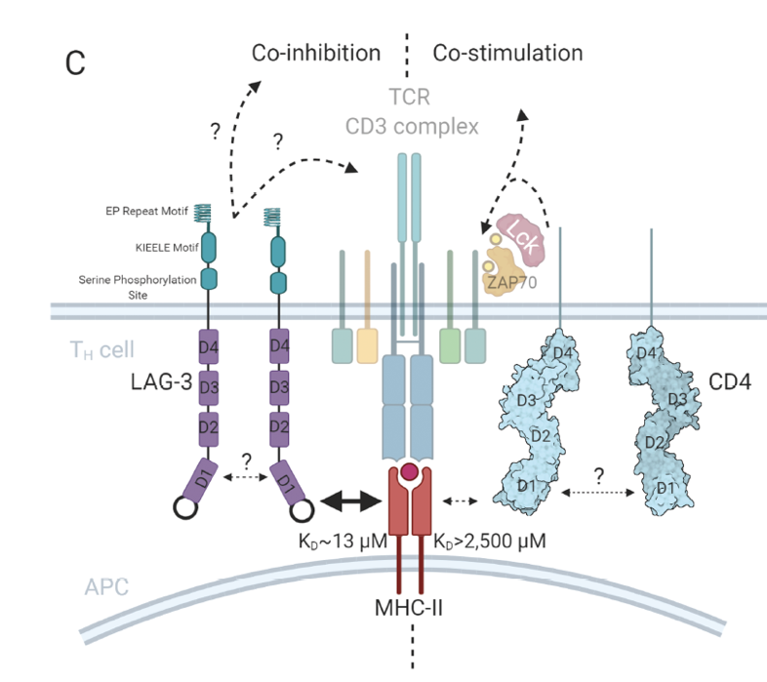
LAG-3 Intracellular Signaling
LAG-3 dimerization required for optimal MHCII binding
No ITIM & unique intracellular KIEELE motif
Role of EP Repeat & Serine phosphorylation site FxxL more relevant
Co-localization with TCR/CD3 complex
LAG-3 activation leads to decreased ZAP70 phosphorylation
LAG-3 modulates TCR signaling

Slide 10
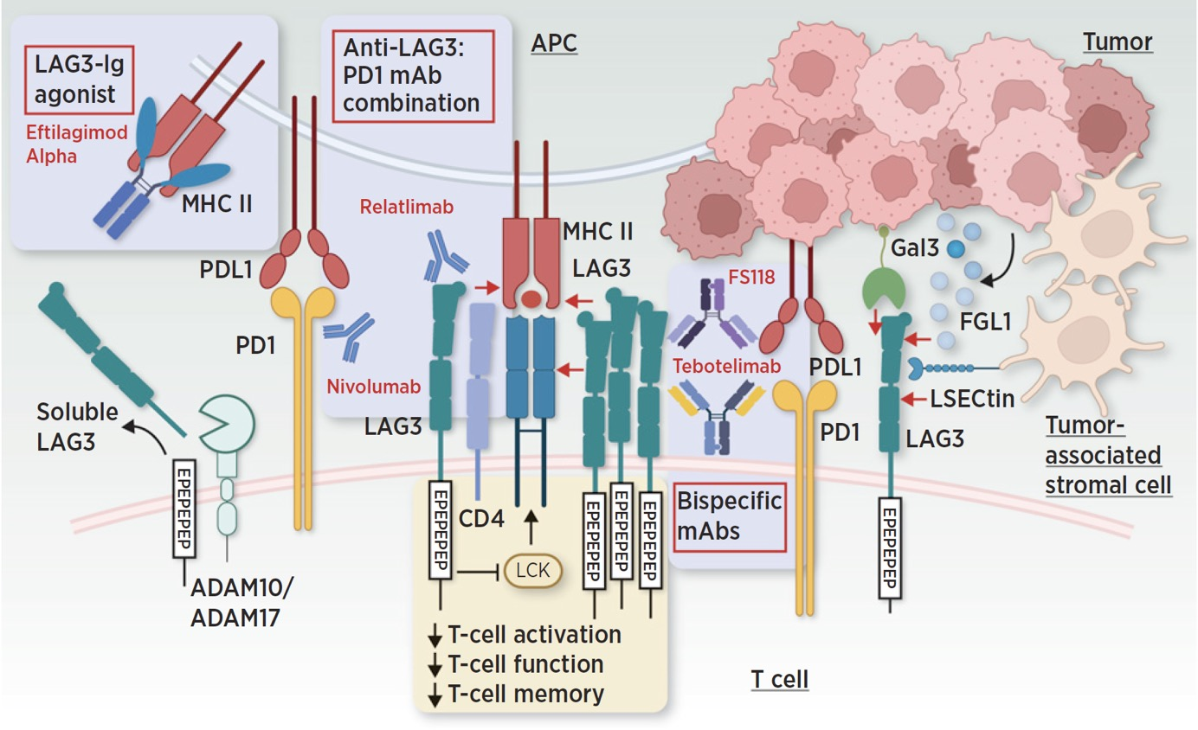
Agents in Development Targeting LAG-3

Slide 11
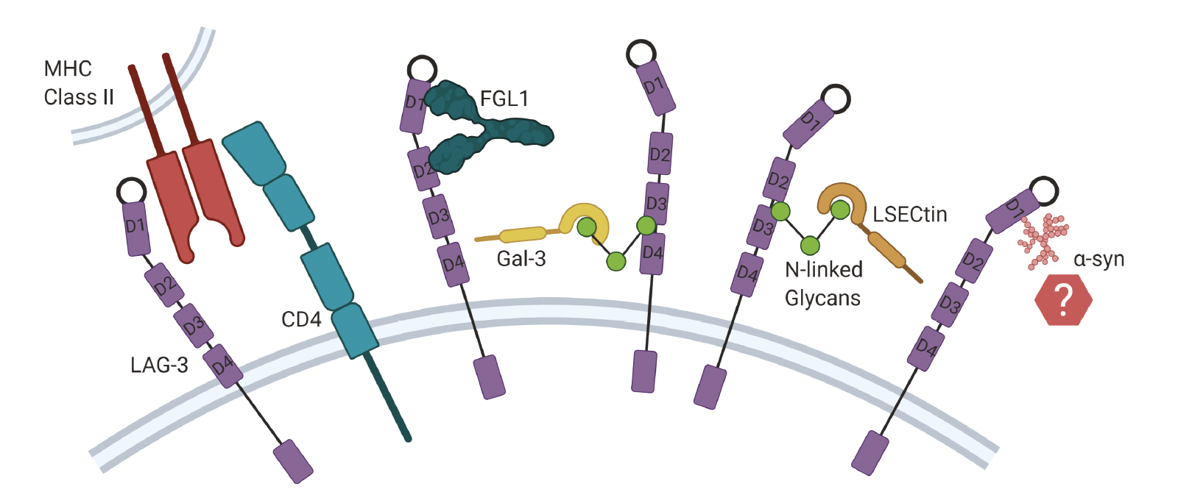
LAG-3 Ligand, MHC Class II?

Slide 12
Take Home Message
LAG-3 is a novel checkpoint with unique immune suppressive properties
There is observed synergy between LAG-3 and PD-1 in maintaining immune homeostasis in tumors and immune-mediated diseases
LAG-3 blockade is now validated as a therapeutic target in combination with anti-PD1 agents

Slide 13
Looking for more resources on this topic?
CME/CE in minutes
Congress highlights
Late-breaking data
Quizzes
Webinars
In-person events
Slides & resources
www.MedEdOTG.com

