Slide 1
Frontline Treatment: A Patient With BRAF WT Metastatic Melanoma - What Is the Optimal ICI Regimen?
Jason J. Luke, MD, FACP
Interim Associate Director for Clinical Research
Director - Immunotherapy and Drug Development Center
Associate Professor of Medicine
UPMC Hillman Cancer Center and University of Pittsburgh
Pittsburgh, PA
Elizabeth Buchbinder, MD
Assistant Professor, Dana-Farber Cancer Institute
Harvard Medical School
Boston, MA

Slide 2
Resource Information
About This Resource
These slides are one component of a continuing education program available online at MedEd On The Go titled Metastatic Melanoma: Solving Clinical Dilemmas in Frontline ICI Treatment
Program Learning Objectives:
Review the risks and benefits of dual immune checkpoint inhibition and identify patient and disease characteristics that may impact the choice of therapy
Use data to determine optimal treatment sequencing for BRAF-mutated, metastatic melanoma
Review clinical challenges surrounding the use of immune checkpoint inhibitors in metastatic melanoma
MedEd On The Go®
www.mededonthego.com
This content or portions thereof may not be published, posted online or used in presentations without permission.
This content can be saved for personal use (non-commercial use only) with credit given to the resource authors.
To contact us regarding inaccuracies, omissions or permissions please email us at support@MedEdOTG.com

Slide 3
Disclaimer
The views and opinions expressed in this educational activity are those of the faculty and do not necessarily represent the views of Total CME, LLC, the CME providers, or the companies providing educational grants. This presentation is not intended to define an exclusive course of patient management; the participant should use their clinical judgment, knowledge, experience, and diagnostic skills in applying or adopting for professional use any of the information provided herein. Any procedures, medications, or other courses of diagnosis or treatment discussed or suggested in this activity should not be used by clinicians without evaluation of their patient's conditions and possible contraindications or dangers in use, review of any applicable manufacturer’s product information, and comparison with recommendations of other authorities. Links to other sites may be provided as additional sources of information.

Slide 4
A Patient With BRAF Wild-type (WT) Metastatic Melanoma
64-year-old woman diagnosed with T4a melanoma on the posterior left leg
WLE and SLN negative. At the time no adjuvant therapy considered
Recurrence with multiple pulmonary, nodal, and L4 lesions
Patient asymptomatic, LDH elevated
Biopsy of nodal metastases showing BRAF WT, NRAS Q61R, PD-L1+

Slide 5
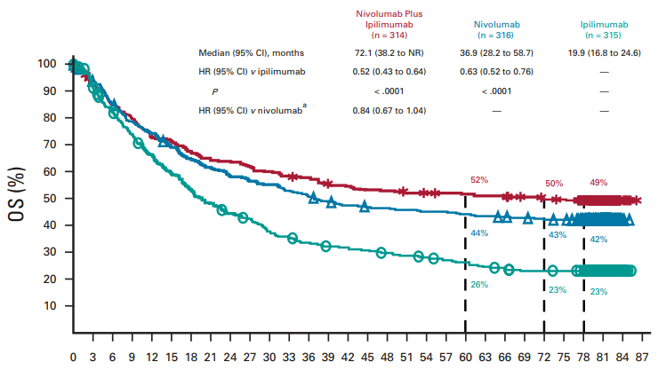
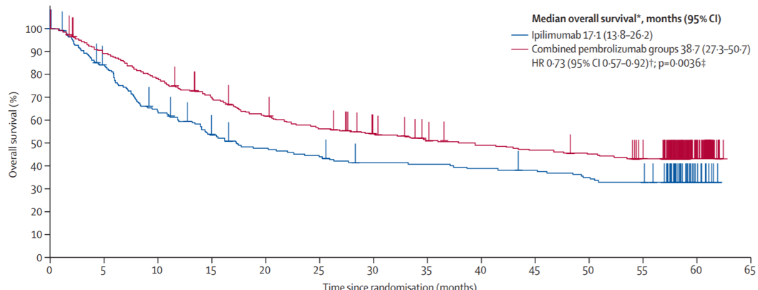
Long-term Survival with Anti-PD-1 +/- Anti-CTLA4
Anti-PD-1 or
Anti-PD-1 + Anti-CTLA4
Time (months)
5-year overall survival Pembrolizumab: 38.7%
Ipilimumab: 31.0%
Time since randomization

Slide 6
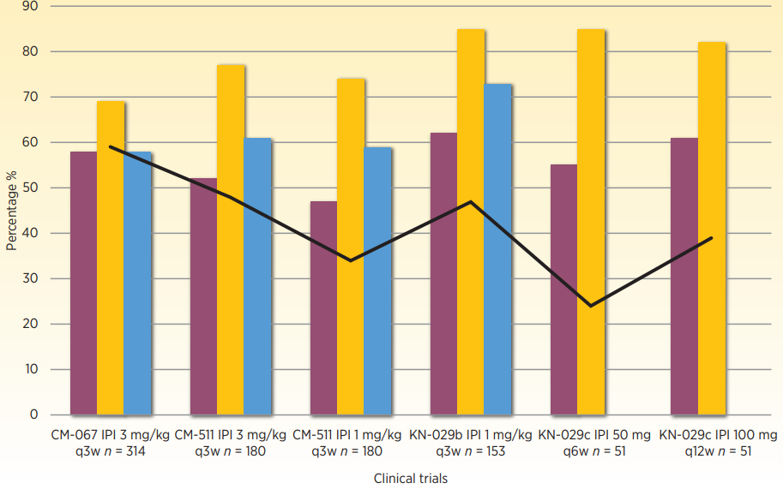
Anti-PD-1 + Ipilimumab Combinations: 1 mg/kg Ipilimumab Appears Adequate and Less Toxic than 3 mg/kg

Slide 7
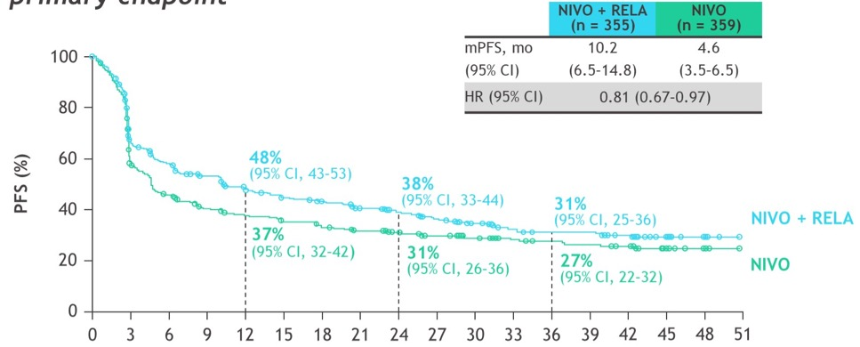
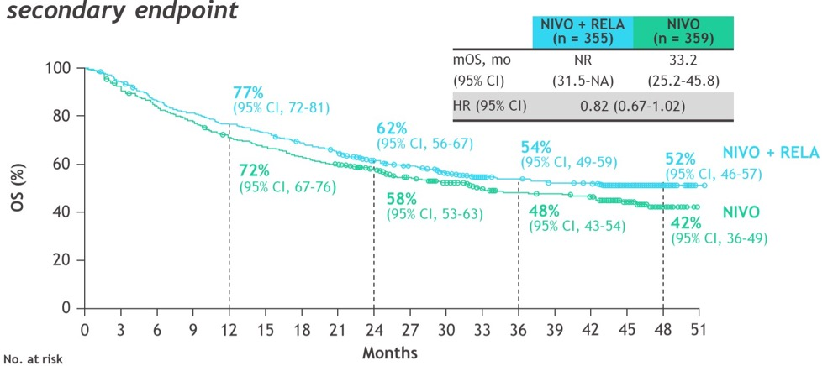
Nivolumab+Relatlimab (Anti-LAG-3) Versus Nivolumab: PFS and OS in All Randomized Patients (RELATIVITY-047)
PFS by BICR
OS
Months
Months

Slide 8
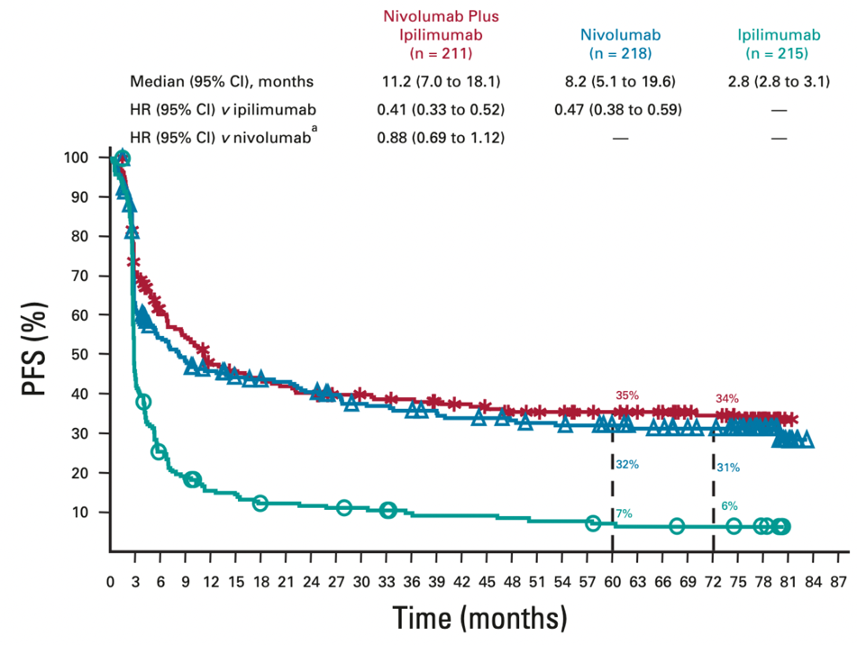
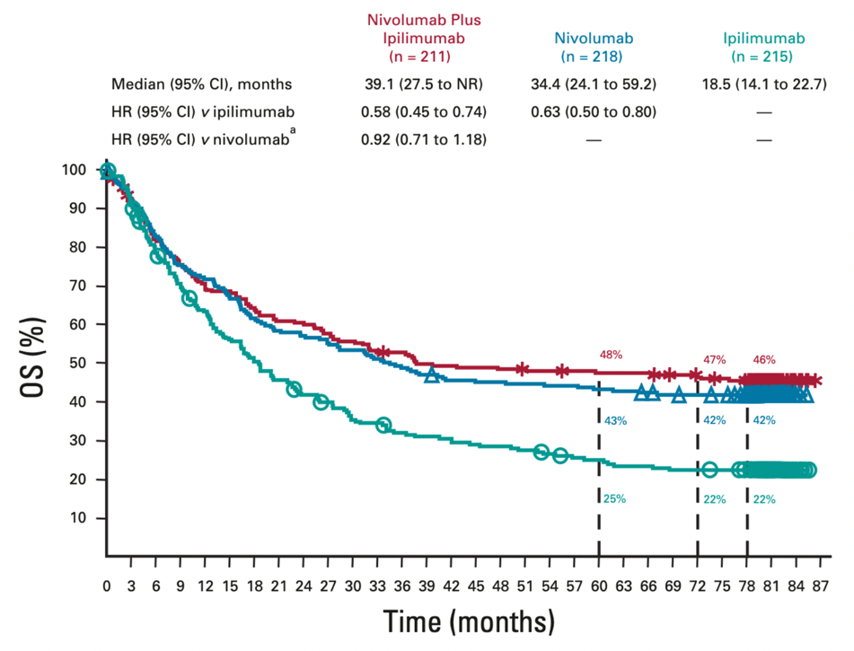
Survival Endpoints in BRAF V600 WT Patients in Checkmate-067

Slide 9
Looking for more resources on this topic?
CME/CE in minutes
Congress highlights
Late-breaking data
Quizzes
Webinars
In-person events
Slides & resources
www.MedEdOTG.com

