Slide 1
Intracranial Activity of ROS1 TKIs
Charu Aggarwal, MD, MPH, FASCO
Associate Director
University of Pennsylvania
Philadelphia, PA

Slide 2
Resource Information
About This Resource
These slides are one component of a continuing education program available online at MedEd On The Go titled Next-Generation TKI Therapy for ROS1-Rearranged NSCLC
Program Learning Objectives:
Discuss current guidelines and standards for molecular testing in real-world practice settings.
Assess the latest evidence of approved ROS1 inhibitors and emerging next-generation TKIs for the treatment of newly diagnosed ROS1-rearranged NSCLC.
Analyze treatment options for patients with ROS1-rearranged, advanced NSCLC in second- or subsequent-line therapy focused on acquired resistance mutations and CNS involvement.
Evaluate intracranial penetration and activity against acquired resistance mutations seen with ROS1-targeted TKI therapies
Evaluate the toxicity profiles of current and emerging ROS1 TKI agents and to inform optimal strategies for preventing and mitigating TKI-related adverse events
MedEd On The Go®
www.mededonthego.com
This content or portions thereof may not be published, posted online or used in presentations without permission.
This content can be saved for personal use (non-commercial use only) with credit given to the resource authors.
To contact us regarding inaccuracies, omissions or permissions please email us at support@MedEdOTG.com

Slide 3
Disclaimer
The views and opinions expressed in this educational activity are those of the faculty and do not necessarily represent the views of Total CME, LLC, the CME providers, or the companies providing educational grants. This presentation is not intended to define an exclusive course of patient management; the participant should use their clinical judgment, knowledge, experience, and diagnostic skills in applying or adopting for professional use any of the information provided herein. Any procedures, medications, or other courses of diagnosis or treatment discussed or suggested in this activity should not be used by clinicians without evaluation of their patient's conditions and possible contraindications or dangers in use, review of any applicable manufacturer’s product information, and comparison with recommendations of other authorities. Links to other sites may be provided as additional sources of information.

Slide 4
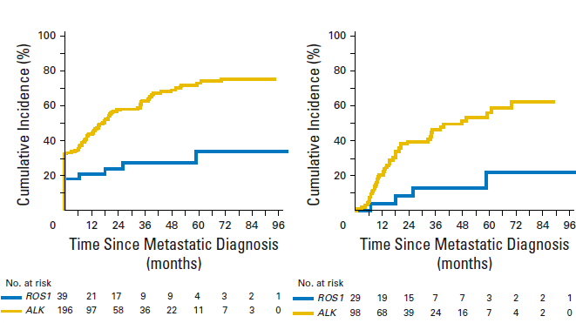
Development of Brain Metastases Over Time ALK-positive and ROS1-positive NSCLC
Lower incidence of brain metastases seen with ROS1-positive NSCLC
All Patients
No BM at Initial Metastatic Diagnosis
73%
56%
34%
22%

Slide 5
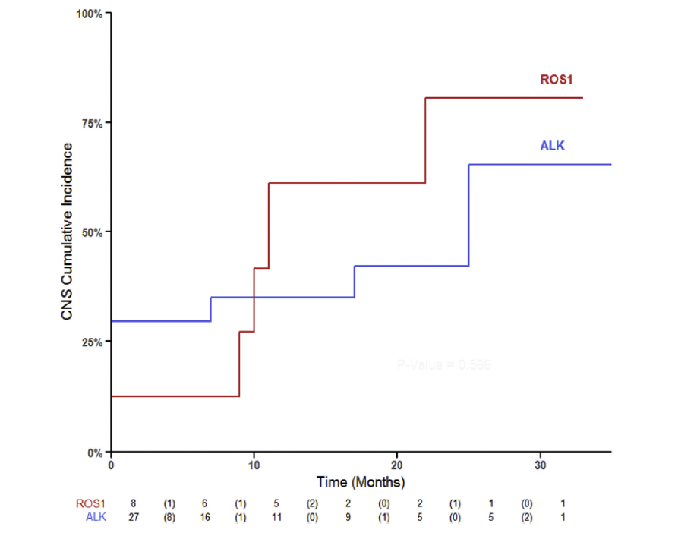
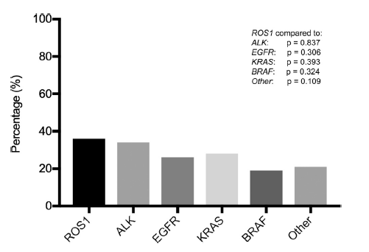
Incidence of Brain Metastases in Stage IV ROS1-Rearranged NSCLC and Rate of CNS Progression on Crizotinib
36%
34%
28%
28%
19%
22%
CD74-ROS1 gene fusions: 42%
Non-CD74-ROS1 fusions: 60%

Slide 6
Intracranial Activity of ROS1 TKIs
Drug | Patients (#) | Patients with CNS mets, # | ORR (%) [95% CI] | mPFS, months | Intracranial Activity (%) [95% CI]
Ceritinib¹ | 32^{g} | 8 | 62 [45-77] | 9.3 | ORR† 25 [7-59]
Crizotinib² | 26 | 6 | 65 [44-82] | 22.8 | ORR† 33
Entrectinib^{3c} | 168 | 25^{b} | 68 [60.2-74.8] | 15.7 | ORR† 80 [59.3-93.2]
Lorlatinib⁴ | 69 21^{c} | 24^{d} 11^{c} | 41 [39-53] | 21 8.5^{c} | ORR† 50^{d [}29-71] 64^{c} [31-89]
Repotrectinib^{5c} | 71 (17*/54**) | 17 | 88* [54-99] 76** [62-86] | 35.7 | ORR† 89 [52-100]
Repotrectinib^{5e} | 56 (26*/ 30**) | 26 | 35* [17-56] 40** [23-59] | 9.0 | ORR† 38 [14-68]
Taletrectinib^{6§} | 25^{c} | 5 | 92 | NR | ORR† 80 [28.4-99.5]
Taletrectinib^{6§} | 21^{f} | 8 | 57.1 | 11.7 | ORR† 62.5 [24.5-91.5]

Slide 7
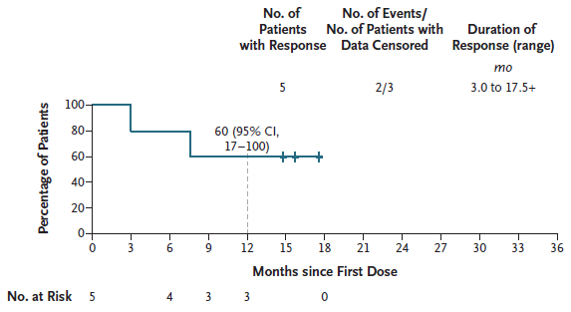
Intracranial Efficacy of Repotrectinib in Patients with Measurable Baseline Brain Metastases
icDoR: ROS1 TKI Naive*
icDoR: 1 Prior ROS1 TKI/No Prior CT†
icORR, % (95% CI) 89% (52-100)
icORR, % (95% CI) 38% (14-63)

Slide 8
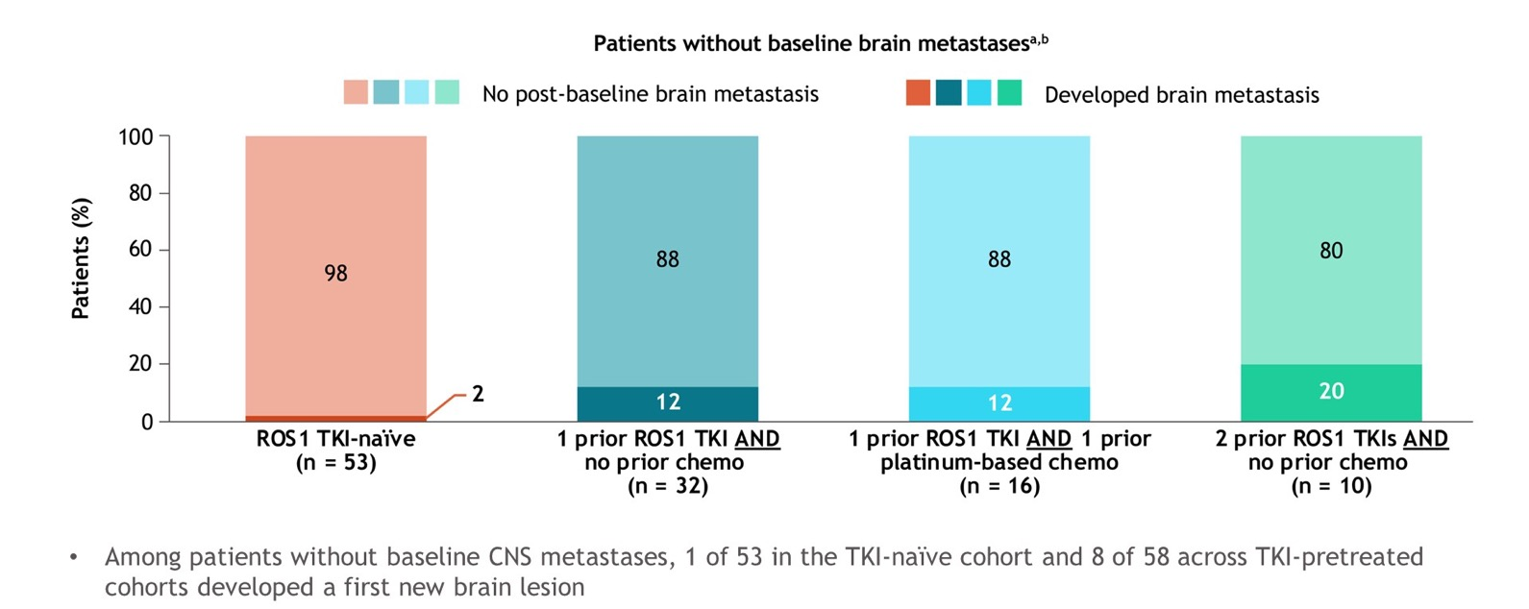
Development of new brain metastasis in TKI-naïve and TKI-pretreated patients without baseline brain metastases per BICR
TRIDENT-1: repotrectinib in ROS1+ NSCLC with/without CNS metastases

Slide 9
Summary
Brain metastases remain an area of therapeutic need for patients with ROS1-rearranged NSCLC
Deep and durable intracranial activity has been demonstrated in both ROS1 TKI-naïve and TKI-pretreated patients with newer ROS1 targeted TKIs
Entrectinib, lorlatinib, and repotrectinib are recommended for patients with ROS1-rearranged NSCLC with brain metastases

Slide 10
Looking for more resources on this topic?
CME/CE in minutes
Congress highlights
Late-breaking data
Quizzes
Webinars
In-person events
Slides & resources
www.MedEdOTG.com

