Slide 1
Distinguishing Between High- and Low-Quality RWE:
A Journal Club for the Real World
Adam Brufsky, MD, PhD
Professor of Medicine
Co-Director, Comprehensive Breast Cancer Center
University of Pittsburgh Cancer Institute
Pittsburgh, PA

Slide 2



Resource Information
About This Resource
These slides are one component of a continuing education program available online at MedEd On The Go titled RWE Where RCTs Fall Short: Optimizing Frontline Treatment of HR+/HER2- Metastatic Breast Cancer
Program Learning Objectives:
Critically evaluate components of RWE publications to distinguish high-quality from low-quality sources of information
Evaluate RWE of CDK4/6 inhibitors in HR+/HER2- MBC as it relates to clinical trial evidence
Apply RWE to make treatment decisions for patients regarding the choice of CDK4/6 inhibitors in HR+/HER2- MBC
Increase clinician awareness of the patient's perspective on the existence and utility of RWE as it applies to shared decision-making conversations
MedEd On The Go®
www.mededonthego.com
This content or portions thereof may not be published, posted online or used in presentations without permission.
This content can be saved for personal use (non-commercial use only) with credit given to the resource authors.
To contact us regarding inaccuracies, omissions or permissions please email us at support@MedEdOTG.com

Slide 3
Disclaimer
The views and opinions expressed in this educational activity are those of the faculty and do not necessarily represent the views of Total CME, LLC, the CME providers, or the companies providing educational grants. This presentation is not intended to define an exclusive course of patient management; the participant should use their clinical judgment, knowledge, experience, and diagnostic skills in applying or adopting for professional use any of the information provided herein. Any procedures, medications, or other courses of diagnosis or treatment discussed or suggested in this activity should not be used by clinicians without evaluation of their patient's conditions and possible contraindications or dangers in use, review of any applicable manufacturer’s product information, and comparison with recommendations of other authorities. Links to other sites may be provided as additional sources of information.

Slide 4



Interpreting Studies
Do the observed results
represent the true effect?
Truth in the study.
Are the observed results applicable to other settings?
Truth in real life.
If the observed results do not represent the true effect this implies, we cannot draw any conclusions.
Are the results of the study true or are they an artifact of the way the study was designed?
If the results of the study may not apply to patients who differ from the study population, then this could consequently lead to low adoption of the treatment.
Are the study results likely to apply to other settings?
Note: when considering these questions when evaluating a study, it is important to acknowledge the answer is a matter of degree. It is not an ‘all or nothing’ concept.

Slide 5
RCTs vs. RWE studies
Concept | RCTs | RWE Studies
Do the observed results represent the true effect? Truth in the study | High (improved by randomization) | POTENTIAL for Low (depends on steps taken to adjust for bias)
Are the observed results applicable to other settings? Truth in real life | Low to Medium (depends on which segment of the population is eligible for inclusion) | Medium to High relative to RCTs (often can be extrapolated to other clinical practice populations)

Slide 6
Potential for Bias in RCTs vs. RWE Studies
RCTs
RWE Studies
RCTs are considered the gold standard for estimating the effects of treatments on
outcomes, though they may still be susceptible to bias (e.g., loss to follow-up)
Random treatment allocation ensures that confounding by measured and unmeasured baseline characteristics is minimized
Blinding hides treatment assignment
RWE studies are generally more susceptible to bias than RCTs as treatment selection may be influenced by several factors, such as patient characteristics, physician preference, and costs
There are often systematic differences in baseline characteristics of patients administered different interventions
Group allocation is usually not concealed

Slide 7

Strategies to Mitigate Bias: Propensity Scores
Systematic differences are likely to exist between real world samples, leading to confounding. Confounding can be reduced through the choice of study design and/or statistical analysis methods. The PS method is one example of a design method which can mitigate bias and reduce confounding.
What is a PS? The predicted probability of being assigned a specific treatment, given what is known about the patient’s confounding factors.
Goal
To compare patients with the same PS but who receive different treatments – similar to randomization of an RCT.
Can be treated analytically like an RCT
Has a notion of “equipoise”
(equivalence at baseline) like an RCT
The results look like they came from an RCT, but:
The balance is only demonstrated among the measured covariates
Though some additional balance may have been achieved, no balance among unmeasured covariates
is implied

Slide 8
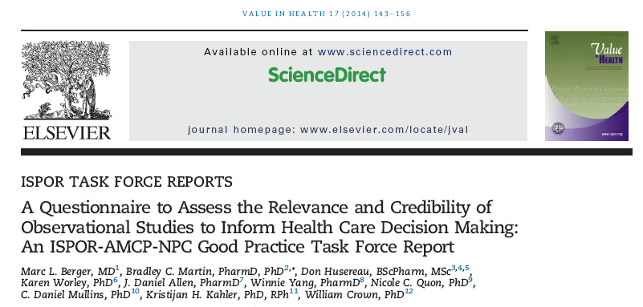
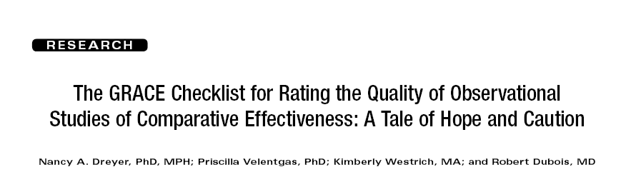
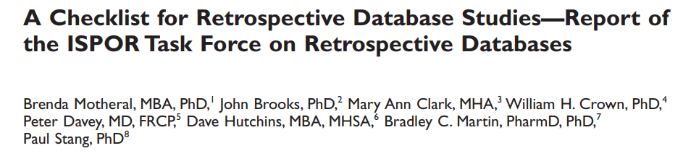
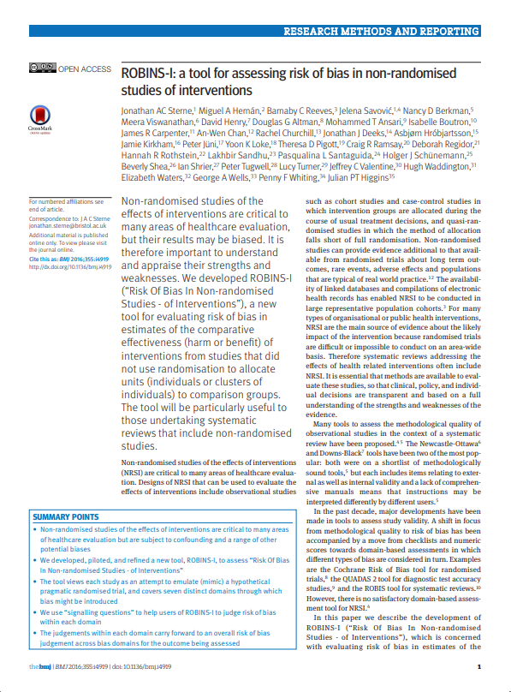
Tools for Assessing the Quality of RWE Studies
Many tools have been developed for assessing the quality of RWE; the more commonly used ones include the ISPOR questionnaire, ISPOR checklist, the GRACE checklist and the ROBINS-I tool.
ISPOR Questionnaire
GRACE
ISPOR Checklist
ROBINS-I

Slide 9
Real-World Evidence Evaluations
RWE is at risk for bias due to lack of randomization/blinding
Multiple confounding variables (physician choice)
Differences in baseline characteristics
Lack of data (imputing?)
Statistical methods exist (propensity score matching) to try to minimize bias
Tools and checklists exist to try to evaluate RWE credibility

Slide 10



Looking for more resources
on this topic?
CME/CE in minutes
Congress highlights
Late-breaking data
Quizzes
Webinars
In-person events
Slides & resources
www.MedEdOTG.com

