Slide 1
Treatment of Patient With Low Risk of Gastrointestinal Absorption Impairment for Established VTE With Cancer
Jean M. Connors, MD
Medical Director, Hemostatic Antithrombotic Stewardship
Medical Director, Anticoagulation Management Services, Hematology Division
Brigham and Women’s Hospital/Dana Farber Cancer Institute
Associate Professor of Medicine, Harvard Medical School
Boston, MA
Twitter @Connors_md

Slide 2
Disclaimer
The views and opinions expressed in this educational activity are those of the faculty and do not necessarily represent the views of TotalCME, Inc., the CME providers, or the companies providing educational grants. This presentation is not intended to define an exclusive course of patient management; the participant should use their clinical judgment, knowledge, experience, and diagnostic skills in applying or adopting for professional use any of the information provided herein. Any procedures, medications, or other courses of diagnosis or treatment discussed or suggested in this activity should not be used by clinicians without evaluation of their patient's conditions and possible contraindications or dangers in use, review of any applicable manufacturer’s product information, and comparison with recommendations of other authorities. Links to other sites may be provided as additional sources of information.

Slide 3
Case 2
A 57-year-old man with newly diagnosed localized pancreatic cancer, status post 2 cycles of neoadjuvant FOLFOX chemotherapy, presents with a 2-day history of worsening DOE with pleuritic chest pain and left lower extremity (LLE) swelling
He is diagnosed with right lower lobar segmental PE without right heart strain on imaging and LLE DVT. The ED asks you what anticoagulant to give…

Slide 4
Case 2
A 57-year-old man with newly diagnosed localized pancreatic cancer, status post 2 cycles of neoadjuvant FOLFOX chemotherapy, presents with a 2-day history of worsening DOE with pleuritic chest pain and left lower extremity (LLE) swelling
He is diagnosed with right lower lobar segmental PE without right heart strain on imaging and LLE DVT. The ED asks you what anticoagulant to give…
Factors that contribute to deciding which anticoagulant to use include:
Type of cancer and intraluminal disease
Anticancer treatments
Decreased absorption
Drug-drug interactions
All of the above

Slide 5
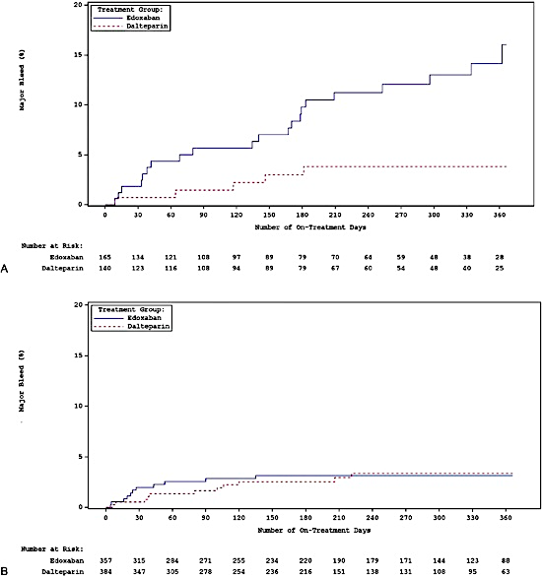

GI Tract Cancer: Increased Risk of Bleeding With DOAC
Hokusai Subanalysis
GI Cancers
Select-D major bleeds
  DSMB: Do not enroll upper GI malignancies
Hokusai major bleeds
  Edoxaban: 22/32 GIB
  Dalteparin: 5/16 GIB
GI bleeds occurred in patients with GI cancers
Upper GI tract tumors and intact luminal primary tumors
Non-GI Cancers

Slide 6
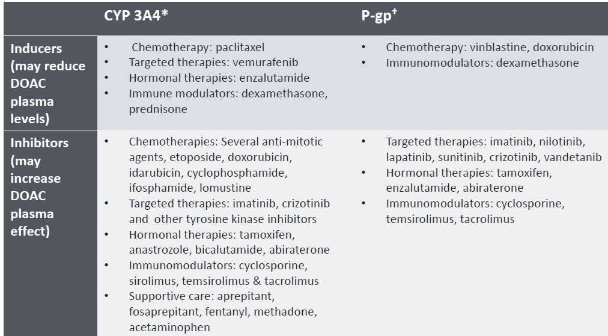
DOAC-Oncology Drug Interactions

Slide 7
GI Tract Pathology
GI tract pathology can affect DOAC absorption and plasma concentration, which can result in decreased efficacy
  Nausea and vomiting
  Diarrhea
  Resected sections of stomach, small intestine, bowel
  Gastric bypass—still not clear
  ? Inflammatory bowel diseases
  Apixaban and rivaroxaban data show that crushing for use in gastrostomy or jejunostomy tubes does not affect activity

Slide 8
Case 2
Factors that contribute to deciding which anticoagulant to use include:
Type of cancer and intraluminal disease
Anticancer treatments
Decreased absorption
Drug-drug interactions
All of the above

Slide 9
Case 2
Factors that contribute to deciding which anticoagulant to use include:
Type of cancer and intraluminal disease
Anticancer treatments
Decreased absorption
Drug-drug interactions
All of the above
Brief explanation:
This patient has pancreatic cancer but does not have luminal disease and has not had any GI tract resection to impair absorption. FOLFOX chemotherapy does not affect DOAC metabolism. While N/V/D can occur with FOLFOX chemotherapy, current antiemetic drugs give excellent control of these side effects. There is no reason not to use a DOAC in this patient at this time.

