Slide 1
Treatment of Patients With Established VTE With Cancer and COVID-19
Alok A. Khorana, MD, FACP, FASCO
Sondra and Stephen Hardis Chair in Oncology Research
Professor of Medicine, Cleveland Clinic Lerner College of Medicine
Taussig Cancer Institute and Case Comprehensive Cancer Center
Cleveland, OH

Slide 2
Disclaimer
The views and opinions expressed in this educational activity are those of the faculty and do not necessarily represent the views of TotalCME, Inc., the CME providers, or the companies providing educational grants. This presentation is not intended to define an exclusive course of patient management; the participant should use their clinical judgment, knowledge, experience, and diagnostic skills in applying or adopting for professional use any of the information provided herein. Any procedures, medications, or other courses of diagnosis or treatment discussed or suggested in this activity should not be used by clinicians without evaluation of their patient's conditions and possible contraindications or dangers in use, review of any applicable manufacturer’s product information, and comparison with recommendations of other authorities. Links to other sites may be provided as additional sources of information.

Slide 3
Background
People with cancer are at higher risk of COVID-19 and its complications, including thromboembolism (TE), severe disease, and mortality¹
Inflammatory response to SARS-CoV-2 infection can cause acute phase response and endothelial dysfunction, which contribute to COVID-19-associated coagulopathy²
D-dimer and other inflammatory and hemostatic biomarkers have been associated with worse COVID-19 outcomes in the general population³
Venous thromboembolism (VTE) rates vary substantially by report; most recent US data suggest a 3% thromboembolism rate in a mixed-tumor, mixed inpatient-outpatient population⁴

Slide 4
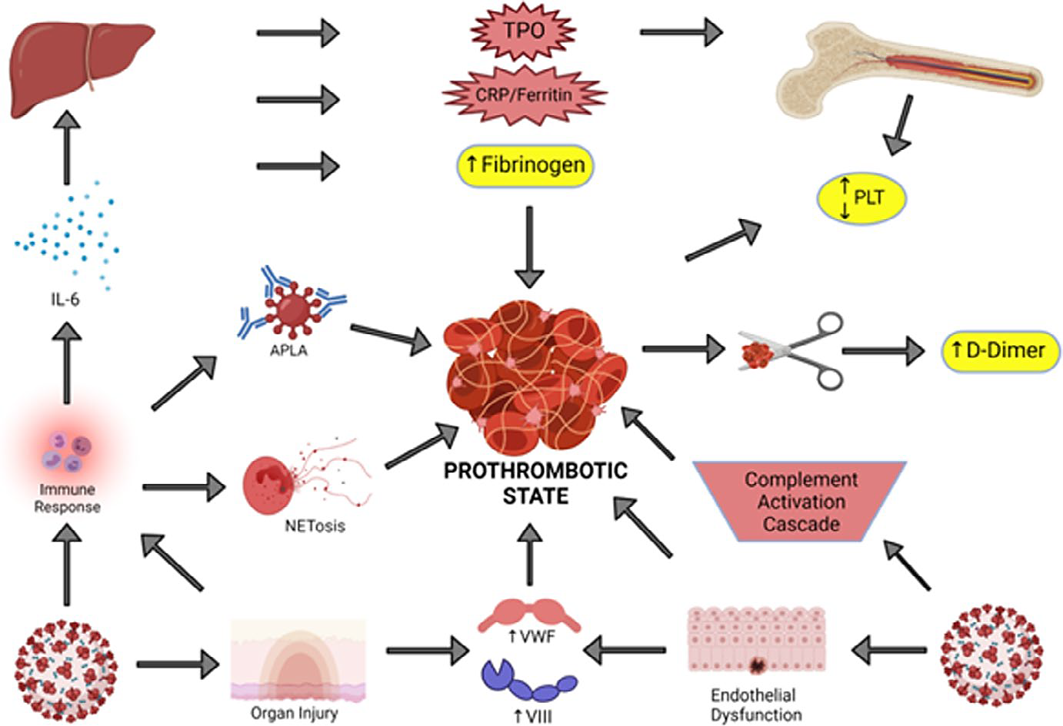
COVID-19 and VTE

Slide 5
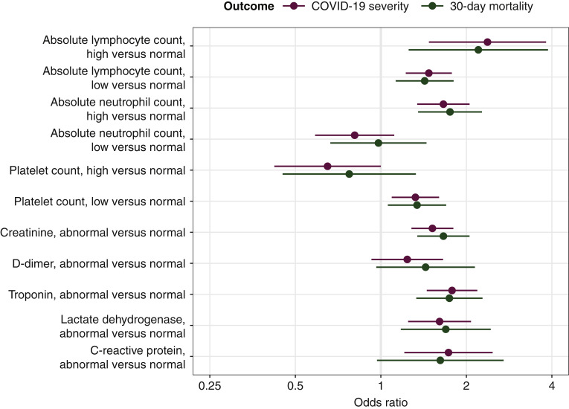
Risk Factors for COVID-19 Severity in Cancer Patients

Slide 6
Efficacy and Safety of DOACs Versus LMWH for the
Treatment of CAT (Primary Analysis)
Recurrent VTE*
ISTH Major Bleeding Events‡
Study | RR (95% CI) | RR (95% CI)
Hokusai VTE Cancer |  | 0.74 (0.48-1.14)
SELECT-D |  | 0.41 (0.17-0.97)
CARAVAGGIO |  | 0.70 (0.45-1.08)
Combined# |  | 0.68 (0.39-1.17)
Study | RR (95% CI) | RR (95% CI)
Hokusai VTE Cancer |  | 1.71 (0.95-3.08)
SELECT-D |  | 1.83 (0.69-4.86)
CARAVAGGIO |  | 0.96 (0.54-1.71)
Combined# |  | 1.36 (0.55-3.35)
0.1
0.2
0.5
1
2
5
10
0.1
0.2
0.5
1
2
5
10
Favours NOAC
Favours LMWH
Favours NOAC
Favours LMWH
NOACs are associated with a nonsignificant lower risk of recurrent VTE (ARR -2.7%; 95% CI -5.1 to 1.4),
and the risk of major bleeding was nonsignificantly higher (ARR 1.3%; 95% CI -1.6 to 8.3) versus LMWH

Slide 7
Hokusai VTE: Bleeding GI Versus Non-GI Cancers
Patients With Gastrointestinal Cancer
Patients With Nongastrointestinal Cancer
20
Edoxaban
20
Edoxaban
Dalteparin
Dalteparin
15
15
Major bleed (%)
Major bleed (%)
10
10
5
5
0
0
0 30 60 90 120 150 180 210 240 270 300 330 360
0 30 60 90 120 150 180 210 240 270 300 330 360
Number of on-treatment days
Number of on-treatment days
Number at risk
Edoxaban | 165 | 134 | 121 | 108 | 97 | 89 | 79 | 70 | 64 | 59 | 48 | 38 | 28
Dalteparin | 140 | 123 | 116 | 108 | 94 | 89 | 79 | 67 | 60 | 54 | 48 | 40 | 25
Number at risk
Edoxaban | 357 | 315 | 284 | 271 | 255 | 234 | 220 | 190 | 179 | 171 | 144 | 123 | 88
Dalteparin | 384 | 347 | 305 | 278 | 254 | 236 | 216 | 151 | 138 | 131 | 108 | 95 | 63

Slide 8
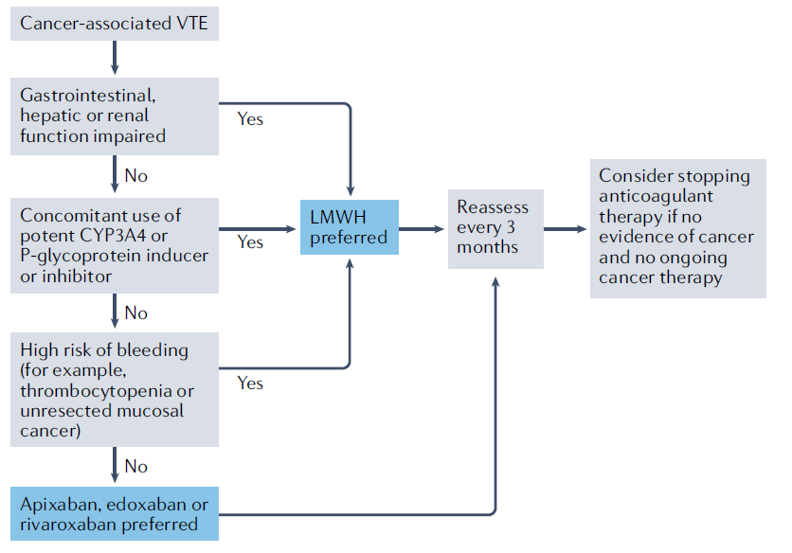
Treatment Algorithm for CAT

Slide 9
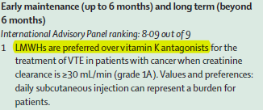
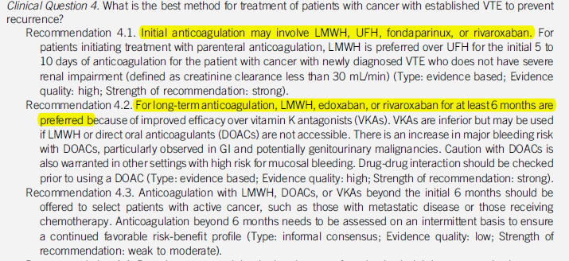
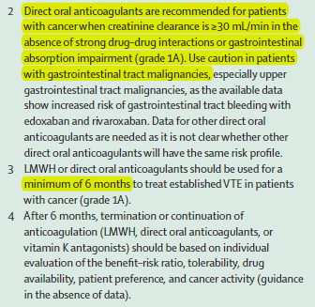
Guidelines for Treatment
ITAC²
ASCO¹

Slide 10
Conclusions
COVID-19 and cancer
Treatment of VTE with cancer and COVID-19
Standard treatment guidelines for cancer-associated VTE should be followed
Cancer patients are at risk for COVID-related complications, given their immunocompromised status
Hypercoagulable state of cancer is enhanced during acute COVID-19 infection
Anticoagulant approaches include warfarin, LMWHs, and DOACs
Treatment should be continued for at least 6 months; longer if active cancer and/or receiving anticancer therapy

