Slide 1
How Do We Apply Evidence Supporting TROP2 Directed ADCs to the Metastatic TNBC Treatment Paradigm?
Sara M. Tolaney, MD, MPH
Chief, Division of Breast Oncology, Susan F. Smith Center for Women’s Cancers
Associate Director, Susan F. Smith Center for Women’s Cancers
Senior Physician, Dana-Farber Cancer Institute
Associate Professor of Medicine, Harvard Medical School
Boston, MA

Slide 2



Resource Information
About This Resource
These slides are one component of a continuing education program available online at MedEd On The Go titled Triple-Negative Breast Cancer (TNBC): Choosing the Right ADC for the Right Patient
Program Learning Objectives:
Explain the rationale for varying levels of ADC target positivity required for ADC efficacy and treatment eligibility
Identify patients with TNBC who are optimal candidates for ADCs
Develop evidence-based treatment strategies using ADCs in metastatic TNBC
Apply knowledge of barriers to access, care, and treatment that exist in the care of minority patients diagnosed with metastatic TNBC
Differentiate advantages of ADCs in special populations of patients with metastatic TNBC
Identify strategies for improving adherence through adverse effect management
MedEd On The Go®
www.mededonthego.com
This content or portions thereof may not be published, posted online or used in presentations without permission.
This content can be saved for personal use (non-commercial use only) with credit given to the resource authors.
To contact us regarding inaccuracies, omissions or permissions please email us at support@MedEdOTG.com

Slide 3
Disclaimer
The views and opinions expressed in this educational activity are those of the faculty and do not necessarily represent the views of Total CME, LLC, the CME providers, or the companies providing educational grants. This presentation is not intended to define an exclusive course of patient management; the participant should use their clinical judgment, knowledge, experience, and diagnostic skills in applying or adopting for professional use any of the information provided herein. Any procedures, medications, or other courses of diagnosis or treatment discussed or suggested in this activity should not be used by clinicians without evaluation of their patient's conditions and possible contraindications or dangers in use, review of any applicable manufacturer’s product information, and comparison with recommendations of other authorities. Links to other sites may be provided as additional sources of information.

Slide 4
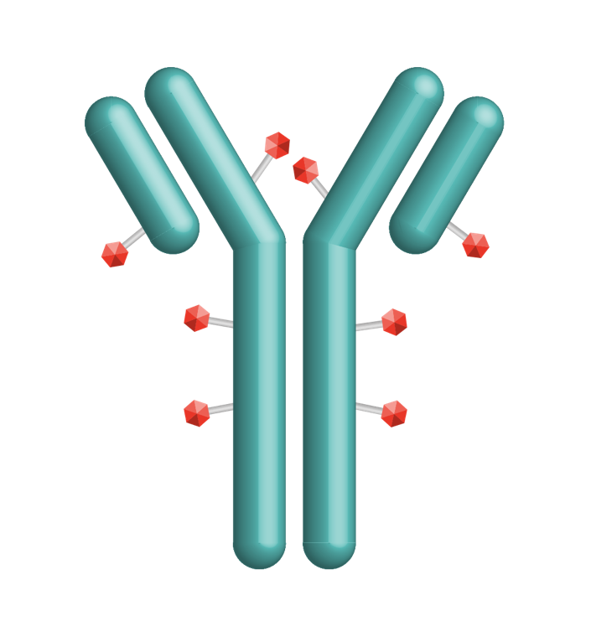

Sacituzumab Govitecan (SG) Is a First-in-Class TROP2-Directed ADC
TROP2 is expressed in all subtypes of breast cancer and linked to poor prognosis^{1,2}
SG is distinct from other ADCs³⁻⁶
  Antibody highly specific for TROP2
  High drug-to-antibody ratio (7.6:1)
  Internalization and enzymatic cleavage by tumor cell not required for the liberation of
  SN-38 from the antibody
  Hydrolysis of the linker also releases the
  SN-38 cytotoxic extracellularly in the tumor microenvironment, providing a bystander effect
Granted accelerated approval by the FDA for metastatic TNBC and fast track designation in metastatic urothelial cancer⁷
Linker for SN-38
Hydrolyzable linker for payload release
High drug-to-antibody ratio (7.6:1)⁶
Humanized anti-TROP2 antibody
Directed toward TROP2, an epithelial antigen expressed on many solid cancers
SN-38 payload
SN-38 more potent than parent compound, irinotecan
1. Vidula N, et al. J Clin Oncol. 2017;35(suppl 15):1075; 2. Ambrogi F, et al. PLoS One. 2014;9(5):e96993; 3. Goldenberg DM, et al. Expert Opin Biol Ther. 2020;20(8):871-885; 4. Nagayama A, et al. Ther Adv Med Oncol. 2020;12:1758835920915980; 5. Cardillo TM, et al. Bioconjug Chem. 2015;26(5):919-931; 6. Goldenberg DM, et al. Oncotarget. 2015;6(26):22496-224512; 7. FDA Press Release. https://www.fda.gov/drugs/drug-approvals-and-databases/fda-grants-accelerated-approval-sacituzumab-govitecan-hziy-metastatic-triple-negative-breast-cancer. April 22, 2020. ADC, antibody-drug conjugate; TNBC, triple-negative breast cancer; TROP2, trophoblast cell surface antigen 2.

Slide 5
ASCENT*: A Phase 3 Confirmatory Study of Sacituzumab Govitecan in 2L and Later Metastatic TNBC¹⁻³
Metastatic TNBC
≥2 chemotherapies, one of which could be in neo/adjuvant setting provided progression occurred within a 12-month period
Patients with stable brain metastasis were allowed
(N=529)
Sacituzumab govitecan
10 mg/kg IV
Days 1 and 8, every 21 days
(n=267)
Endpoints
Primary
PFS‡
Secondary
PFS for the ITT population§, OS, ORR, DOR, TTR, QoL, safety
Continue treatment until progression or unacceptable toxicity
1:1
Treatment of
physician’s choice† (n=262)
Stratification factors
Number of prior chemotherapies (2 or 3 vs >3)
Geographic region (North America vs Europe)
Presence/absence of known brain metastases (Yes/No)
NCT02574455
*ASCENT was an international, Phase 3, multicentre, open-label, randomised trial of patients with unresectable locally advanced or metastatic TNBC (N=529); †Treatment of physician’s choice: eribulin, vinorelbine, gemcitabine, or capecitabine; ‡PFS measured by an independent centralised and blinded group of radiology experts who assessed tumour response using RECIST 1.1 criteria in patients without brain metastasis; §The full population or intention-to-treat population includes all randomised patients (with and without brain metastases).
1. Bardia A, et al. N Engl J Med. 2021;384(16):1529-41; 2. Bardia A, et al. ESMO 2020. Abstract LBA17; 3. ClinicalTrials.gov. Trial of sacituzumab govitecan in participants with refractory/relapsed metastatic triple-negative breast cancer (TNBC) (ASCENT). https://clinicaltrials.gov/ct2/show/NCT02574455.
2L, second-line; DOR, duration of response; ITT, intention-to-treat; IV, intravenous; ORR, objective response rate; OS, overall survival; PFS, progression-free survival; QoL, quality of life; RECIST, Response Evaluation Criteria in Solid Tumours; TTR, time to response.

Slide 6
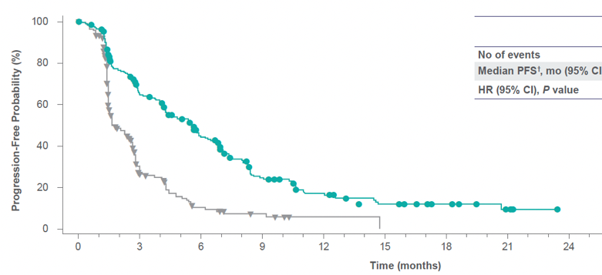
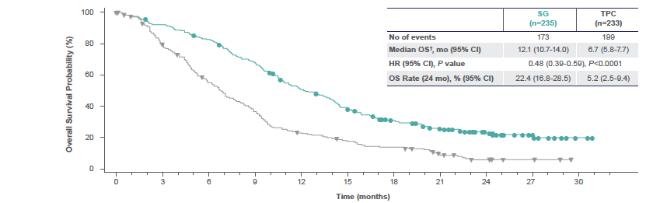
ASCENT: Statistically Significant and Clinically Meaningful Improvement in PFS and OS (BMNeg Population)
The ASCENT trial demonstrated statistically significant improvement in PFS and OS over single-agent chemotherapy in the primary study population
Progression-free survival (BICR analysis)
Overall survival
BICR analysis | SG (n=235) | TPC (n=233)
No. of events | 167 | 150
Median PFS, mo (95% CI) | 5.6 (4.3–6.3) | 1.7 (1.5–2.6)
HR (95% CI), P value | 0.39 (0.31–0.49), P<.0001
 | SG (n=235) | TPC (n=233)
No. of events | 173 | 199
Median OS, mo (95% CI) | 12.1 (10.7–14.0) | 6.7 (5.8–7.7)
HR (95% CI), P value | 0.48 (0.39–0.59), P<.0001
Analysis based on final database lock confirmed the improvement in clinical outcomes over TPC:
  Median PFS of 5.6 versus 1.7 months (HR 0.39, P<0.0001)
  Median OS of 12.1 versus 6.7 months (HR 0.48, P<0.0001)
  OS rate at 24 months of 22.4% (95% CI, 16.8-28.5) versus 5.2% (95% CI, 2.5-9.4)
BICR, blinded independent central review; HR, hazard ratio; TPC, treatment of physician’s choice.
Bardia A, et al. J Clin Oncol. 2022;40(suppl 16):1071.

Slide 7
ASCENT: In Patients with 2L Metastatic TNBC, PFS and OS Improvement Was Consistent with the Overall Study Population
Progression-free survival
Overall survival
100
Approved for patients with ≥2 systemic therapies, at least one of them for metastatic disease†
100
80
80
60
60
PFS probability (%)
OS probability (%)
40
40
20
SG
20
SG
TPC
TPC
0
Censored
0
Censored
0
3
6
9
12
15
0
3
6
9
12
15
18
21
24
27
No. of patients still at risk
Time (months)
No. of patients still at risk
Time (months)
SG
33
32
23
19
16
12
8
6
5
2
2
1
1
1
0
0
SG
33
32
31
29
28
26
26
21
19
19
17
15
13
13
11
9
7
7
7
4
2
1
0
0
0
0
TCP
32
28
8
3
2
2
2
2
2
1
1
1
1
1
1
0
TCP
32
29
27
22
17
14
12
10
8
6
5
5
5
5
5
3
2
2
1
1
1
1
1
1
1
0
BICR analysis | SG (n=33) | TPC (n=32)
No. of events | 21 | 23
Median PFS, mo (95%) CI | 5.7 (2.6–8.1) | 1.5 (1.4–2.6)
HR (95% CI) | 0.41 (0.22–0.76)
BICR analysis | SG (n=33) | TPC (n=32)
No. of events | 22 | 24
Median OS, mo (95% CI) | 10.9 (6.9–19.5) | 4.9 (3.1–7.1)
HR (95% CI) | 0.51 (0.28–0.91)
†Sacituzumab govitecan. Summary of product characteristics. https://www.ema.europa.eu/en/documents/product-information/trodelvy-epar-product-information_en.pdf.
Assessed by independent central review in the brain-metastasis-negative population who recurred ≤12 months after (neo)adjuvant chemotherapy and received one line of therapy in the metastatic
setting prior to study enrolment.
(Neo)adjuvant, neoadjuvant or adjuvant.
Carey LA, et al. NPJ Breast Cancer. 2022;8(1):72.

Slide 8
TRAEs (All Grade, >20%; Grade 3/4, >5% of Patients)
 |  |  | SG (n=258) |  |  | TPC (n=224)
TRAE* |  |  | All grade % | Grade 3, % | Grade 4, % | All grade, % | Grade 3, % | Grade 4, %
Hematologic | Neutropenia† | Neutropenia Febrile neutropenia Anemia Leukopenia | 63 | 46 | 17 | 43 | 27 | 13
 | Anemia‡ |  | 34 | 8 | 0 | 24 | 5 | 0
 | Leukopenia§ |  | 16 | 10 | 1 | 11 | 5 | 1
 | Febrile neutropenia |  | 6 | 5 | 1 | 2 | 2 | <1
Gastrointestinal | Diarrhea |  | 59 | 10 | 0 | 12 | <1 | 0
 | Nausea |  | 57 | 2 | <1 | 26 | <1 | 0
 | Vomiting |  | 29 | 1 | <1 | 10 | <1 | 0
Other | Fatigue | Fatigue Alopecia Decreased appetite Hyperglycemia Hypomagnesemia Hypophosphatemia | 45 | 3 | 0 | 30 | 5 | 0
 | Alopecia |  | 46 | 0 | 0 | 16 | 0 | 0
Key grade ≥3 TRAEs (SG vs TPC): neutropenia (51% vs 33%), diarrhea (10% vs <1%), leukopenia (10% vs 5%), anemia (8% vs 5%), and febrile neutropenia (6% vs 2%)
  G-CSF usage was 49% in the SG arm versus 23% in the TPC arm
  Dose reductions due to TRAEs were similar (22% SG vs 26% TPC)
No severe cardiovascular toxicity, no grade >2 neuropathy or grade >3 interstitial lung disease with SG
No treatment-related deaths with SG; 1 treatment-related death (neutropenic sepsis) with TPC
AEs leading to treatment discontinuation were low for SG and TPC: 4.7% and 5.4%
Patients received a median of 7 treatment cycles of SG, with a median treatment duration of 4.4 months (range, 0.03-22.9)
*Patients may report more than 1 event per preferred term. AEs were classified according to the MedDRA systems of preferred terms and system organ class and according to severity by NCI CTCAE v4.03; †Combined preferred terms of ‘neutropenia’ and ‘decreased neutrophil count’; ‡Combined preferred terms of ‘anemia’ and ‘decreased hemoglobin’; §Combined preferred terms of ‘leukopenia’ and ‘decreased white blood cell count’.
AE, adverse event; G-CSF, granulocyte-colony stimulating factor; MeDRA, Medical Dictionary for Regulatory Activities; NCI CTCAE, National Cancer Institute Common Terminology Criteria for AE; TRAE, treatment-related AE. Bardia A, et al. J Clin Oncol. 2022;40(suppl 16):1071.

Slide 9
ASCENT 03: Sacituzumab Govitecan Versus TPC (Gem + Carbo, Paclitaxel, Nab-Paclitaxel) in 1L PD-L1- Metastatic TNBC, NCT05382299
1L mTNBC PD-L1-
Previously untreated, inoperable, locally advanced, or metastatic TNBC
PD-L1- tumors (CPS <10, IHC 22C3 assay) OR PD-L1+ tumors (CPS ≥10, IHC 22C3 assay) if treated with anti-PD-(L)1 agent in the curative setting
≥6 months since treatment in curative setting
Prior anti-PD-(L)1 agent allowed in the curative setting
PD-L1 and TNBC status
centrally confirmed
Sacituzumab govitecan
10 mg/kg IV on
Days 1 and 8 of 21-day cycles
Treated until BICR-confirmed progression or unacceptable toxicity
1:1
Long-term
follow-up
TPC chemotherapy
Gem + carbo: gem 1000 mg/m² with carbo AUC 2 IV on Days 1 and 8 of 21-day cycles
Paclitaxel: 90 mg/m² IV on Days 1, 8, and 15 of 28-day cycles
Nab-paclitaxel: 100 mg/m² IV on Days 1, 8, and 15 of 28-day cycles
N=540
(≤25% de novo)
Crossover to SG allowed after BICR-verified disease progression
Stratification Factors:
De novo versus recurrent disease within 6-12 months of treatment in the curative setting versus recurrent disease >12 months after treatment in the curative setting
Geographic region
AUC, area under the curve; carbo, carboplatin; CPS, combined positive score; gem, gemcitabine; IHC, immunohistochemistry; IV, intravenous; mTNBC, metastatic triple-negative breast cancer; PD-L1, programmed death-ligand 1. EU Clinical Trial Register. EudraCT: 2021-005743-79. https://www.clinicaltrialsregister.eu/ctr-search/search.

Slide 10
ASCENT 04: Sacituzumab Govitecan + Pembrolizumab Versus TPC + Pembrolizumab in 1L PD-L1+ Metastatic TNBC, NCT05382286
SG + pembrolizumab
(SG: 10 mg/kg IV on Days
1 and 8 of 21-day cycles;
Pembro: 200 mg IV on Day
1 of 21-day cycles)
1L mTNBC PD-L1+
Previously untreated, inoperable, locally advanced,
OR metastatic TNBC
PD-L1+ (CPS ≥10, IHC 22C3 assay)
PD-L1 and TNBC status
centrally confirmed
Prior anti-PD-(L)1 allowed in the curative setting
≥6 months since treatment in curative setting
Treated until BICR-confirmed progression or unacceptable toxicity
1:1
Long-term
follow-up
TPC chemotherapy + pembrolizumab
(Pembro dosed as above. TPC: gem 1000 mg/m² with carbo AUC 2 IV on Days 1 and 8 of 21-day cycles OR paclitaxel 90 mg/m² IV on Days 1, 8, and 15 of 28-day cycles OR nab-paclitaxel:
100 mg/m² IV on Days 1, 8, and 15 of
28-day cycles)
Crossover to SG allowed after BICR-confirmed progression
N=570
(≤25% de novo)
Stratification factors:
De novo versus recurrent disease within 6-12 months of treatment in the curative setting versus recurrent disease >12 months after treatment in the curative setting
Geographic region (US/Canada vs rest of world)
Prior exposure to anti-PD-(L)1 therapy
1L, first-line.
EU Clinical Trial Register. EudraCT: 2021-005742-14. https://www.clinicaltrialsregister.eu/ctr-search/search.

Slide 11
Datopotamab Deruxtecan (Dato-DXd):
TROP2 ADC in DEVELOPMENT
Circulating free payload is negligible due to high stability of the linker, thereby limiting systemic exposure or nontargeted delivery of the payload
High-potency membrane-permeable payload (DXd) that requires TROP2-mediated internalization for release
DS-1062 has a DAR of 4 for optimized therapeutic index
DS-1062 has a substantially longer half-life than SG (≈5 days vs 11-14 hours), enabling a more optimal dosing regimen
SG’s DLT is neutropenia, while DS-1062’s DLTs are maculopapular rash and stomatitis/mucosal inflammation
Slide courtesy of Sara Tolaney, MD, MPH
DAR, drug-to-antibody ratio; DLT, dose-limiting toxicity.
Notes:
References
Goldenberg DM, et al. Oncotarget 2015;6:22496-22512.
Ogitani Y, et al. Clin Cancer Res 2016;22(20):5097-5108.
Ocean AJ, et al. Cancer. 2017;123:3843-3854.
Bardia A, et al. J Clin Oncol 2017;35:2141–2148.
Lisberg AE, et al. Poster presented at: ASCO; May 29-31, 2020; Chicago, IL (abstract 9619).
Heist RS, etal. Oral presentation at: WCLC; September 7-10, 2019; Barcelona, Spain.
Ocean 2017/p3849/A
Lisberg 2020/p1/A
Heist 2019/p5/A
Goldenberg 2015/p22506/D
Goldenberg 2015/p22506/A
p22507/B/E
Ogitani 2016/p5099/C
Bardia 2017/p2147/A

Slide 12
Phase I TROPION-PanTumor01: Datopotamab Deruxtecan in TROP2-Unselected TNBC and HR+/HER2- ABC Cohorts
Dato-DXd: Novel ADC targeting TROP2 with topoisomerase I inhibitor payload; can elicit bystander antitumor effects
Responses observed among patients with TNBC previously treated with sacituzumab govitecan
1 case of grade 3 drug-related ILD in HR+/HER2- ABC cohort
Most common TEAEs
  Stomatitis: 73%-83% (grade ≥3: 10%-11%)
  Nausea: 56%-66%
  Alopecia: 36%-37%
  Fatigue: 34%-46%
Neutropenia and diarrhea occurred in ≤20%
Parameter | Dato-DXd 6 mg/kg IV Q3W
Parameter | TNBC (n=44*) | HR+/HER2- ABC (n=41)
Median study duration, mo | 19.3 | 13.7
Median no. prior regimens for metastatic disease | 3 | 5
Median OS, mo | 13.5 | NR
Median PFS, mo | 4.4 | 8.3
ORR per BICR, % | 32 | 27
Median DoR, mo | 16.8 | NE
*2 patients treated with dato-DXd at 8 mg/kg IV Q3W.
ABC, advanced breast cancer; DOR, duration of response; HER2, human epidermal growth factor receptor 2; HR, hormone receptor; ILD, interstitial lung disease; Q3W, every 3 weeks; TEAE, treatment-emergent adverse event. Bardia A, et al. SABCS 2022. Abstract P6-10-03; Krop I, et al. SABCS 2021. Abstract GS1-05; Meric-Bernstam F, et al. SABCS 2022; Abstract PD13-08.

Slide 13
TROPION-Breast02
DFI, disease-free interval; ECOG PS, Eastern Cooperative Oncology Group performance status; PD-1, programmed cell death protein.
ClinicalTrials.gov. A study of dato-DXd versus investigator's choice chemotherapy in patients with locally recurrent inoperable or metastatic triple-negative breast cancer, who are not candidates for PD-1/PD-L1 inhibitor therapy (TROPION-Breast02). https://clinicaltrials.gov/study/NCT05374512. https://clinicaltrials.gov/study/NCT05374512.

Slide 14
TROP2 ADCs for Metastatic TNBC
Currently, sacituzumab govitecan is approved for treatment of ≥2L mTNBC based on ASCENT
  Ongoing studies looking at 1L therapy for PDL1+ and PDL1-
Dato-DXd also targets TROP2 and has a topo-1 payload, and has activity in pretreated mTNBC
  Ongoing study looking at 1L therapy for IO ineligible patients
Will need to better understand efficacy of these ADCs sequentially
IO, immuno-oncology; topo-1, topoisomerase 1.

Slide 15



Looking for more resources
on this topic?
CME/CE in minutes
Congress highlights
Late-breaking data
Quizzes
Webinars
In-person events
Slides & resources
www.MedEdOTG.com

