Slide 1
What Factors Impact Use of ADCs inSpecial Patient Populations with Metastatic TNBC?
Sara A. Hurvitz, MD, FACP
Professor of Medicine
University of California
Los Angeles, CA

Slide 2
Resource Information
About This Resource
These slides are one component of a continuing education program available online at MedEd On The Go titled Triple-Negative Breast Cancer (TNBC): Choosing the Right ADC for the Right Patient
Program Learning Objectives:
Explain the rationale for varying levels of ADC target positivity required for ADC efficacy and treatment eligibility
Identify patients with TNBC who are optimal candidates for ADCs
Develop evidence-based treatment strategies using ADCs in metastatic TNBC
Apply knowledge of barriers to access, care, and treatment that exist in the care of minority patients diagnosed with metastatic TNBC
Differentiate advantages of ADCs in special populations of patients with metastatic TNBC
Identify strategies for improving adherence through adverse effect management
MedEd On The Go®
www.mededonthego.com
This content or portions thereof may not be published, posted online or used in presentations without permission.
This content can be saved for personal use (non-commercial use only) with credit given to the resource authors.
To contact us regarding inaccuracies, omissions or permissions please email us at support@MedEdOTG.com

Slide 3
Disclaimer
The views and opinions expressed in this educational activity are those of the faculty and do not necessarily represent the views of Total CME, LLC, the CME providers, or the companies providing educational grants. This presentation is not intended to define an exclusive course of patient management; the participant should use their clinical judgment, knowledge, experience, and diagnostic skills in applying or adopting for professional use any of the information provided herein. Any procedures, medications, or other courses of diagnosis or treatment discussed or suggested in this activity should not be used by clinicians without evaluation of their patient's conditions and possible contraindications or dangers in use, review of any applicable manufacturer’s product information, and comparison with recommendations of other authorities. Links to other sites may be provided as additional sources of information.

Slide 4
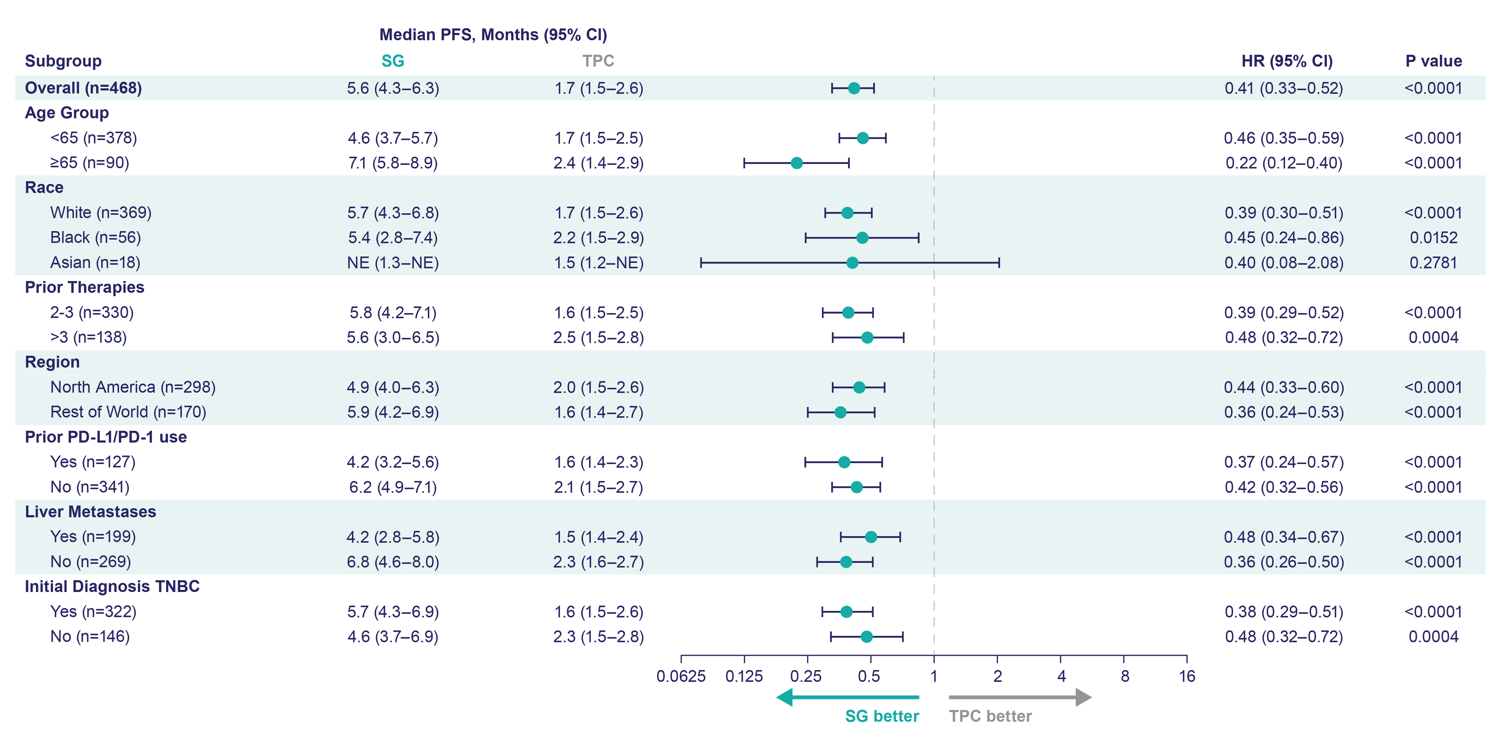
ASCENT Progression-Free Survival by Subgroup
ASCENT Progression-Free Survival by Subgroup
Assessed by independent central review in brain metastases-negative population.
CI, confidence interval; HR, hazard ratio; NE, not evaluated; PD-1, programmed cell death-1; PD-L1, programmed cell death-ligand 1; PFS, progression-free survival; SG, Sacituzumab govitecan; TNBC, triple negative breast cancer; TPC, treatment of physician’s choice.
Bardia A, et al. N Engl J Med. 2021;384(16):1529-41.

Slide 5
Phase 3 ASCENT: Outcomes in Patients with Brain Metastases
BICR Analysis | SG (n=32) | TPC (n=29)
No. of events | 24 | 21
Median PFS—mo (95% Cl) | 2.8 (1.5-3.9) | 1.6 (1.3-2.9)
HR (95% Cl) | 0.65 (0.35-1.22)
PFS rate—% (95% Cl)
At 3 months | 41.4 (23.7-58.3) | 27.7 (11.4-46.9)
At 6 months | 9.0 (0.9-29.2) | 6.9 (0.6-24.9)
At 9 months | 9.0 (0.9-29.2) | 0
At 12 months | 9.0 (0.9-29.2) | 0
BICR, blinded independent central review.
Dieras V, et al. SABCS 2020. Abstract PD13-07.

Slide 6
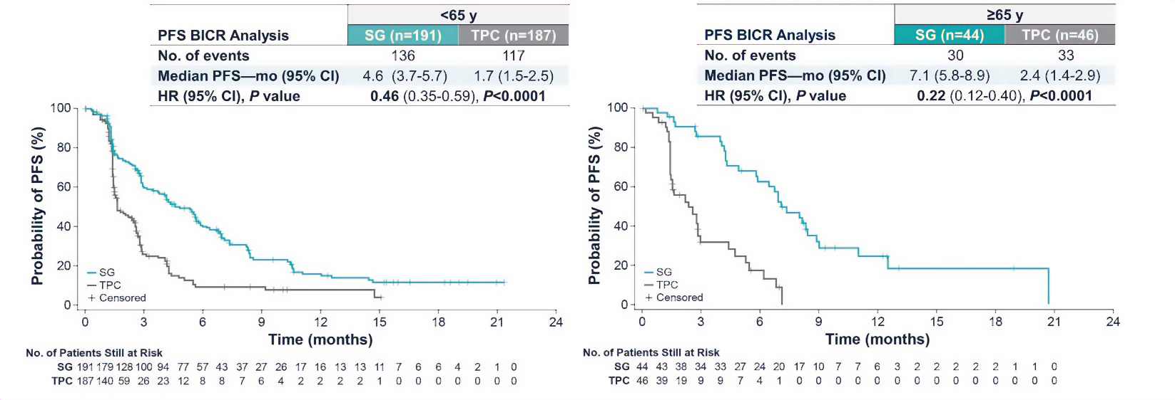
Phase 3 ASCENT: Outcomes by Age <65 Years Versus ≥65 Years
Median OS: 11.2 versus 6.6 mo
ORR: 60% versus 11%
Median OS: 15.3 versus 8.2 mo
ORR: 50% versus 0%
Dose reductions: more frequent in patients ≥ 65 years versus < 65 years; similar between SG and TPC treatment arms in all age groups, with no considerable impact on efficacy
Treatment discontinuation due to TRAE: 2% in both groups aged ≥ 65 and < 65 years
No treatment-related deaths
Rates of AEs were similar among patients aged ≥ 75 years and those aged ≥ 65 years
AE, adverse event; OS, overall survival; ORR, objective response rate; TRAE, treatment-related adverse event.
Kalinsky K, et al. ASCO 2021. Abstract 1011.

Slide 7
DESTINY-Breast04: Updated PFS by Age
<65 years | T-DXd (n = 260) | CT (n = 120) | HR (95% CI)
mPFS, mo | 9.8 | 4.6 | 0.47 (0.37-0.61)
≥65 years | T-DXd (n = 71) | CT (n = 43) | HR (95% CI)
mPFS, mo | 11.4 | 6.2 | 0.57 (0.36-0.89)
CT, chemotherapy; mPFS, median progression-free survival; T-DXd, trastuzumab deruxtecan.
Cameron DA, et al. ESMO 2023. Abstract 192MO.

Slide 8
DESTINY-Breast04: Drug-Related TEAEs by Age
TEAE, n (%) | <65 Years |  | ≥65 Years
 | T-DXd (n = 289) | CT (n = 126) | T-DXd (n = 82) | CT (n = 46)
Any grade Grade ≥3 | 258 (89.3) 115 (39.8) | 92 (73.0) 71 (56.3) | 67 (81.7) 39 (47.6) | 38 (82.6) 28 (60.9)
Most prevalent (any grade) Nausea Vomiting Neutropenia Anemia Thrombocytopenia ILD | 213 (73.7) 102 (35.3) 97 (33.6) 93 (32.2) 74 (25.6) 29 (10.0) | 27 (21.4) 11 (8.1) 65 (51.6) 26 (20.8) 9 (7.1) 1 (0.8) | 58 (70.7) 24 (29.3) 26 (31.7) 30 (36.6) 14 (17.1) 14 (17.1) | 14 (30.4) 6 (13.0) 23 (50.0) 13 (28.3) 7 (15.2) 0
Associated with drug discontinuation ILD/pneumonitis | 40 (13.8) 25 (8.7) | 12 (9.5) 0 | 20 (24.4) 12 (14.6) | 2 (4.3) 0
Toxicity profile for T-DXd was consistent and independent of age
ILD, interstitial lung disease.
Cameron DA, et al. ESMO 2023. Abstract 192MO.

Slide 9
ILD Risk Factors: Pooled Analysis from 9 Phase I/II Trials of T-DXd Monotherapy
Subgroup Analysis
Potential risk factor | Patients, n (N=1150) | Hazard ratio* (95% Cl) | Hazard Ratio* (95% Cl)
Age Group <65 years ≥65 years | 754 396 | 1.56 (1.02-2.38) Ref
Country Japan Non-Japan | 506 644 | 2.08 (1.45-2.98) Ref
Lung comorbidities† Yes No | 81 1069 | 1.75 (1.03-2.98) Ref
Baseline renal function‡,§ Normal Mild Decrease Moderate/Severe Decrease | 470 458 196 | Ref 1.24 (0.83-1.84) 2.73 (1.65-4.52)
Time since disease diagnosis‡ 0 to ≤4 years >4 years | 624 403 | Ref 1.82 (1.20-2.75)
Dose 5.4 mg/kg q3w 6.4 mg/kg q3w >6.4 mg/kg q3w | 315 808 27 | Ref 1.30 (0.85-1.99) 2.92 (1.32-6.42)
Baseline SpO₂‡ ≥95% <95% | 1080 57 | Ref 2.14 (1.11-4.13)
Time to First Adjudicated Drug-Related ILD Event
0.25
0.20
0.15
Cumulative Probability of ILD
0.10
0.05
0
0
6
12
18
24
30
36
42
48
54
Time to first ILD event, months
Pooled population (N=1150)
HER2+ breast cancer (5.4 mg/kg q3w)(N=245)
0.05
0.1
0.25
0.5
1
2
4
8
16
32
64
*HRs are presented relative to the reference categories indicated; †Includes asthma, chronic obstructive pulmonary disease, prior interstitial lung disease/pneumonitis, pulmonary fibrosis, pulmonary emphysema, and radiation pneumonitis; ‡Due to differences in data collection among the studies, some data were not collected for all patients; thus, the number of patients may not add up to the total population; §Determined by Cockcroft-Gault formula.
HER2, human epidermal growth factor receptor 2; Ref, reference; SpO₂, oxygen saturation; q3w, every three weeks.
Powell CA, et al. ESMO 2022;7:100554.

Slide 10
Looking for more resources on this topic?
CME/CE in minutes
Congress highlights
Late-breaking data
Quizzes
Webinars
In-person events
Slides & resources
www.MedEdOTG.com

