Slide 1
Later-Line Targeted Therapies for ROS1 Fusion-Positive Lung Cancers
Alexander Drilon, MD
Chief, Early Drug Development
Memorial Sloan Kettering Cancer Center
New York, NY

Slide 2
Resource Information
About This Resource
These slides are one component of a continuing education program available online at MedEd On The Go titled Next-Generation TKI Therapy for ROS1-Rearranged NSCLC
Program Learning Objectives:
Discuss current guidelines and standards for molecular testing in real-world practice settings.
Assess the latest evidence of approved ROS1 inhibitors and emerging next-generation TKIs for the treatment of newly diagnosed ROS1-rearranged NSCLC.
Analyze treatment options for patients with ROS1-rearranged, advanced NSCLC in second- or subsequent-line therapy focused on acquired resistance mutations and CNS involvement.
Evaluate intracranial penetration and activity against acquired resistance mutations seen with ROS1-targeted TKI therapies
Evaluate the toxicity profiles of current and emerging ROS1 TKI agents and to inform optimal strategies for preventing and mitigating TKI-related adverse events
MedEd On The Go®
www.mededonthego.com
This content or portions thereof may not be published, posted online or used in presentations without permission.
This content can be saved for personal use (non-commercial use only) with credit given to the resource authors.
To contact us regarding inaccuracies, omissions or permissions please email us at support@MedEdOTG.com

Slide 3
Disclaimer
The views and opinions expressed in this educational activity are those of the faculty and do not necessarily represent the views of Total CME, LLC, the CME providers, or the companies providing educational grants. This presentation is not intended to define an exclusive course of patient management; the participant should use their clinical judgment, knowledge, experience, and diagnostic skills in applying or adopting for professional use any of the information provided herein. Any procedures, medications, or other courses of diagnosis or treatment discussed or suggested in this activity should not be used by clinicians without evaluation of their patient's conditions and possible contraindications or dangers in use, review of any applicable manufacturer’s product information, and comparison with recommendations of other authorities. Links to other sites may be provided as additional sources of information.

Slide 4
Advanced ROS1 Fusion-Positive Lung Cancers Can Develop Resistance to Targeted Therapy
ROS1
fusion dependence
Advanced ROS1 fusion-positive lung cancer
crizotinib
entrectinib
reliance on “bypass resistance”
(sequencing of plasma or tumor may help determine)

Slide 5
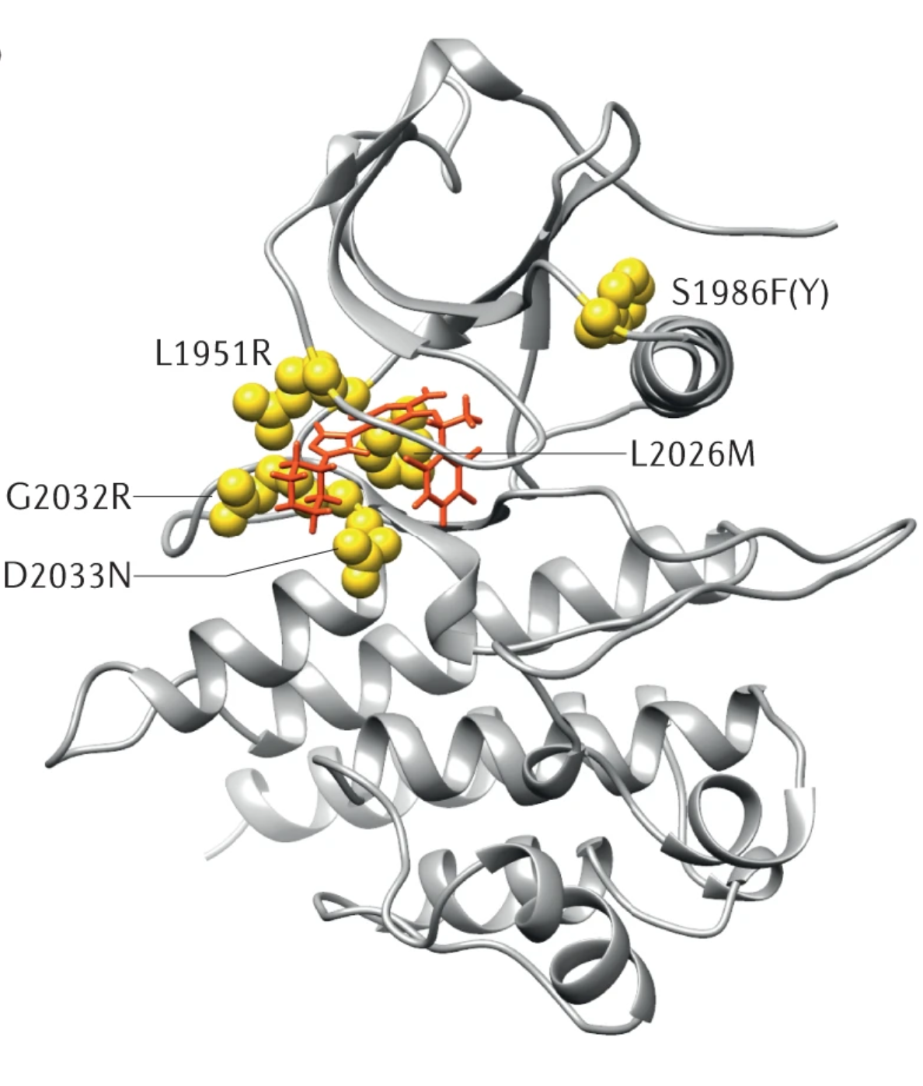
Cancers that Remain Dependent on ROS1 Can Acquire ROS1 Resistance Mutations
ROS1 fusion dependence
-ROS1 resistance mutation (ROS1 G2032R is common)
-no obvious culprit

Slide 6
Two ROS1 TKIs Are Available Therapeutic Options Apart from Clinical Trials
ROS1 fusion dependence
-ROS1 resistance mutation
-no obvious culprit
lorlatinib¹
repotrectinib^{1,2}

Slide 7
Sequential TKI Therapy Can Be Active in Patients with ROS1 TKI Resistance
 | ORR (%) | icORR (%) | PFS (mo)
Lorlatinib^{1*} | 35 | 50 | 8.5
Repotrectinib^{2†} | 38 | 38 | 9.0

Slide 8
Repotrectinib Achieves High Response Rates in ROS1 TKI-Refractory Cancers with a ROS1 G2032R Mutation
 | ROS1 G2032R (n = 17)
Objective response rate*†
No. patients | 10
Percent (95% Cl) | 59 (33, 82)
Best overall response – no. (%)*†
Complete response | 1 (6)
Partial response | 9 (53)
Stable disease | 2 912)
Progressive disease | 3 (18)
Not evaluable | 1 (6)

Slide 9
Chemotherapy May Be Appropriate for Some ROS1 TKI Resistance
reliance on “bypass resistance*”
platinum doublet inclusive therapy

Slide 10
Algorithm for ROS1 Fusion-Positive Lung Cancers After Systemic Progression on a Prior TKI
repotrectinib
crizotinib
lorlatinib
Advanced ROS1 fusion-positive lung cancer
entrectinib
platinum doublet inclusive therapy
Advanced ROS1 fusion-positive lung cancer
platinum doublet inclusive therapy
repotrectinib
(surgery/RT with continued TKI therapy can be considered for solitary site or oligo progression)

Slide 11
Summary
ROS1 fusion-positive lung cancers develop different types of resistance to TKI therapy
The use of sequential TKI therapy is appropriate for ROS1 resistance mutations and/or no obvious bypass resistance
When bypass resistance is identified, consider the use of platinum doublet inclusive chemotherapy

Slide 12
Looking for more resources on this topic?
CME/CE in minutes
Congress highlights
Late-breaking data
Quizzes
Webinars
In-person events
Slides & resources
www.MedEdOTG.com

